Slide 1
Elementary Statistics: Picturing The World
Sixth Edition
Chapter 10
Chi-Square Tests and the
F-Distribution
Copyright © 2015, 2012, 2009 Pearson Education, Inc. All Rights Reserved

Slide 2
Chapter Outline
10.1 Goodness of Fit
10.2 Independence
10.3 Comparing Two Variances
10.4 Analysis of Variance

Slide 3
Section 10.1
Goodness of Fit

Slide 4
Section 10.1 Objectives
How to use the chi-square distribution to test whether a frequency distribution fits a claimed distribution

Slide 5
Multinomial Experiments (1 of 3)
Multinomial experiment
A probability experiment consisting of a fixed number of independent trials in which there are more than two possible outcomes for each trial.
The probability for each outcome is fixed and each outcome is classified into categories.
Recall that a binomial experiment has only two possible outcomes.

Slide 6
Multinomial Experiments (2 of 3)
A tax preparation company wants to determine the proportions of people who used different methods to prepare their taxes.
The company can perform a multinomial experiment.
It wants to test a previous survey’s claim concerning the distribution of proportions of people who use different methods to prepare their taxes.
It can compare the distribution of proportions obtained in the multinomial experiment with the previous survey’s specified distribution.
It can perform a chi-square goodness-of-fit test.

Slide 7
Chi-Square Goodness-of-Fit Test (1 of 9)
Chi-Square Goodness-of-Fit Test
Used to test whether a frequency distribution fits an expected distribution.
The null hypothesis states that the frequency distribution fits the specified distribution.
The alternative hypothesis states that the frequency distribution does not fit the specified distribution.

Slide 8
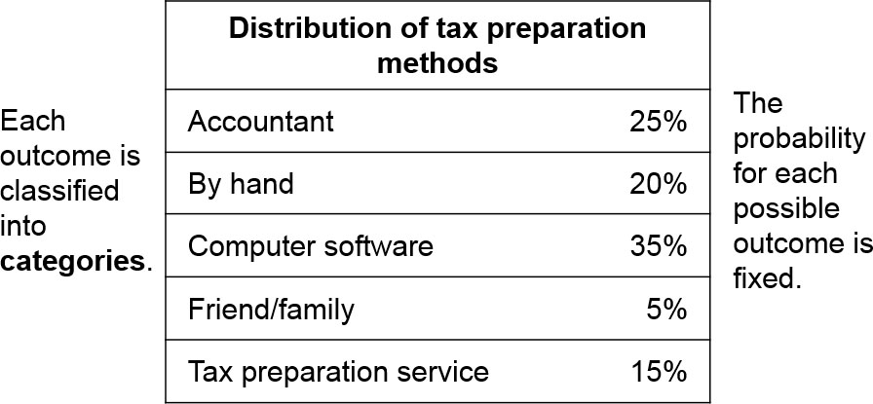
Multinomial Experiments (3 of 3)
Results of a survey of tax preparation methods.

Slide 9
Chi-Square Goodness-of-Fit Test (2 of 9)
To test the previous survey’s claim, a company can perform a chi-square goodness-of-fit test using the following hypotheses.
H₀: The distribution of tax preparation methods is 25% by accountant, 20% by hand, 35% by computer software, 5% by friend or family, and 15% by tax preparation service. (claim)
H_{a}: The distribution of tax preparation methods differs from the claimed or expected distribution.

Slide 10
Chi-Square Goodness-of-Fit Test (3 of 9)
To calculate the test statistic for the chi-square goodness-of-fit test, the observed frequencies and the expected frequencies are used.
The observed frequency O of a category is the frequency for the category observed in the sample data.

Slide 11
Chi-Square Goodness-of-Fit Test (4 of 9)
The expected frequency E of a category is the calculated frequency for the category.
Expected frequencies are obtained assuming the specified (or hypothesized) distribution. The expected frequency for the i^{th} category is
E_{i} = np_{i}
where n is the number of trials (the sample size) and p_{i} is the assumed probability of the i^{th} category.

Slide 12
Example: Finding Observed and Expected Frequencies (1 of 3)
A tax preparation company randomly selects 300 adults and asks them how they prepare their taxes. The results are shown at the right. Find the observed frequency and the expected frequency for each tax preparation method. (Adapted from National Retail Federation)
Survey results (n = 300) | blank
Accountant | 71
By hand | 40
Computer software | 101
Friend/family | 35
Tax preparation service | 53

Slide 13
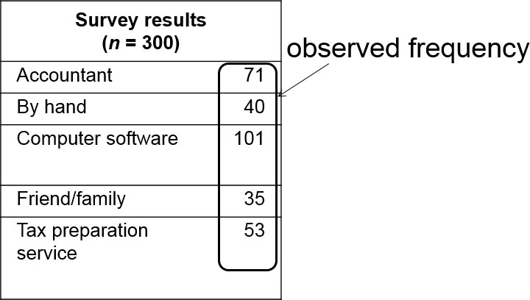
Example: Finding Observed and Expected Frequencies (2 of 3)
Solution
Observed frequency: The number of adults in the survey naming a particular tax preparation method

Slide 14
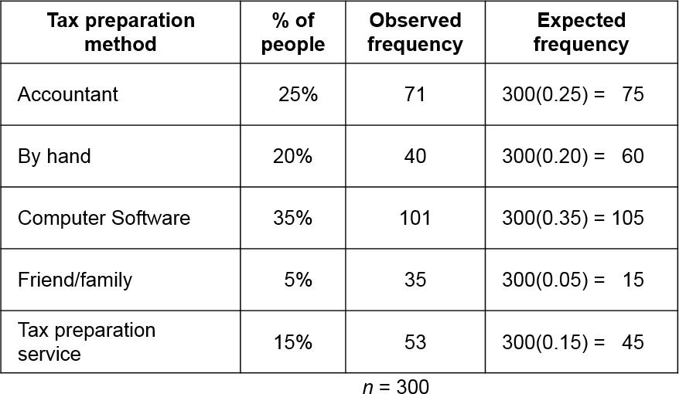
Example: Finding Observed and Expected Frequencies (3 of 3)
Expected Frequency: E_{i} = np_{i}

Slide 15
Chi-Square Goodness-of-Fit Test (5 of 9)
For the chi-square goodness-of-fit test to be used, the following must be true.
The observed frequencies must be obtained by using a random sample.
Each expected frequency must be greater than or equal to 5.

Slide 16
Chi-Square Goodness-of-Fit Test (6 of 9)
If these conditions are satisfied, then the sampling distribution for the goodness-of-fit test is approximated by a chi-square distribution with k − 1 degrees of freedom, where k is the number of categories.

Slide 17
Chi-Square Goodness-of-Fit Test (7 of 9)
In Words | In Symbols
Verify that the observed frequencies were from a random sample and each expected frequency is at least 5. | blank
Identify the claim. State the null and alternative hypotheses. | State H₀ and H_{a}.
Specify the level of significance. | Identify α.

Slide 18
Chi-Square Goodness-of-Fit Test (8 of 9)

Slide 19
Chi-Square Goodness-of-Fit Test (9 of 9)
In Words | In Symbols
Make a decision to reject or fail to reject the null hypothesis. | If χ² is in the rejection region, reject H₀. Otherwise, fail to reject H₀.
Interpret the decision in the context of the original claim. | blank

Slide 20
Example 1: Performing a Goodness of Fit Test (1 of 4)
Use the tax preparation method data to perform a chi-square goodness-of-fit test to test whether the distributions are different. Use α = 0.01.
Distribution of tax preparation methods | blank
Accountant | 25%
By hand | 20%
Computer software | 35%
Friend/family | 5%
Tax preparation service | 15%
Survey results (n = 300) | blank
Accountant | 71
By hand | 40
Computer software | 101
Friend/family | 35
Tax preparation service | 53

Slide 21
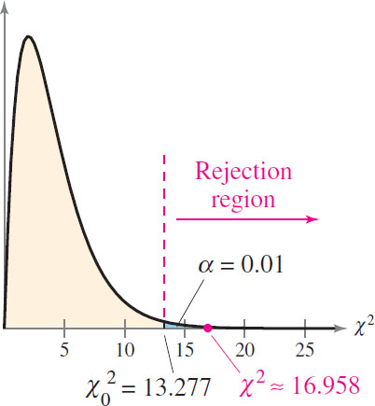
Example 1: Performing a Goodness of Fit Test (2 of 4)
Solution
H₀: The distribution is 25% by accountant, 20% by hand, 35% by computer software, 5% by friend/ family, and 15% by tax preparation service. (Claim)
H_{a}: The distribution of tax preparation methods differs from the claimed or expected distribution.
α = 0.01
d.f. = 5 − 1 = 4
Rejection Region

Slide 22
Example 1: Performing a Goodness of Fit Test (3 of 4)
Tax preparation method | Observed frequency | Expected frequency
Accountant | 71 | 75
By hand | 40 | 60
Computer hardware | 101 | 105
Friend/family | 35 | 15
Tax preparation service | 53 | 45

Slide 23
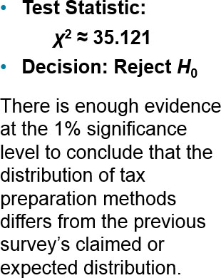
Example 1: Performing a Goodness of Fit Test (4 of 4)
H₀: The distribution is 25% by accountant, 20% by hand, 35% by computer software, 5% by friend/ family, and 15% by tax preparation service. (Claim)
H_{a}: The distribution of tax preparation methods differs from the claimed or expected distribution.
α = 0.01
d.f. = 5 – 1 = 4
Rejection Region

Slide 24
Example 2: Performing a Goodness of Fit Test (1 of 5)
A researcher claims that the number of different-colored candies in bags of dark chocolate M&M’s is uniformly distributed. To test this claim, you randomly select a bag that contains 500 dark chocolate M&M’s. The results are shown in the table on the next slide. Using α = 0.10, perform a chi-square goodness-of-fit test to test the claimed or expected distribution. What can you conclude? (Adapted from Mars Incorporated)

Slide 25
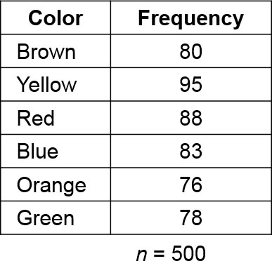
Example 2: Performing a Goodness of Fit Test (2 of 5)
Solution
The claim is that the distribution is uniform, so the expected frequencies of the colors are equal.
To find each expected frequency, divide the sample size by the number of colors.
E = 500/6 ≈ 83.3

Slide 26
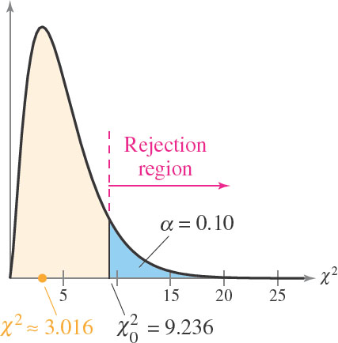
Example 2: Performing a Goodness of Fit Test (3 of 5)
H₀: Distribution of different-colored candies in bags of dark chocolate M&M’s is uniform. (Claim)
H_{a}: Distribution of different-colored candies in bags of dark chocolate M&M’s is not uniform.
α = 0.10
d.f. = 6 – 1 = 5
Rejection Region

Slide 27
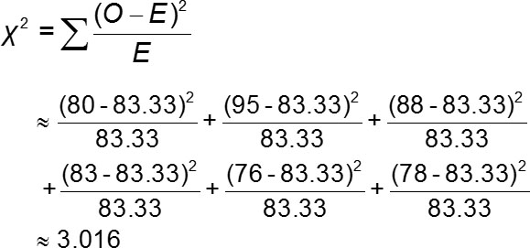
Example 2: Performing a Goodness of Fit Test (4 of 5)
Color | Observed frequency | Expected frequency
Brown | 80 | 83.33
Yellow | 95 | 83.33
Red | 88 | 83.33
Blue | 83 | 83.33
Orange | 76 | 83.33
Green | 78 | 83.33

Slide 28
Example 2: Performing a Goodness of Fit Test (5 of 5)
H₀: Distribution of different-colored candies in bags of dark chocolate M&M’s is uniform. (Claim)
H_{a}: Distribution of different-colored candies in bags of dark chocolate M&M’s is not uniform.
α = 0.01
d.f. = 6 – 1 = 5
Rejection Region
Test Statistic:
χ² ≈ 3.016
Decision: Fail to Reject H₀
There is not enough evidence at the 10% level of significance to reject the claim that the distribution is uniform.

Slide 29
Section 10.1 Summary
Used the chi-square distribution to test whether a frequency distribution fits a claimed distribution

