Slide 1
Elementary Statistics: Picturing The World
Sixth Edition
Chapter 9
Correlation and Regression
Copyright © 2015, 2012, 2009 Pearson Education, Inc. All Rights Reserved

Slide 2
Chapter Outline
9.1 Correlation
9.2 Linear Regression
9.3 Measures of Regression and Prediction Intervals
9.4 Multiple Regression

Slide 3
Section 9.2
Linear Regression

Slide 4
Section 9.2 Objectives
How to find the equation of a regression line
How to predict y-values using a regression equation

Slide 5
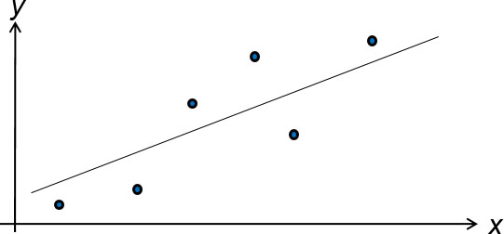
Regression Lines (1 of 2)
After verifying that the linear correlation between two variables is significant, next we determine the equation of the line that best models the data (regression line).
Can be used to predict the value of y for a given value of x.

Slide 6
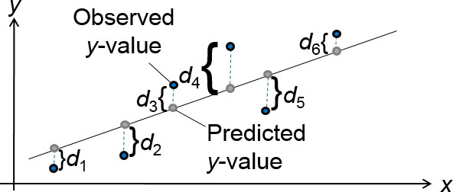
Residuals
Residual
The difference between the observed y-value and the predicted y-value for a given x-value on the line.

Slide 7
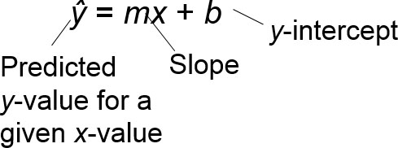
Regression Lines (2 of 2)
Regression line (line of best fit)
The line for which the sum of the squares of the residuals is a minimum.
The equation of a regression line for an independent variable x and a dependent variable y is

Slide 8
The Equation of a Regression Line

Slide 9
Example: Finding the Equation of a Regression Line (1 of 4)
Find the equation of the regression line for the gross domestic products and carbon dioxide emissions data.
GDP (trillions of $), x | CO₂ emission (millions of metric tons), y
1.6 | 428.2
3.6 | 828.8
4.9 | 1214.2
1.1 | 444.6
0.9 | 264.0
2.9 | 415.3
2.7 | 571.8
2.3 | 454.9
1.6 | 358.7
1.5 | 573.5

Slide 10
Example: Finding the Equation of a Regression Line (2 of 4)
Solution
Recall from section 9.1:
x | y | xy | x² | y²
1.6 | 428.2 | 685.12 | 2.56 | 183,355.24
3.6 | 828.8 | 2983.68 | 12.96 | 686,909.44
4.9 | 1214.2 | 5949.58 | 24.01 | 1,474,281.64
1.1 | 444.6 | 489.06 | 1.21 | 197,669.16
0.9 | 264.0 | 237.6 | 0.81 | 69,696
2.9 | 415.3 | 1204.37 | 8.41 | 172,474.09
2.7 | 571.8 | 1543.86 | 7.29 | 326,955.24
2.3 | 454.9 | 1046.27 | 5.29 | 206,934.01
1.6 | 358.7 | 573.92 | 2.56 | 128,665.69
1.5 | 573.5 | 860.25 | 2.25 | 328,902.25
Σx = 23.1 | Σy = 5554 | Σxy = 15,573.71 | Σx² = 67.35 | Σy² = 3,775,842.76

Slide 11
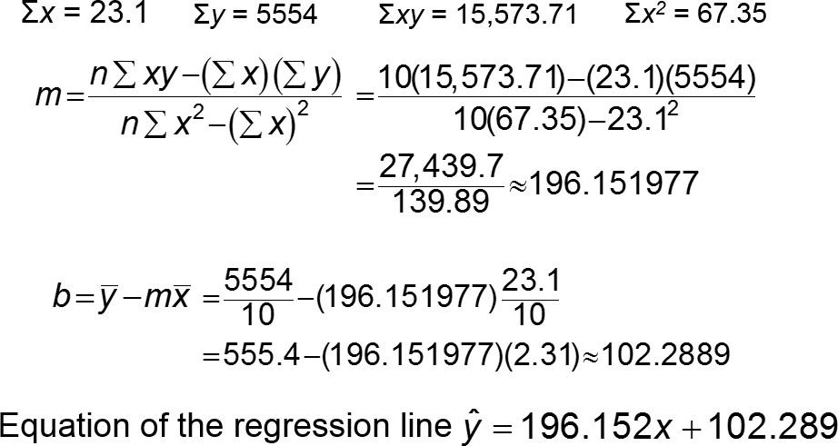
Example: Finding the Equation of a Regression Line (3 of 4)

Slide 12
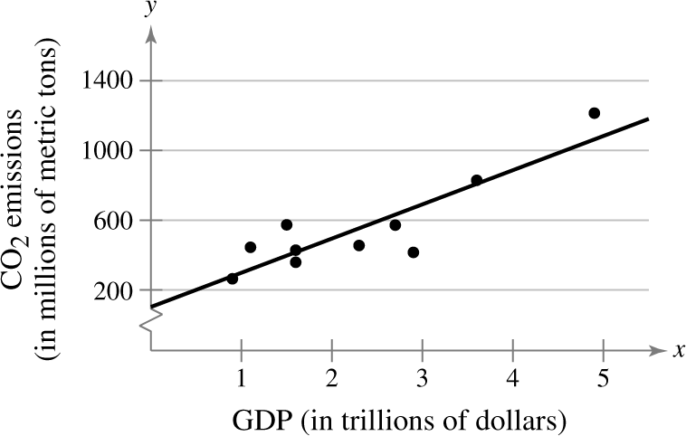
Example: Finding the Equation of a Regression Line (4 of 4)
To sketch the regression line, use any two x-values within the range of the data and calculate the corresponding y-values from the regression line.

Slide 13
Example: Using Technology to Find a Regression Equation (1 of 2)
Use a technology tool to find the equation of the regression line for the Old Faithful data.
Duration x | Time, y | Duration x | Time, y
1.80 | 56 | 3.78 | 79
1.82 | 58 | 3.83 | 85
1.90 | 62 | 3.88 | 80
1.93 | 56 | 4.10 | 89
1.98 | 57 | 4.27 | 90
2.05 | 57 | 4.30 | 89
2.13 | 60 | 4.43 | 89
2.30 | 57 | 4.47 | 86
2.37 | 61 | 4.53 | 89
2.82 | 73 | 4.55 | 86
3.13 | 76 | 4.60 | 92
3.27 | 77 | 4.63 | 91
3.65 | 77

Slide 14
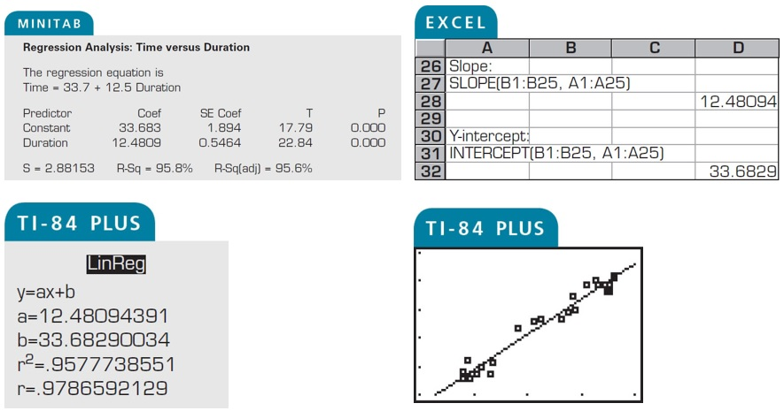
Example: Using Technology to Find a Regression Equation (2 of 2)

Slide 15
Example: Predicting y-Values Using Regression Equations (1 of 3)
The regression equation for the gross domestic products (in trillions of dollars) and carbon dioxide emissions (in millions of metric tons) data is ŷ = 196.152x + 102.289. Use this equation to predict the expected carbon dioxide emissions for the following gross domestic products. (Recall from section 9.1 that x and y have a significant linear correlation.)
1.2 trillion dollars
2.0 trillion dollars
2.5 trillion dollars

Slide 16
Example: Predicting y-Values Using Regression Equations (2 of 3)
Solution
ŷ = 196.152x + 102.289
1.2 trillion dollars
ŷ =196.152(1.2) + 102.289 ≈ 337.671
When the gross domestic product is $1.2 trillion, the CO₂ emissions are about 337.671 million metric tons.
2.0 trillion dollars
ŷ =196.152(2.0) + 102.289 ≈ 494.593
When the gross domestic product is $2.0 trillion, the CO₂ emissions are 494.595 million metric tons.

Slide 17
Example: Predicting y-Values Using Regression Equations (3 of 3)
2.5 trillion dollars
ŷ =196.152(2.5) + 102.289 ≈ 592.669
When the gross domestic product is $2.5 trillion, the CO₂ emissions are 592.669 million metric tons.
Prediction values are meaningful only for x-values in (or close to) the range of the data. The x-values in the original data set range from 0.9 to 4.9. So, it would not be appropriate to use the regression line to predict carbon dioxide emissions for gross domestic products such as $0.2 or $14.5 trillion dollars.

Slide 18
Section 9.2 Summary
Found the equation of a regression line
Predicted y-values using a regression equation

