Slide 1
Elementary Statistics: Picturing The World
Sixth Edition
Chapter 9
Correlation and Regression
Copyright © 2015, 2012, 2009 Pearson Education, Inc. All Rights Reserved

Slide 2
Chapter Outline
9.1 Correlation
9.2 Linear Regression
9.3 Measures of Regression and Prediction Intervals
9.4 Multiple Regression

Slide 3
Section 9.1
Correlation

Slide 4
Section 9.1 Objectives
An introduction to linear correlation, independent and dependent variables, and the types of correlation
How to find a correlation coefficient
How to test a population correlation coefficient ρ using a table
How to perform a hypothesis test for a population correlation coefficient ρ
How to distinguish between correlation and causation

Slide 5
Correlation (1 of 2)
Correlation
A relationship between two variables.
The data can be represented by ordered pairs (x, y)
x is the independent (or explanatory) variable
y is the dependent (or response) variable

Slide 6
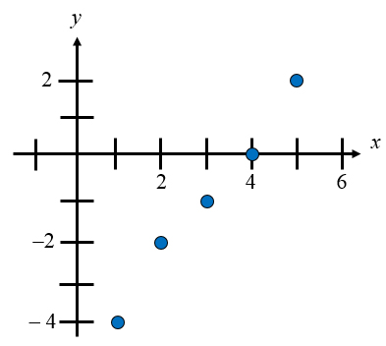
Correlation (2 of 2)
A scatter plot can be used to determine whether a linear (straight line) correlation exists between two variables.
Example
x | 1 | 2 | 3 | 4 | 5
y | – 4 | – 2 | – 1 | 0 | 2

Slide 7
Types of Correlation

Slide 8
Example: Constructing a Scatter Plot (1 of 2)
An economist wants to determine whether there is a linear relationship between a country’s gross domestic product (GDP) and carbon dioxide (CO₂) emissions. The data are shown in the table. Display the data in a scatter plot and determine whether there appears to be a positive or negative linear correlation or no linear correlation. (Source: World Bank and U.S. Energy Information Administration)
GDP (trillions of $), x | CO₂ emission (millions of metric tons), y
1.6 | 428.2
3.6 | 828.8
4.9 | 1214.2
1.1 | 444.6
0.9 | 264.0
2.9 | 415.3
2.7 | 571.8
2.3 | 454.9
1.6 | 358.7
1.5 | 573.5

Slide 9
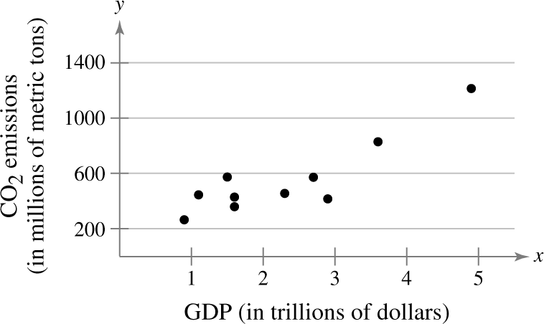
Example: Constructing a Scatter Plot (2 of 2)
Appears to be a positive linear correlation. As the gross domestic products increase, the carbon dioxide emissions tend to increase.

Slide 10
Example: Constructing a Scatter Plot Using Technology (1 of 2)
Old Faithful, located in Yellowstone National Park, is the world’s most famous geyser. The duration (in minutes) of several of Old Faithful’s eruptions and the times (in minutes) until the next eruption are shown in the table. Using a TI-83/84, display the data in a scatter plot. Determine the type of correlation.
Duration x | Time, y | Duration x | Time, y
1.8 | 56 | 3.78 | 79
1.82 | 58 | 3.83 | 85
1.9 | 62 | 3.88 | 80
1.93 | 56 | 4.1 | 89
1.98 | 57 | 4.27 | 90
2.05 | 57 | 4.3 | 89
2.13 | 60 | 4.43 | 89
2.3 | 57 | 4.47 | 86
2.37 | 61 | 4.53 | 89
2.82 | 73 | 4.55 | 86
3.13 | 76 | 4.6 | 92
3.27 | 77 | 4.63 | 91
3.65 | 77 | blank | blank

Slide 11
Example: Constructing a Scatter Plot Using Technology (2 of 2)
From the scatter plot, it appears that the variables have a positive linear correlation, as the durations of the eruptions increase, the times until the next eruption tend to increase.

Slide 12
Correlation Coefficient (1 of 2)
Correlation coefficient
A measure of the strength and the direction of a linear relationship between two variables.
The symbol r represents the sample correlation coefficient.

Slide 13
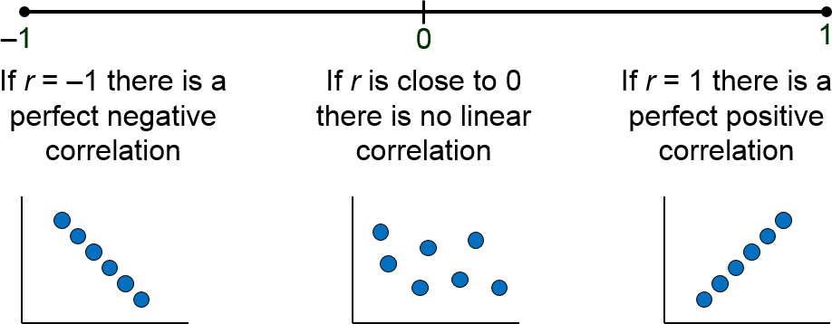
Correlation Coefficient (2 of 2)
The range of the correlation coefficient is −1 to 1.

Slide 14
Linear Correlation

Slide 15
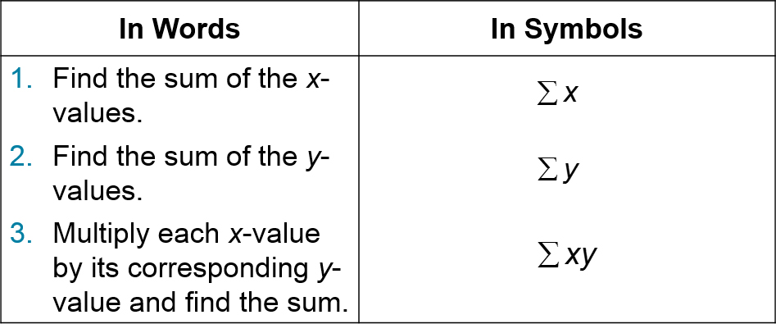
Calculating a Correlation Coefficient (1 of 2)

Slide 16
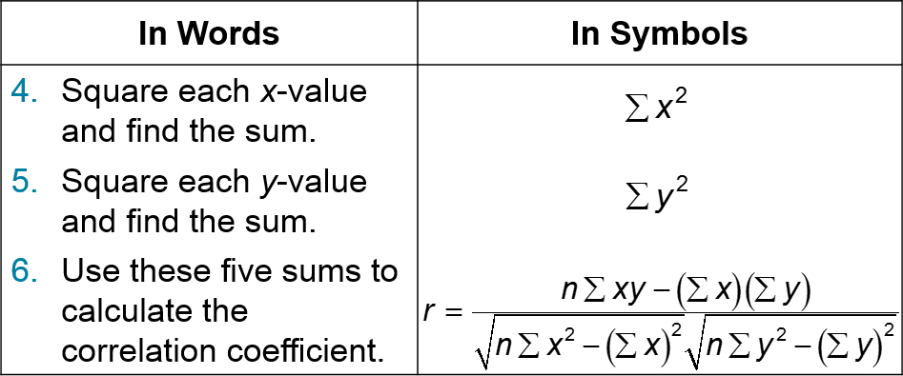
Calculating a Correlation Coefficient (2 of 2)

Slide 17
Example: Calculating the Correlation Coefficient (1 of 3)
Calculate the correlation coefficient for the gross domestic products and carbon dioxide emissions data. What can you conclude?
GDP (trillions of $), x | CO₂ emission (millions of metric tons), y
1.6 | 428.2
3.6 | 828.8
4.9 | 1214.2
1.1 | 444.6
0.9 | 264.0
2.9 | 415.3
2.7 | 571.8
2.3 | 454.9
1.6 | 358.7
1.5 | 573.5

Slide 18
Example: Calculating the Correlation Coefficient (2 of 3)
x | y | xy | x² | y²
1.6 | 428.2 | 685.12 | 2.56 | 183,355.24
3.6 | 828.8 | 2983.68 | 12.96 | 686,909.44
4.9 | 1214.2 | 5949.58 | 24.01 | 1,474,281.64
1.1 | 444.6 | 489.06 | 1.21 | 197,669.16
0.9 | 264.0 | 237.6 | 0.81 | 69,696
2.9 | 415.3 | 1204.37 | 8.41 | 172,474.09
2.7 | 571.8 | 1543.86 | 7.29 | 326,955.24
2.3 | 454.9 | 1046.27 | 5.29 | 206,934.01
1.6 | 358.7 | 573.92 | 2.56 | 128,665.69
1.5 | 573.5 | 860.25 | 2.25 | 328,902.25
Σx = 23.1 | Σy = 5554 | Σxy = 15,573.71 | Σx² = 67.35 | Σy² = 3,775,842.76

Slide 19
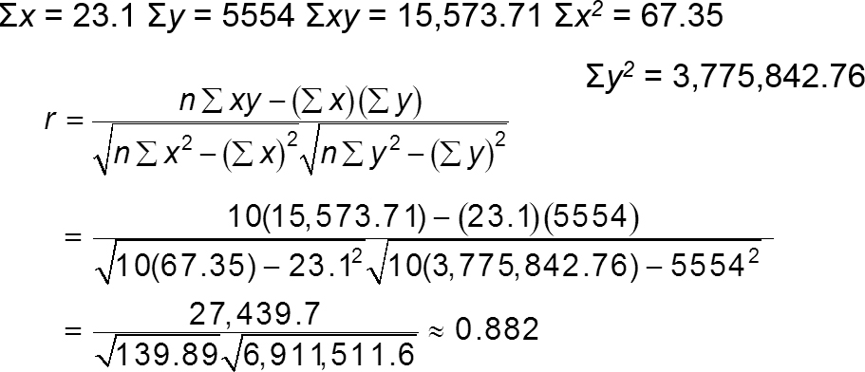
Example: Calculating the Correlation Coefficient (3 of 3)
r ≈ 0.882 suggests a strong positive linear correlation. As the gross domestic product increases, the carbon dioxide emissions also increase.

Slide 20
Example: Using Technology to Find a Correlation Coefficient (1 of 2)
Use a technology tool to calculate the correlation coefficient for the Old Faithful data. What can you conclude?
Duration x | Time, y | Duration x | Time, y
1.8 | 56 | 3.78 | 79
1.82 | 58 | 3.83 | 85
1.9 | 62 | 3.88 | 80
1.93 | 56 | 4.1 | 89
1.98 | 57 | 4.27 | 90
2.05 | 57 | 4.3 | 89
2.13 | 60 | 4.43 | 89
2.3 | 57 | 4.47 | 86
2.37 | 61 | 4.53 | 89
2.82 | 73 | 4.55 | 86
3.13 | 76 | 4.6 | 92
3.27 | 77 | 4.63 | 91
3.65 | 77 | blank | blank

Slide 21
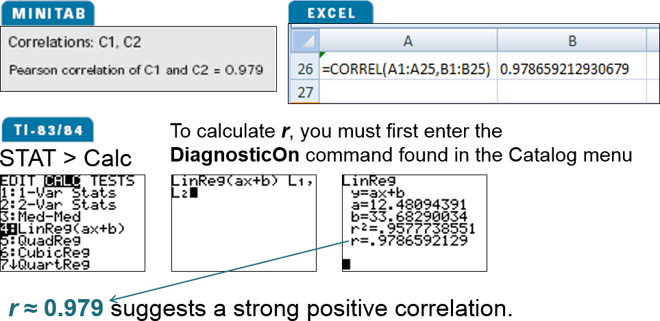
Example: Using Technology to Find a Correlation Coefficient (2 of 2)

Slide 22
Using a Table to Test a Population Correlation Coefficient ρ (1 of 4)
Once the sample correlation coefficient r has been calculated, we need to determine whether there is enough evidence to decide that the population correlation coefficient ρ is significant at a specified level of significance.
Use Table 11 in Appendix B.
If |r| is greater than the critical value, there is enough evidence to decide that the correlation coefficient ρ is significant.

Slide 23
Using a Table to Test a Population Correlation Coefficient ρ (2 of 4)
Determine whether ρ is significant for five pairs of data (n = 5) at a level of significance of α = 0.01.
If |r| > 0.959, the correlation is significant. Otherwise, there is not enough evidence to conclude that the correlation is significant.

Slide 24
Using a Table to Test a Population Correlation Coefficient ρ (3 of 4)
In Words | In Symbols
Determine the number of pairs of data in the sample. | Determine n.
Specify the level of significance. | Identify α.
Find the critical value. | Use Table 11 in Appendix B.

Slide 25
Using a Table to Test a Population Correlation Coefficient ρ (4 of 4)
In Words | In Symbols
Decide if the correlation is significant. | If |r| > critical value, the correlation is significant. Otherwise, there is not enough evidence to support that the correlation is significant.
Interpret the decision in the context of the original claim. | blank

Slide 26
Example: Using a Table to Test a Population Correlation Coefficient ρ (1 of 2)
Using the Old Faithful data, you used 25 pairs of data to find r ≈ 0.979. Is the correlation coefficient significant? Use α = 0.05.
Duration x | Time, y | Duration x | Time, y
1.8 | 56 | 3.78 | 79
1.82 | 58 | 3.83 | 85
1.9 | 62 | 3.88 | 80
1.93 | 56 | 4.1 | 89
1.98 | 57 | 4.27 | 90
2.05 | 57 | 4.3 | 89
2.13 | 60 | 4.43 | 89
2.3 | 57 | 4.47 | 86
2.37 | 61 | 4.53 | 89
2.82 | 73 | 4.55 | 86
3.13 | 76 | 4.6 | 92
3.27 | 77 | 4.63 | 91
3.65 | 77 | blank | blank

Slide 27
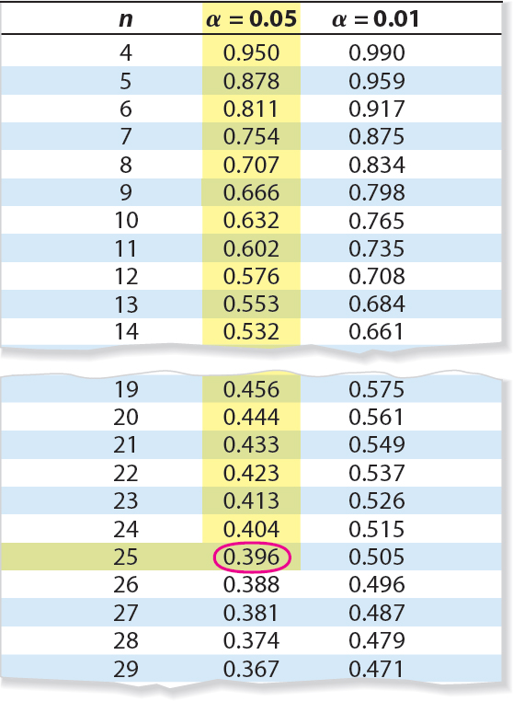
Example: Using a Table to Test a Population Correlation Coefficient ρ (2 of 2)
Solution
n = 25, α = 0.05
|r| ≈ 0.979 > 0.396
There is enough evidence at the 5% level of significance to conclude that there is a significant linear correlation between the duration of Old Faithful’s eruptions and the time between eruptions.

Slide 28
Hypothesis Testing for a Population Correlation Coefficient ρ (1 of 2)
A hypothesis test can also be used to determine whether the sample correlation coefficient r provides enough evidence to conclude that the population correlation coefficient ρ is significant at a specified level of significance.
A hypothesis test can be one-tailed or two-tailed.

Slide 29
Hypothesis Testing for a Population Correlation Coefficient ρ (2 of 2)
Left-tailed test
H₀: ρ ≥ 0 (no significant negative correlation)
H_{a}: ρ < 0 (significant negative correlation)
Right-tailed test
H₀: ρ ≤ 0 (no significant positive correlation)
H_{a}: ρ > 0 (significant positive correlation
Two-tailed test
H₀: ρ = 0 (no significant correlation)
H_{a}: ρ ≠ 0 (significant correlation)

Slide 30
The t-Test for the Correlation Coefficient
Can be used to test whether the correlation between two variables is significant.
The test statistic is r.
The standardized test statistic

Slide 31
Using the t-Test for ρ (1 of 2)
In Words | In Symbols
State the null and alternative hypothesis. | State H₀ and H_{a}.
Specify the level of significance. | Identify α.
Identify the degrees of freedom. | d.f. = n – 2.
Determine the critical value(s) and rejection region(s). | Use Table 5 in Appendix B.

Slide 32
Using the t-Test for ρ (2 of 2)

Slide 33
Example: t-Test for a Correlation Coefficient (1 of 2)
Previously you calculated r ≈ 0.882. Test the significance of this correlation coefficient. Use α = 0.05.
GDP (trillions of $), x | CO₂ emission (millions of metric tons), y
1.6 | 428.2
3.6 | 828.8
4.9 | 1214.2
1.1 | 444.6
0.9 | 264.0
2.9 | 415.3
2.7 | 571.8
2.3 | 454.9
1.6 | 358.7
1.5 | 573.5

Slide 34
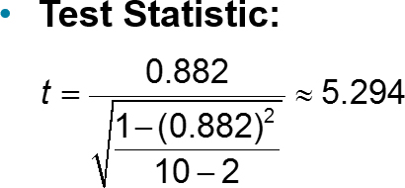
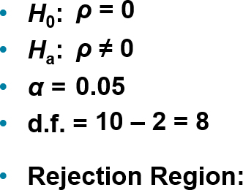
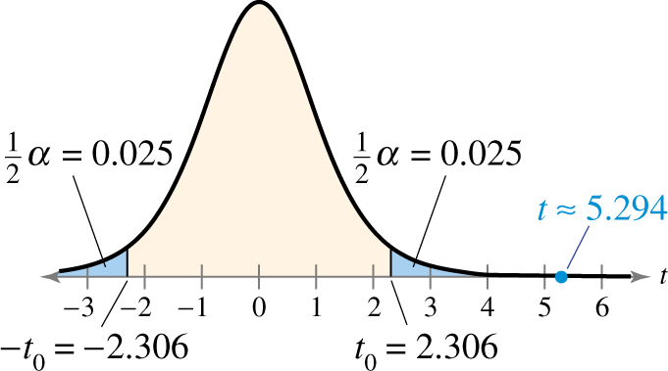
Example: t-Test for a Correlation Coefficient (2 of 2)
Decision: Reject H₀
At the 5% level of significance, there is enough evidence to conclude that there is a significant linear correlation between gross domestic products and carbon dioxide emissions.

Slide 35
Correlation and Causation (1 of 2)
The fact that two variables are strongly correlated does not in itself imply a cause-and-effect relationship between the variables.
If there is a significant correlation between two variables, you should consider the following possibilities.
Is there a direct cause-and-effect relationship between the variables?
Does x cause y?

Slide 36
Correlation and Causation (2 of 2)
Is there a reverse cause-and-effect relationship between the variables?
Does y cause x?
Is it possible that the relationship between the variables can be caused by a third variable or by a combination of several other variables?
Is it possible that the relationship between two variables may be a coincidence?

Slide 37
Section 9.1 Summary
Introduced to linear correlation, independent and dependent variables and the types of correlation
Found a correlation coefficient
Tested a population correlation coefficient ρ using a table
Performed a hypothesis test for a population correlation coefficient ρ
Distinguished between correlation and causation

