Slide 1
Elementary Statistics: Picturing The World
Sixth Edition
Chapter 8
Hypothesis Testing with Two Samples
Copyright © 2015, 2012, 2009 Pearson Education, Inc. All Rights Reserved

Slide 2
Chapter Outline
8.1 Testing the Difference Between Means (Independent Samples, σ₁ and σ₂ Known)
8.2 Testing the Difference Between Means (Independent Samples, σ₁ and σ₂ Unknown)
8.3 Testing the Difference Between Means (Dependent Samples)
8.4 Testing the Difference Between Proportions

Slide 3
Section 8.4
Testing the Difference Between Proportions

Slide 4
Section 8.4 Objectives
How to perform a two-sample z-test for the difference between two population proportions p₁ and p₂

Slide 5
Two-Sample z-Test for Proportions
Used to test the difference between two population proportions, p₁ and p₂.
Three conditions are required to conduct the test.
The samples must be randomly selected.
The samples must be independent.
The samples must be large enough to use a normal sampling distribution. That is, n₁p₁ ≥ 5, n₁q₁ ≥ 5, n₂p₂ ≥ 5, and n₂q₂ ≥ 5.

Slide 6
Two-Sample z-Test for the Difference Between Proportions (1 of 5)

Slide 7
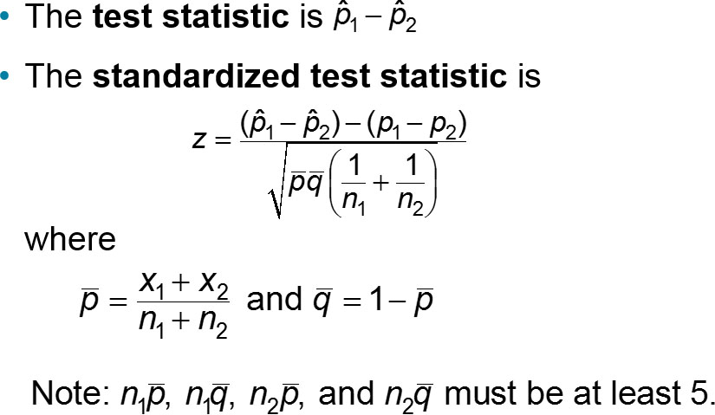
Two-Sample z-Test for the Difference Between Proportions (2 of 5)

Slide 8
Two-Sample z-Test for the Difference Between Proportions (3 of 5)

Slide 9
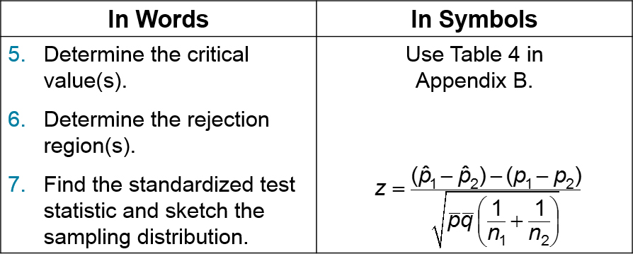
Two-Sample z-Test for the Difference Between Proportions (4 of 5)

Slide 10
Two-Sample z-Test for the Difference Between Proportions (5 of 5)
In Words | In Symbols
Make a decision to reject or fail to reject the null hypothesis. | If z is in the rejection region, reject H₀. Otherwise, fail to reject H₀.
Interpret the decision in the context of the original claim. | blank

Slide 11
Example 1: Two-Sample z-Test for the Difference Between Proportions (1 of 5)
In a study of 150 randomly selected occupants in passenger cars and 200 randomly selected occupants in pickup trucks, 86% of occupants in passenger cars and 74% of occupants in pickup trucks wear seat belts. At α = 0.10 can you reject the claim that the proportion of occupants who wear seat belts is the same for passenger cars and pickup trucks? (Adapted from National Highway Traffic Safety Administration)
Solution
1 = Passenger cars 2 = Pickup trucks

Slide 12
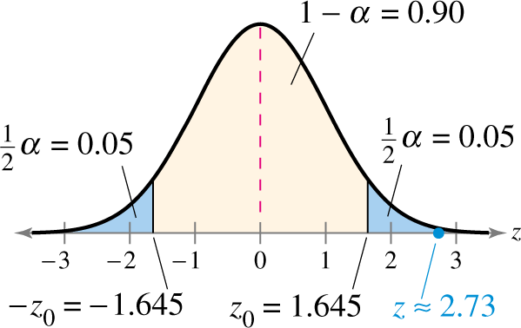
Example 1: Two-Sample z-Test for the Difference Between Proportions (2 of 5)
H₀: P₁ = P₂
H_{a}: P₁ ≠ P₂
α = 0.10
n₁= 150, n₂ = 200
Rejection Region:

Slide 13
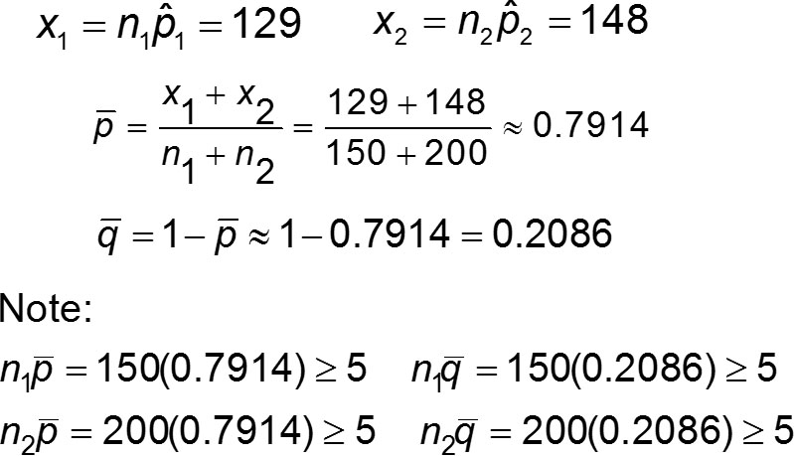
Example 1: Two-Sample z-Test for the Difference Between Proportions (3 of 5)

Slide 14
Example 1: Two-Sample z-Test for the Difference Between Proportions (4 of 5)

Slide 15
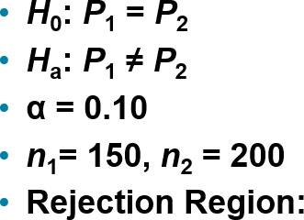
Example 1: Two-Sample z-Test for the Difference Between Proportions (5 of 5)
Test Statistic:
Z = 2.73
Decision: Reject H₀
At the 10% level of significance, there is enough evidence to reject the claim that the proportion of occupants who wear seat belts is the same for passenger cars and pickup trucks.

Slide 16
Example 2: Two-Sample z-Test for the Difference Between Proportions (1 of 5)
A medical research team conducted a study to test the effect of a cholesterol reducing medication. At the end of the study, the researchers found that of the 4700 randomly selected subjects who took the medication, 301 died of heart disease. Of the 4300 randomly selected subjects who took a placebo, 357 died of heart disease. At α = 0.01 can you conclude that the death rate due to heart disease is lower for those who took the medication than for those who took the placebo? (Adapted from New England Journal of Medicine)
Solution
1 = Medication 2 = Placebo

Slide 17
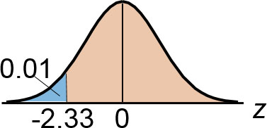
Example 2: Two-Sample z-Test for the Difference Between Proportions (2 of 5)
H₀: P₁ ≥ P₂
H_{a}: P₁ < P₂
α = 0.01
n₁= 4700, n₂ = 4300
Rejection Region:

Slide 18
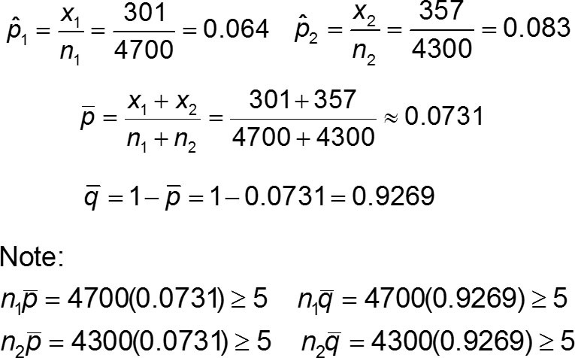
Example 2: Two-Sample z-Test for the Difference Between Proportions (3 of 5)

Slide 19
Example 2: Two-Sample z-Test for the Difference Between Proportions (4 of 5)

Slide 20
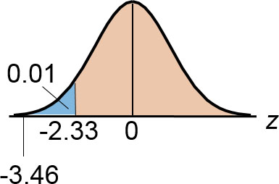
Example 2: Two-Sample z-Test for the Difference Between Proportions (5 of 5)
Test Statistic:
z = −3.46
Decision: Reject H₀
At the 1% level of significance, there is enough evidence to conclude that the death rate due to heart disease is lower for those who took the medication than for those who took the placebo.
H₀: P₁ ≥ P₂
H_{a}: P₁ < P₂
α = 0.01
n₁ = 4700, n₂ = 4300
Rejection Region:

Slide 21
Section 8.4 Summary
Performed a two-sample z-test for the difference between two population proportions p₁ and p₂

