Slide 1
Elementary Statistics: Picturing The World
Sixth Edition
Chapter 8
Hypothesis Testing with Two Samples
Copyright © 2015, 2012, 2009 Pearson Education, Inc. All Rights Reserved

Slide 2
Chapter Outline
8.1 Testing the Difference Between Means (Independent Samples, σ₁ and σ₂ Known)
8.2 Testing the Difference Between Mean (Independent Samples, σ₁ and σ₂ Unknown)
8.3 Testing the Difference Between Means (Dependent Samples)
8.4 Testing the Difference Between Proportions

Slide 3
Section 8.3
Testing the Difference Between Means (Dependent Samples)

Slide 4
Section 8.3 Objectives
How to perform a t-test to test the mean of the difference for a population of paired data

Slide 5
t-Test for the Difference Between Means (1 of 4)
To perform a two-sample hypothesis test with dependent samples, the difference between each data pair is first found:
d = x₁ − x₂ Difference between entries for a data pair

Slide 6
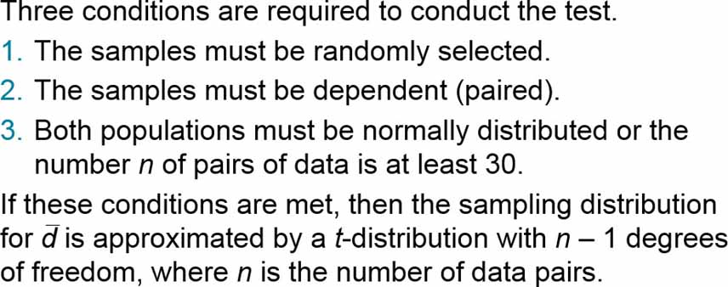
t-Test for the Difference Between Means (2 of 4)

Slide 7
Symbols used for the t-Test for μ_{d} (1 of 2)
Symbol | Description
n | The number of pairs of data
d | The difference between entries for a data pair, d = x₁ − x₂
µ_{d} | The hypothesized mean of the differences of paired data in the population

Slide 8
Symbols used for the t-Test for μ_{d} (2 of 2)

Slide 9
t-Test for the Difference Between Means (3 of 4)
A t-test can be used to test the difference of two population means when these conditions are met.
The samples are random.
The samples are dependent (paired).
The populations are normally distributed or the number n ≥ 30.

Slide 10
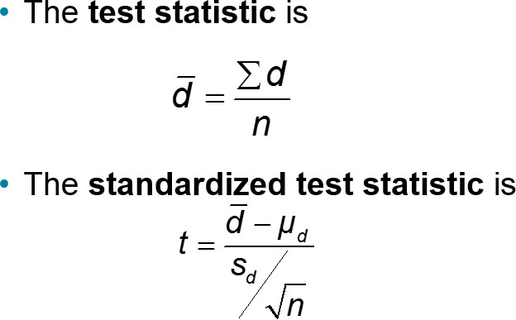
t-Test for the Difference Between Means (4 of 4)
The degrees of freedom are d.f. = n − 1

Slide 11
t-Test for the Difference Between Means (Dependent Samples) (1 of 3)
In Words | In Symbols
Verify that the samples are random and dependent, and either the populations are normally distributed or n ≥ 30. | blank
State the claim mathematically. Identify the null and alternative hypotheses. | State H₀ and H_{a}.
Specify the level of significance. | Identify α.

Slide 12
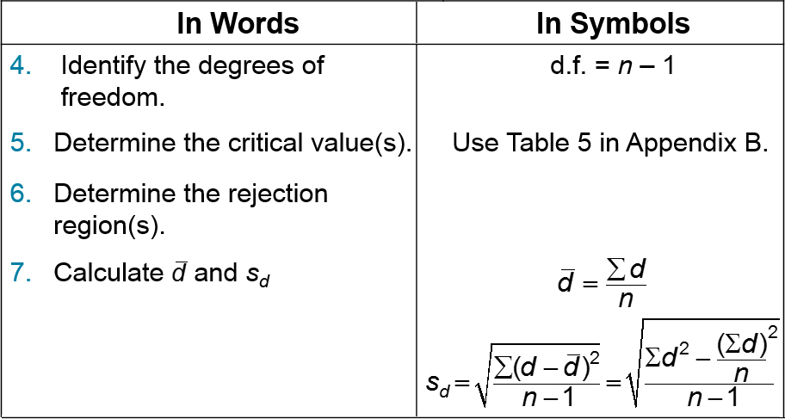
t-Test for the Difference Between Means (Dependent Samples) (2 of 3)

Slide 13
t-Test for the Difference Between Means (Dependent Samples) (3 of 3)

Slide 14
Example: Two-Sample t-Test for the Difference Between Means (1 of 4)
A shoe manufacturer claims that the athletes can increase their vertical jump heights using the manufacturer’s training shoes. The vertical jump heights of eight randomly selected athletes are measured. After the athletes have used the training shoes for 8 months, their vertical jump heights are measured again. The vertical jump heights (in inches) for each athlete are shown in the table. Assuming the vertical jump heights are normally distributed, is there enough evidence to support the manufacturer’s claim at α = 0.10? (Adapted from Coaches Sports Publishing)

Slide 15
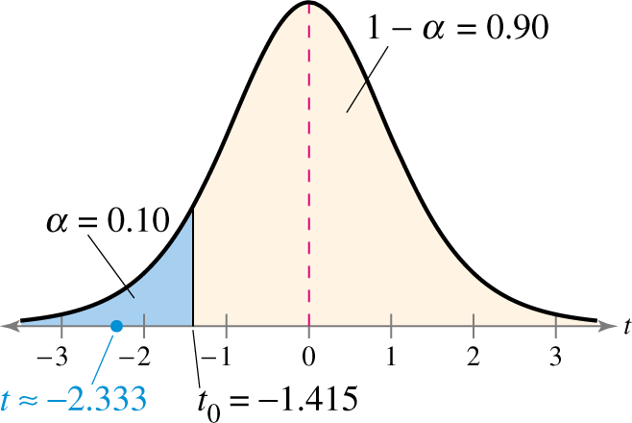
Example: Two-Sample t-Test for the Difference Between Means (2 of 4)
Solution
d = (jump height before shoes) − (jump height after shoes)
H_{a} : μ_{d} < 0
H₀ : μ_{d} > = 0
α = 0.10
d.f. = 8 − 1 = 7
Rejection Region:

Slide 16
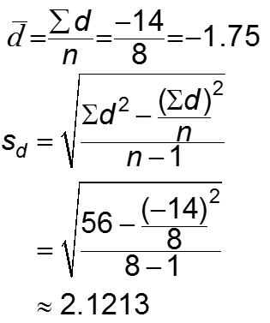
Example: Two-Sample t-Test for the Difference Between Means (3 of 4)
d = (jump height before shoes) − (jump height after shoes)
Before | After | d | d²
24 | 26 | −2 | 4
22 | 25 | −3 | 9
25 | 25 | 0 | 0
28 | 29 | −1 | 1
35 | 33 | 2 | 4
32 | 34 | −2 | 4
30 | 35 | −5 | 25
27 | 30 | −3 | 9
blank | blank | Σ = −14 | Σ = 56

Slide 17
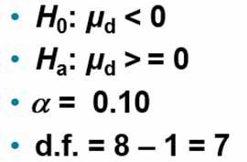
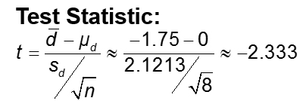
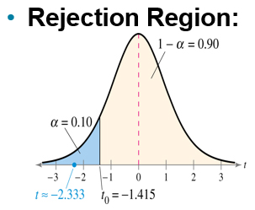
Example: Two-Sample t-Test for the Difference Between Means (4 of 4)
Decision: Reject H₀
At the 10% level of significance, there is enough evidence to support the shoe manufacturer’s claim that athletes can increase their vertical jump heights using the manufacturer’s training shoes.

Slide 18
Section 8.3 Summary
Performed a t-test to test the mean of the difference for a population of paired data

