Slide 1
Elementary Statistics: Picturing The World
Sixth Edition
Chapter 8
Hypothesis Testing with Two Samples
Copyright © 2015, 2012, 2009 Pearson Education, Inc. All Rights Reserved

Slide 2
Chapter Outline
8.1 Testing the Difference Between Means (Independent Samples, σ₁ and σ₂ Known)
8.2 Testing the Difference Between Means (Independent Samples, σ₁ and σ₂ Unknown)
8.3 Testing the Difference Between Means (Dependent Samples)
8.4 Testing the Difference Between Proportions

Slide 3
Section 8.2
Testing the Difference Between Means (Independent Samples, σ₁ and σ₂ Unknown)

Slide 4
Section 8.2 Objectives
How to perform a t-test for the difference between two means µ₁ and µ₂ with independent samples with σ₁ and σ₂ unknown

Slide 5
Two Sample t-Test for the Difference Between Means (1 of 4)
A two-sample t-test is used to test the difference between two population means µ₁ and µ₂ when
​σ₁ and σ₂ are unknown,
the samples are random,
the samples are independent, and
the populations are normally distributed or both n₁ ≥ 30 and n₂ ≥ 30.

Slide 6
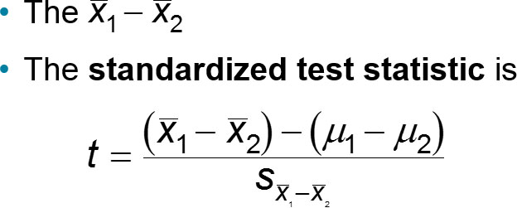
Two Sample t-Test for the Difference Between Means (2 of 4)
The standard error and the degrees of freedom of the sampling distribution depend on whether the population variances σ₁² and σ₂² are equal.

Slide 7
Two Sample t-Test for the Difference Between Means (3 of 4)

Slide 8
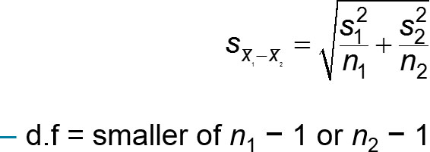
Two Sample t-Test for the Difference Between Means (4 of 4)
Variances are not equal
If the population variances are not equal, then the standard error is

Slide 9
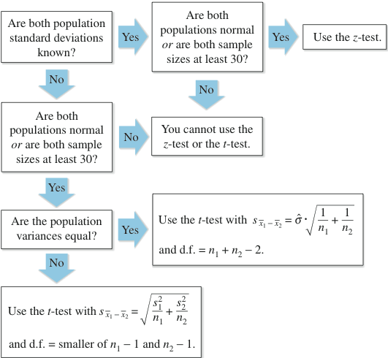
Normal (z) or t-Distribution?

Slide 10
Two-Sample t-Test for the Difference Between Means (Small Independent Samples) (1 of 3)
In Words | In Symbols
Verify that σ₁ and σ₂ are unknown, the samples are random and independent, and either the populations are normally distributed or both n₁ ≥ 30 and n₂ ≥ 30. | blank
State the claim mathematically. Identify the null and alternative hypotheses. | State H₀ and H_{a}.
Specify the level of significance. | Identify α.

Slide 11
Two-Sample t-Test for the Difference Between Means (Small Independent Samples) (2 of 3)
In Words | In Symbols
Determine the degrees of freedom. | d.f. = n₁+ n₂ − 2 or d.f. = smaller of n₁ − 1 or n₂ − 1.
Determine the critical value(s). | Use Table 5 in Appendix B.
Determine the rejection region(s). | blank

Slide 12
Two-Sample t-Test for the Difference Between Means (Small Independent Samples) (3 of 3)

Slide 13
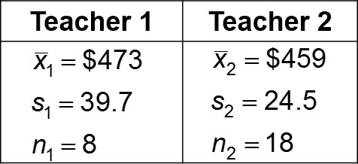
Example 1: Two-Sample t-Test for the Difference Between Means (1 of 2)
The results of a state mathematics test for random samples of students taught by two different teachers at the same school are shown below. Can you conclude that there is a difference in the mean mathematics test scores for the students of the two teachers? Use α = 0.10. Assume the populations are normally distributed and the population variances are not equal.

Slide 14
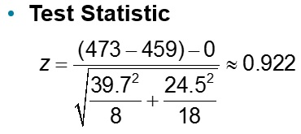
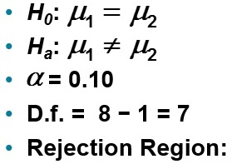
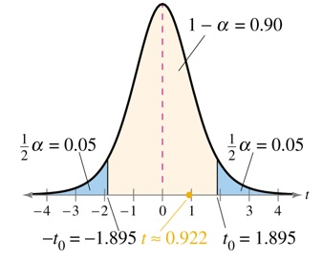
Example 1: Two-Sample t-Test for the Difference Between Means (2 of 2)
Decision: Fail to reject H₀
At the 10% level of significance, there is not enough evidence to support the claim that the mean mathematics test scores for the students of the two teachers are different.

Slide 15
Example 2: Two-Sample t-Test for the Difference Between Means (1 of 4)
A manufacturer claims that the calling range (in feet) of its 2.4-GHz cordless telephone is greater than that of its leading competitor. You perform a study using 14 randomly selected phones from the manufacturer and 16 randomly selected similar phones from its competitor. The results are shown below. At α = 0.05, can you support the manufacturer’s claim? Assume the populations are normally distributed and the population variances are equal.

Slide 16
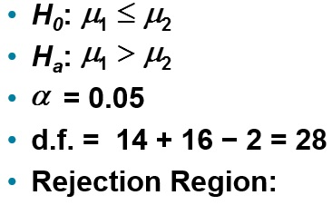
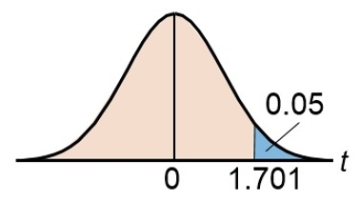
Example 2: Two-Sample t-Test for the Difference Between Means (2 of 4)

Slide 17
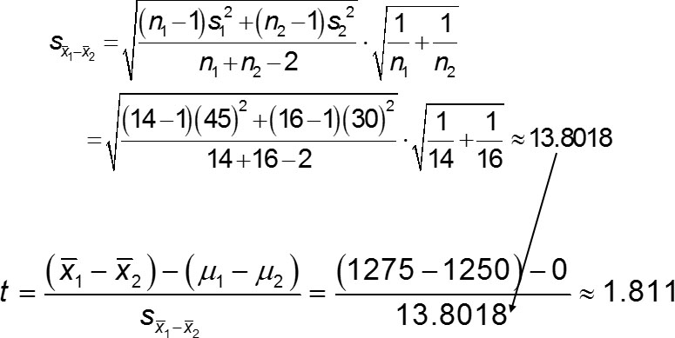
Example 2: Two-Sample t-Test for the Difference Between Means (3 of 4)

Slide 18
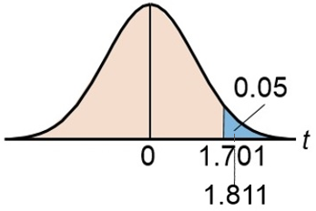
Example 2: Two-Sample t-Test for the Difference Between Means (4 of 4)
Decision: Reject H₀
At the 5% level of significance, there is enough evidence to support the manufacturer’s claim that its phone has a greater calling range than its competitors.

Slide 19
Section 8.2 Summary
Performed a t-test for the difference between two means µ₁ and µ₂ with independent samples with σ₁ and σ₂ unknown

