Slide 1
Elementary Statistics: Picturing The World
Sixth Edition
Chapter 7
Hypothesis Testing with One Sample
Copyright © 2015, 2012, 2009 Pearson Education, Inc. All Rights Reserved

Slide 2
Chapter Outline
7.1 Introduction to Hypothesis Testing
7.2 Hypothesis Testing for the Mean (σ Known)
7.3 Hypothesis Testing for the Mean (σ Unknown)
7.4 Hypothesis Testing for Proportions
7.5 Hypothesis Testing for Variance and Standard Deviation

Slide 3
Section 7.2
Hypothesis Testing for the Mean (σ Known)

Slide 4
Section 7.2 Objectives
How to find and interpret P-values
How to use P-values for a z-test for a mean μ when σ is known
How to find critical values and rejection regions in the standard normal distribution
How to use rejection regions for a z-test for a mean μ when σ is known

Slide 5
Using P-values to Make a Decision
Decision Rule Based on P-value
To use a P-value to make a conclusion in a hypothesis test, compare the P-value with α.
  If P ≤ α, then reject H₀.
  If P > α, then fail to reject H₀.

Slide 6
Example: Interpreting a P-value
The P-value for a hypothesis test is P = 0.0237. What is your decision if the level of significance is
​α = 0.05?
Solution
Because 0.0237 < 0.05, you should reject the null hypothesis.
​α = 0.01?
Solution
Because 0.0237 > 0.01, you fail to reject the null hypothesis.

Slide 7
Finding the P-value for a Hypothesis Test
After determining the hypothesis test’s standardized test statistic and the test statistic’s corresponding area, do one of the following to find the P-value.
For a left-tailed test, P = (Area in left tail).
For a right-tailed test, P = (Area in right tail).
For a two-tailed test, P = 2(Area in tail of standardized test statistic).

Slide 8
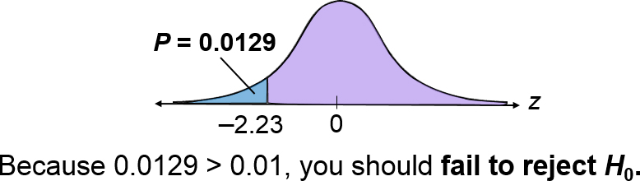
Example: Finding the P-value for a Left-Tailed Test
Find the P-value for a left-tailed hypothesis test with a test statistic of z = –2.23. Decide whether to reject H₀ if the level of significance is α = 0.01.
Solution
For a left-tailed test, P = (Area in left tail)

Slide 9
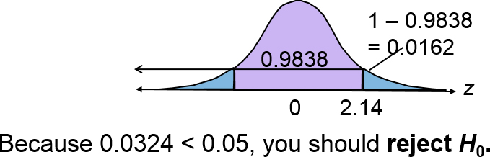
Example: Finding the P-value for a Two-Tailed Test
Find the P-value for a two-tailed hypothesis test with a test statistic of z = 2.14. Decide whether to reject H₀ if the level of significance is α = 0.05.
Solution
For a two-tailed test, P = 2(Area in tail of standardized test statistic)
P = 2(0.0162) = 0.0324

Slide 10
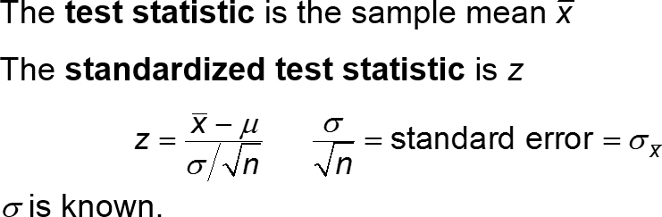
z-Test for a Mean μ
Can be used when
Sample is random
The population is normally distributed, or for any population when the sample size n is at least 30.

Slide 11
Using P-values for a z-Test for Mean μ (1 of 3)
In Words | In Symbols
Verify that σ is known, the sample is random, and either the population is normally distributed or n ≥ 30. | blank
State the claim mathematically and verbally. Identify the null and alternative hypotheses. | State H₀ and H_{a}.
Specify the level of significance. | Identify α.

Slide 12
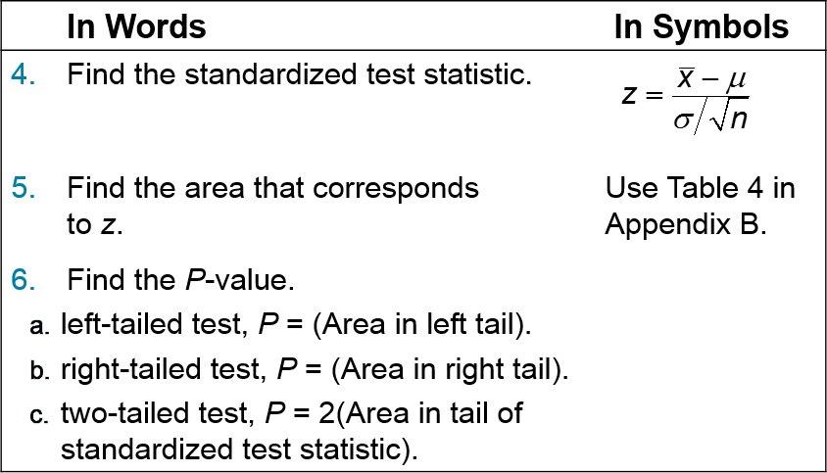
Using P-values for a z-Test for Mean μ (2 of 3)
(skip)
(skip)
(Use z-interval)

Slide 13
Using P-values for a z-Test for Mean μ (3 of 3)
In Words | In Symbols
Make a decision to reject or fail to reject the null hypothesis. | If P ≤ α, then reject H_{0.} Otherwise, fail to reject H_{0.}
Interpret the decision in the context of the original claim. | blank

Slide 14
Example 1: Hypothesis Testing Using P-values (1 of 2)
In auto racing, a pit crew claims that its mean pit stop time (for 4 new tires and fuel) is less than 13 seconds. A random selection of 32 pit stop times has a sample mean of 12.9 seconds. Assume the population standard deviation is 0.19 second. Is there enough evidence to support the claim at α = 0.01? Use a P-value.

Slide 15
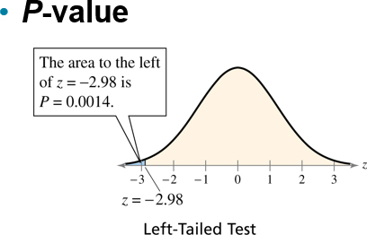
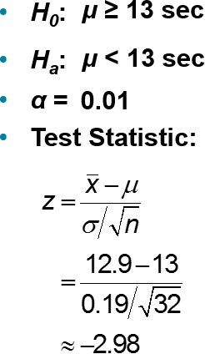
Example 1: Hypothesis Testing Using P-values (2 of 2)
Decision: 0.0014 < 0.01
Reject H₀
At the 1% level of significance, you have sufficient evidence to conclude the mean pit stop time is less than 13 seconds.

Slide 16
Example 2: Hypothesis Testing Using P-values (1 of 2)
According to a study, the mean cost of bariatric (weight loss) surgery is $21,500. You think this information is incorrect. You randomly select 25 bariatric surgery patients and find that the average cost for their surgeries is $20,695. The population standard deviation is known to be $2250 and the population is normally distributed. Is there enough evidence to support your claim at α = 0.05? Use a P-value.

Slide 17
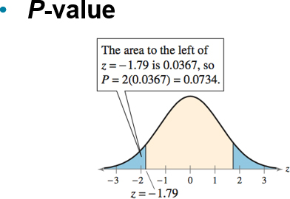
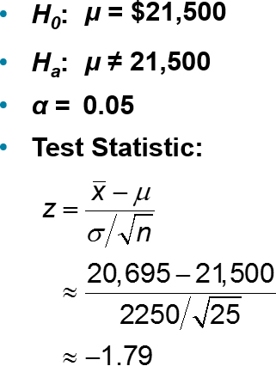
Example 2: Hypothesis Testing Using P-values (2 of 2)
Decision: 0.0734 > 0.05
Fail to reject H₀
At the 5% level of significance, there is not sufficient evidence to support the claim that the mean cost of bariatric surgery is different from $21,500.

Slide 18
Example 1: Testing Using a Rejection Region (1 of 2)
Employees at a construction and mining company claim that the mean salary of the company’s mechanical engineers is less than that of the one of its competitors, which is $68,000. A random sample of 20 of the company’s mechanical engineers has a mean salary of $66,900. Assume the population standard deviation is $5500 and the population is normally distributed. At α = 0.05, test the employees’ claim.

Slide 19
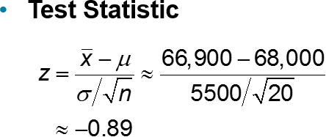
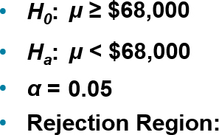
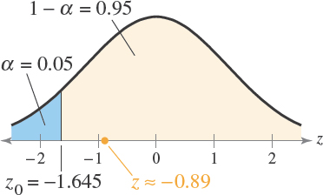
Example 1: Testing Using a Rejection Region (2 of 2)
Decision: Fail to reject H₀
At the 5% level of significance, there is not sufficient evidence to support the employees’ claim that the mean salary is less than $68,000.

Slide 20
Example 2: Testing Using a Rejection Region (1 of 2)
A researcher claims that the mean cost of raising a child from birth to age 2 by husband-wife families in the U.S. is $13,960. A random sample of 500 children (age 2) has a mean cost of $13,725. Assume the population standard deviation is $2345. At α = 0.10, is there enough evidence to reject the claim? (Adapted from U.S. Department of Agriculture Center for Nutrition Policy and Promotion)

Slide 21
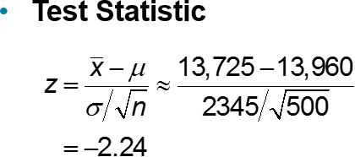
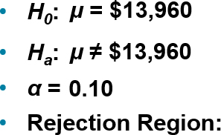
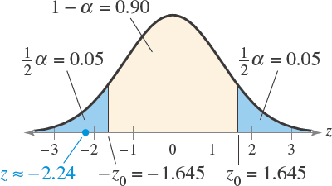
Example 2: Testing Using a Rejection Region (2 of 2)
Decision: Fail to reject H₀
At the 10% level of significance, you have enough evidence to reject the claim that the mean cost of raising a child from birth to age 2 by husband-wife families in the U.S. is $13,960.

Slide 22
Section 7.2 Summary
Found and interpreted P-values and used them to test a mean μ
Used P-values for a z-test for a mean μ when σ is known
Found critical values and rejection regions in the standard normal distribution
Used rejection regions for a z-test for a mean μ when σ is known

