Slide 1
Elementary Statistics: Picturing The World
Sixth Edition
Chapter 7
Hypothesis Testing with One Sample
Copyright © 2015, 2012, 2009 Pearson Education, Inc. All Rights Reserved

Slide 2
Chapter Outline
7.1 Introduction to Hypothesis Testing
7.2 Hypothesis Testing for the Mean (σ Known)
7.3 Hypothesis Testing for the Mean (σ Unknown)
7.4 Hypothesis Testing for Proportions
7.5 Hypothesis Testing for Variance and Standard Deviation

Slide 3
Section 7.1
Introduction to Hypothesis Testing

Slide 4
Section 7.1 Objectives
A practical introduction to hypothesis tests
How to state a null hypothesis and an alternative hypothesis
Identify type I and type II errors and interpret the level of significance
How to know whether to use a one-tailed or two-tailed statistical test and find a P-value
How to make and interpret a decision based on the results of a statistical test
How to write a claim for a hypothesis test

Slide 5
Hypothesis Tests (1 of 2)
Hypothesis test
A process that uses sample statistics to test a claim about the value of a population parameter.
For example An automobile manufacturer advertises that its new hybrid car has a mean mileage of 50 miles per gallon. To test this claim, a sample would be taken. If the sample mean differs enough from the advertised mean, you can decide that the advertisement is false.

Slide 6
Hypothesis Tests (2 of 2)
Statistical hypothesis
A statement, or claim, about a population parameter.
Carefully state a pair of hypotheses
  one that represents the claim
  the other, its complement
When one of these hypotheses is false, the other must be true.

Slide 7

Stating a Hypothesis (1 of 2)
Null hypothesis
A statistical hypothesis that contains a statement of equality such as ≤, =, or ≥.
Denoted H₀ read “H subzero” or “H naught.”
Alternative hypothesis
A statement of inequality such as >, ≠, or <.
Must be true if H₀ is false.
Denoted H_{a} read “H sub-a.”

Slide 8
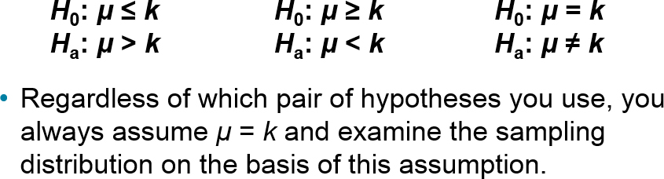
Stating a Hypothesis (2 of 2)
To write the null and alternative hypotheses, translate the claim made about the population parameter from a verbal statement to a mathematical statement.
Then write its complement.

Slide 9

Example 1: Stating the Null and Alternative Hypotheses
Write the claim as a mathematical sentence. State the null and alternative hypotheses and identify which represents the claim.
A school publicizes that the proportion of its students who are involved in at least one extracurricular activity is 61%.
Solution

Slide 10

Example 2: Stating the Null and Alternative Hypotheses
Write the claim as a mathematical sentence. State the null and alternative hypotheses and identify which represents the claim.
A car dealership announces that the mean time for an oil change is less than 15 minutes.
Solution

Slide 11

Example 3: Stating the Null and Alternative Hypotheses
Write the claim as a mathematical sentence. State the null and alternative hypotheses and identify which represents the claim.
A company advertises that the mean life of its furnaces is more than 18 years
Solution

Slide 12
Types of Errors
No matter which hypothesis represents the claim, always begin the hypothesis test assuming that the equality condition in the null hypothesis is true.
At the end of the test, one of two decisions will be made:
  reject the null hypothesis
  fail to reject the null hypothesis
Because your decision is based on a sample, there is the possibility of making the wrong decision.

Slide 13
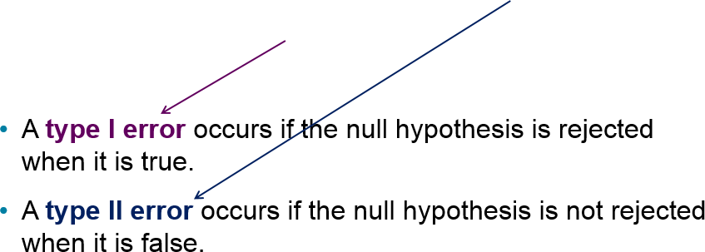
Possible Outcomes and Types of Errors
Actual Truth of H₀
Decision | H₀ is true | H₀ is false
Do not reject H₀ | Correct Decision | Type II Error
Reject H₀ | Type I Error | Correct Decision

Slide 14
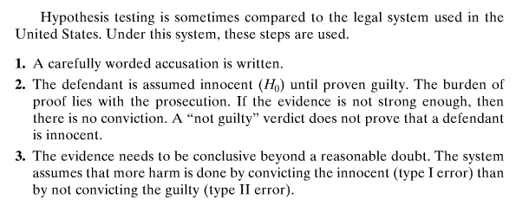
Hypothesis Testing as compared to the United State Legal System

Slide 15
Possible Outcomes and Types of Errors in the Justice System
Truth About Defendant
Verdict | Innocent | Guilty
Not Guilty | Justice | Type II Error
Guilty | Type I Error | Justice
A Type I Error is when an innocent person is convicted of a crime
A Type II Error is when a guilty person is set free.

Slide 16
Example: Identifying Type I and Type II Errors (1 of 4)
The USDA limit for salmonella contamination for chicken is 20%. A meat inspector reports that the chicken produced by a company exceeds the USDA limit. You perform a hypothesis test to determine whether the meat inspector’s claim is true. When will a type I or type II error occur? Which is more serious? (Source: United States Department of Agriculture)

Slide 17
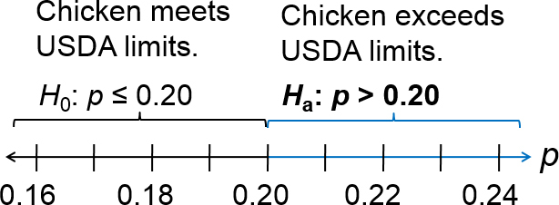
Example: Identifying Type I and Type II Errors (2 of 4)
Solution
Let p represent the proportion of chicken that is contaminated.
Hypotheses: H₀: P ≤ 0.2
H_{a}: P > 0.2 (Claim)

Slide 18
Example: Identifying Type I and Type II Errors (3 of 4)
Hypotheses: H₀: P ≤ 0.2
H_{a}: P > 0.2 (Claim)
A type I error is rejecting H₀ when it is true.
The actual proportion of contaminated chicken is less than or equal to 0.2, but you decide to reject H₀.
A type II error is failing to reject H₀ when it is false.
The actual proportion of contaminated chicken is greater than 0.2, but you do not reject H₀

Slide 19
Example: Identifying Type I and Type II Errors (4 of 4)
Hypotheses: H₀: P ≤ 0.2
H_{a}: P > 0.2 (Claim)
With a type I error, you might create a health scare and hurt the sales of chicken producers who were actually meeting the USDA limits.
With a type II error, you could be allowing chicken that exceeded the USDA contamination limit to be sold to consumers.
A type II error is more serious because it could result in sickness or even death.

Slide 20
Level of Significance
Level of significance
Your maximum allowable probability of making a type I error.
  Denoted by α, the lowercase Greek letter alpha.
By setting the level of significance at a small value, you are saying that you want the probability of rejecting a true null hypothesis to be small.
Commonly used levels of significance:
  α = 0.10 α = 0.05 α = 0.01
P(type II error) = β (beta)

Slide 21
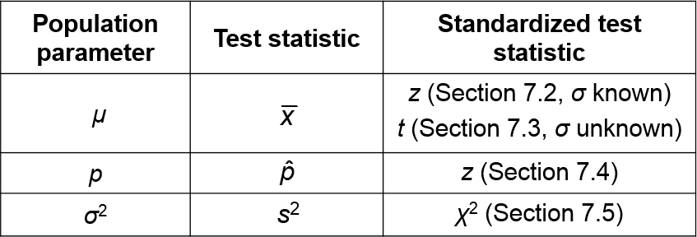
Statistical Tests
After stating the null and alternative hypotheses and specifying the level of significance, a random sample is taken from the population and sample statistics are calculated.
The statistic that is compared with the parameter in the null hypothesis is called the test statistic.

Slide 22
P-values
P-value (or probability value)
The probability, if the null hypothesis is true, of obtaining a sample statistic with a value as extreme or more extreme than the one determined from the sample data.
Depends on the nature of the test.

Slide 23
Nature of the Test
Three types of hypothesis tests
  left-tailed test
  right-tailed test
  two-tailed test
The type of test depends on the region of the sampling distribution that favors a rejection of H₀.
This region is indicated by the alternative hypothesis.

Slide 24
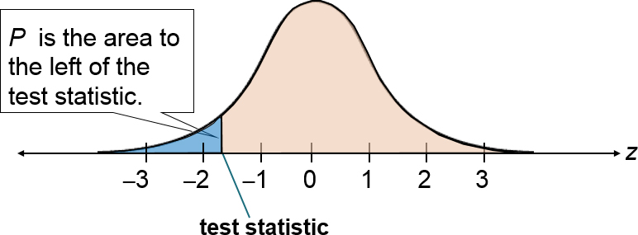
Left-tailed Test
The alternative hypothesis H_{a} contains the less-than inequality symbol (<).
H₀: μ ≥ k
H_{a}: μ < k

Slide 25
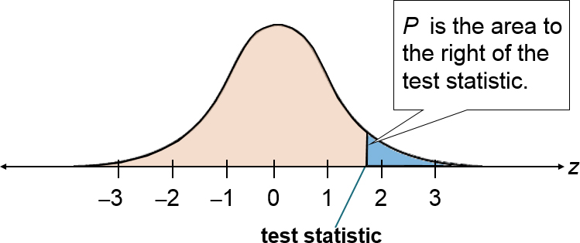
Right-tailed Test
The alternative hypothesis H_{a} contains the greater-than inequality symbol (>).
H₀: μ ≤ k
H_{a}: μ > k

Slide 26
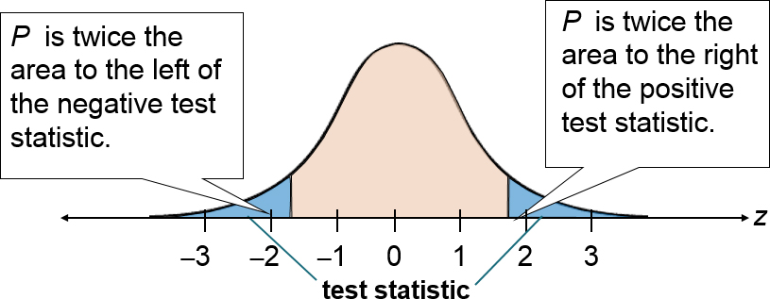
Two-tailed Test
The alternative hypothesis H_{a} contains the not-equal-to inequality symbol (≠). Each tail has an area of ½P.
H₀: μ = k
H_{a}: μ ≠ k

Slide 27
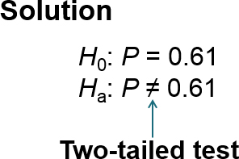
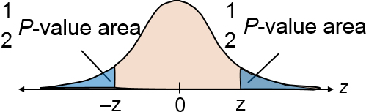
Example 1: Identifying The Nature of a Test
For each claim, state H₀ and H_{a}. Then determine whether the hypothesis test is a left-tailed, right-tailed, or two-tailed test. Sketch a normal sampling distribution and shade the area for the P-value.
A school publicizes that the proportion of its students who are involved in at least one extracurricular activity is 61%.

Slide 28
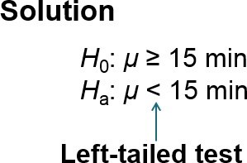
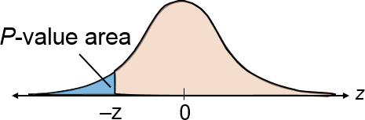
Example 2: Identifying The Nature of a Test
For each claim, state H₀ and H_{a}. Then determine whether the hypothesis test is a left-tailed, right-tailed, or two-tailed test. Sketch a normal sampling distribution and shade the area for the P-value.
A car dealership announces that the mean time for an oil change is less than 15 minutes.

Slide 29
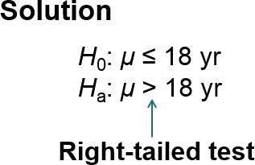
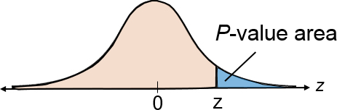
Example 3: Identifying The Nature of a Test
For each claim, state H₀ and H_{a}. Then determine whether the hypothesis test is a left-tailed, right-tailed, or two-tailed test. Sketch a normal sampling distribution and shade the area for the P-value.
A company advertises that the mean life of its furnaces is more than 18 years.

Slide 30
Making a Decision
Decision Rule Based on P-value
Compare the P-value with α.
  If P ≤ α, then reject H₀.
  If P > α, then fail to reject H₀.
Claim
Decision | Claim is H₀ | Claim is H_{a}
Reject H₀ | There is enough evidence to reject the claim | There is enough evidence to support the claim
Fail to reject H₀ | There is not enough evidence to reject the claim | There is not enough evidence to support the claim

Slide 31
Example 1: Interpreting a Decision (1 of 2)
You perform a hypothesis test for the following claim. How should you interpret your decision if you reject H₀? If you fail to reject H₀?
​H₀ (Claim): A school publicizes that the proportion of its students who are involved in at least one extracurricular activity is 61%.

Slide 32
Example 1: Interpreting a Decision (2 of 2)
Solution
The claim is represented by H₀.
If you reject H₀ you should conclude “there is enough evidence to reject the school’s claim that the proportion of students who are involved in at least one extracurricular activity is 61%.”
If you fail to reject H₀, you should conclude “there is not enough evidence to reject the school’s claim that the proportion of students who are involved in at least one extracurricular activity is 61%.”

Slide 33
Example 2: Interpreting a Decision (1 of 2)
You perform a hypothesis test for the following claim. How should you interpret your decision if you reject H₀? If you fail to reject H₀?
​H_{a} (Claim): A car dealership announces that the mean time for an oil change is less than 15 minutes.
Solution
The claim is represented by H_{a}.
H₀ is “the mean time for an oil change is greater than or equal to 15 minutes.”

Slide 34
Example 2: Interpreting a Decision (2 of 2)
If you reject H₀ you should conclude “there is enough evidence to support the dealership’s claim that the mean time for an oil change is less than 15 minutes.”
If you fail to reject H₀, you should conclude “there is not enough evidence to support the dealership’s claim that the mean time for an oil change is less than 15 minutes.”

Slide 35
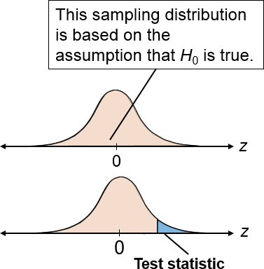
Steps for Hypothesis Testing (1 of 2)
State the claim mathematically and verbally. Identify the null and alternative hypotheses.
  H₀: ? H_{a}: ?
Specify the level of significance.
  α = ?
Determine the standardized sampling distribution and draw its graph.
Calculate the test statistic and its standardized value. Add it to your sketch.

Slide 36
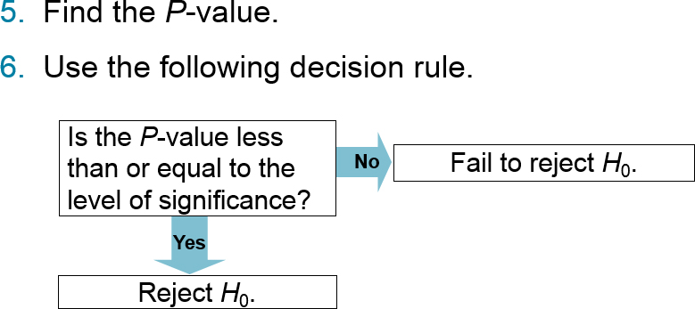
Steps for Hypothesis Testing (2 of 2)
Write a statement to interpret the decision in the context of the original claim.

Slide 37
Section 7.1 Summary
Learned a practical introduction to hypothesis test
Stated a null hypothesis and an alternative hypothesis
Identified type I and type II errors and interpreted the level of significance
Knew whether to use a one-tailed or two-tailed statistical test and found a P-value
Made and interpreted a decision based on the results of a statistical test
Wrote a claim for a hypothesis test

