Slide 1
Elementary Statistics: Picturing The World
Sixth Edition
Chapter 6
Confidence Intervals
Copyright © 2015, 2012, 2009 Pearson Education, Inc. All Rights Reserved

Slide 2
Chapter Outline
6.1 Confidence Intervals for the Mean (σ Known)
6.2 Confidence Intervals for the Mean (σ Unknown)
6.3 Confidence Intervals for Population Proportions
6.4 Confidence Intervals for Variance and Standard Deviation

Slide 3
Section 6.3
Confidence Intervals for Population Proportions

Slide 4
Section 6.3 Objectives
How to find a point estimate for the population proportion
How to construct and interpret confidence intervals for a population proportion
How to determine the minimum sample size required when estimating a population proportion

Slide 5
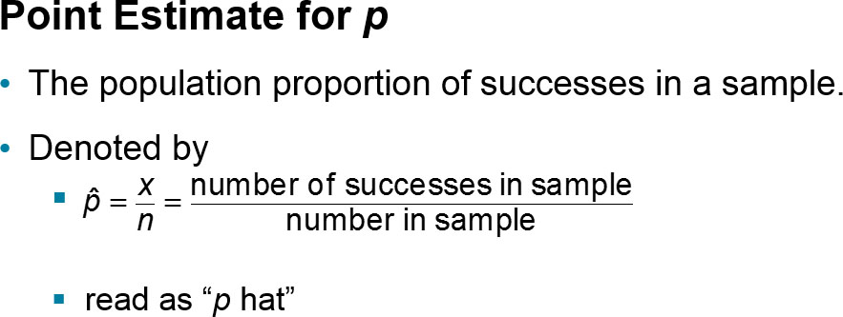
Point Estimate for Population p (1 of 2)
Population Proportion
The probability of success in a single trial of a binomial experiment.
Denoted by p

Slide 6
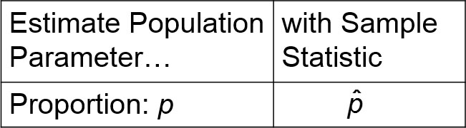
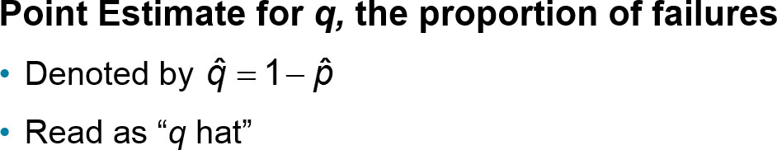
Point Estimate for Population p (2 of 2)

Slide 7
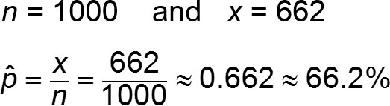
Example: Point Estimate for p
In a survey of 1000 U.S. adults, 662 said that it is acceptable to check personal e-mail while at work. Find a point estimate for the population proportion of U.S. adults who say it is acceptable to check personal e-mail while at work. (Adapted from Liberty Mutual)
Solution

Slide 8
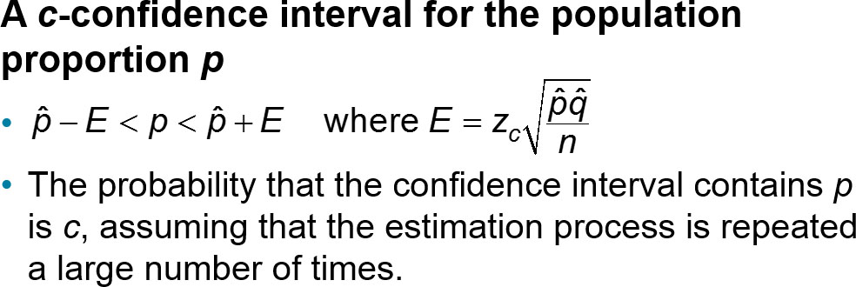
Confidence Intervals for p

Slide 9
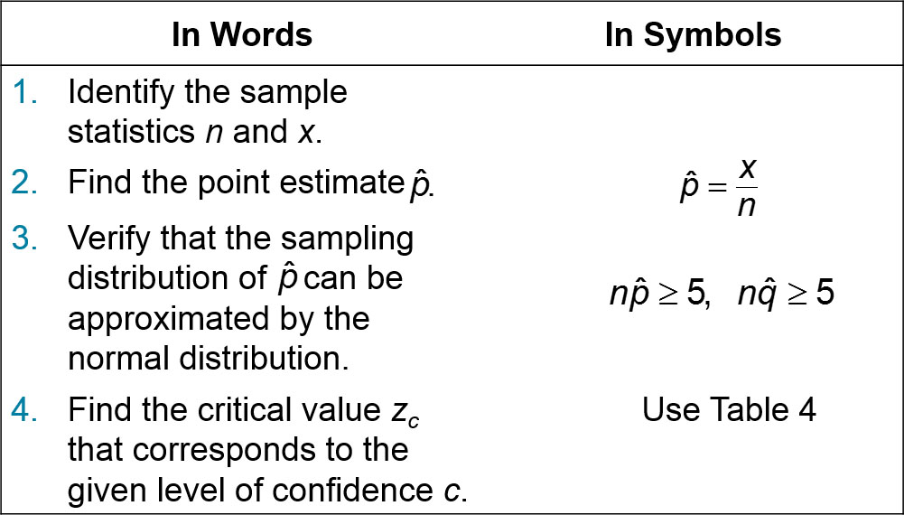
Constructing Confidence Intervals for p (1 of 2)

Slide 10
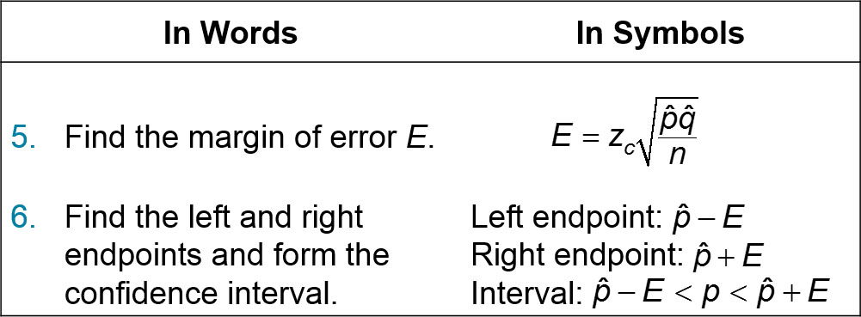
Constructing Confidence Intervals for p (2 of 2)

Slide 11
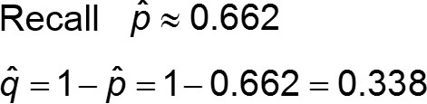
Example: Confidence Interval for p (1 of 4)
In a survey of 1000 U.S. adults, 662 said that it is acceptable to check personal e-mail while at work. Construct a 95% confidence interval for the population proportion of adults in the U.S. adults who say that it is acceptable to check personal e-mail while at work.
Solution

Slide 12
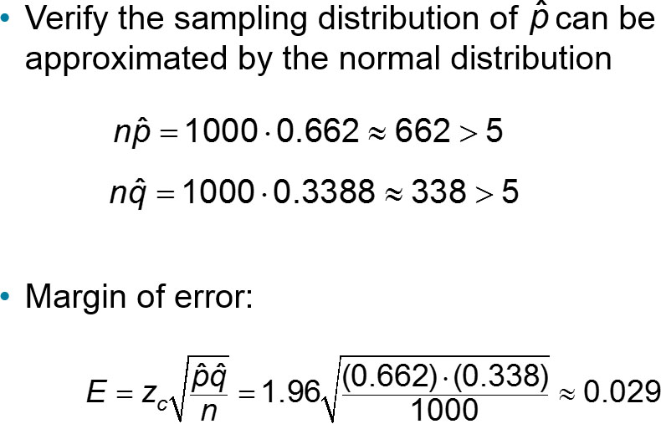
Example: Confidence Interval for p (2 of 4)

Slide 13
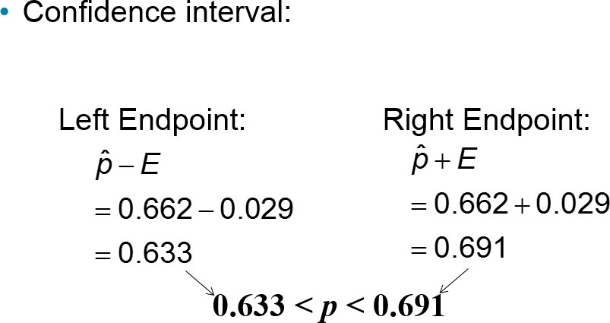
Example: Confidence Interval for p (3 of 4)

Slide 14
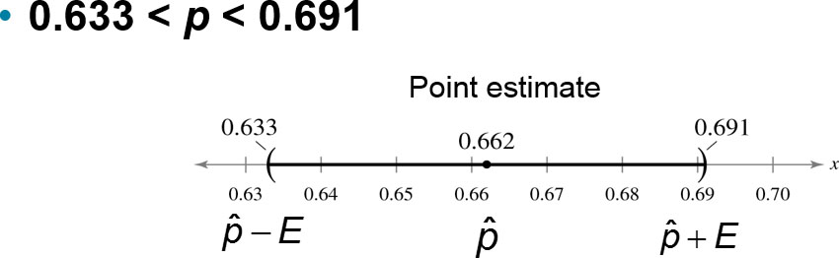
Example: Confidence Interval for p (4 of 4)
With 95% confidence, you can say that the population proportion of U.S. adults who say that it is acceptable to check personal e-mail while at work is between 63.3% and 69.1%.

Slide 15
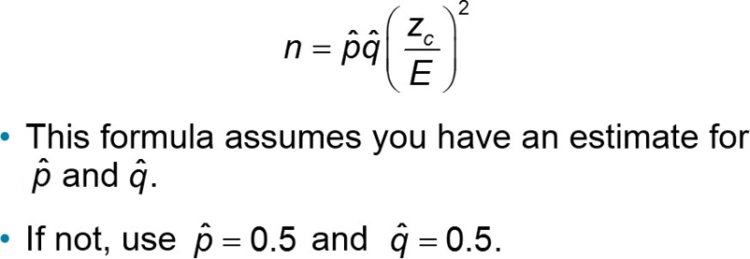
Determining a Minimum Sample Size
Given a c-confidence level and a margin of error E, the minimum sample size n needed to estimate p is

Slide 16
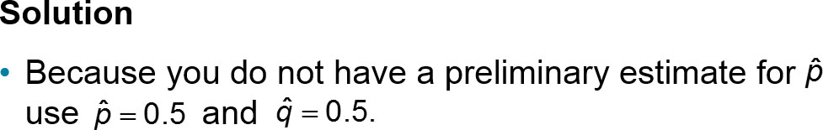
Example 1: Determining a Minimum Sample Size (1 of 2)
You are running a political campaign and wish to estimate, with 95% confidence, the proportion of registered voters who will vote for your candidate. Your estimate must be accurate within 3% of the true population. Find the minimum sample size needed if
no preliminary estimate is available.

Slide 17
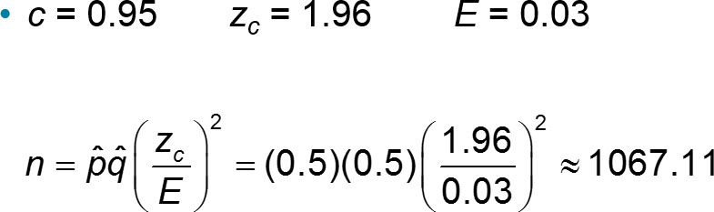
Example 1: Determining a Minimum Sample Size (2 of 2)
Round up to the nearest whole number.
With no preliminary estimate, the minimum sample size should be at least 1068 voters.

Slide 18
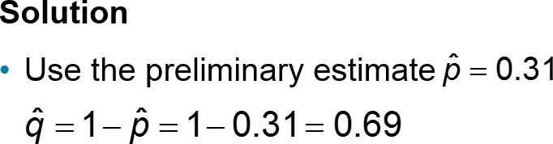
Example 2: Determining a Minimum Sample Size (1 of 2)
You are running a political campaign and wish to estimate, with 95% confidence, the proportion of registered voters who will vote for your candidate. Your estimate must be accurate within 3% of the true population. Find the minimum sample size needed if

Slide 19
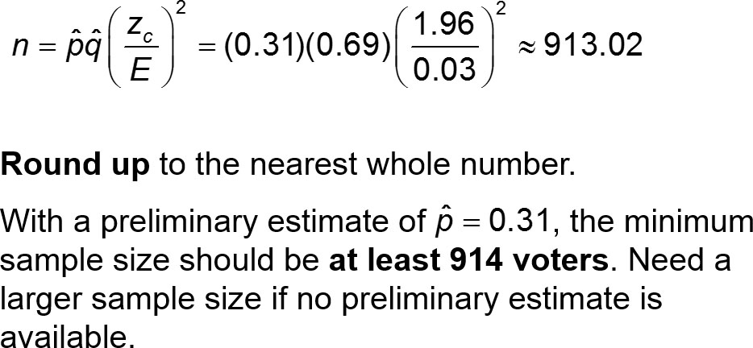
Example 2: Determining a Minimum Sample Size (2 of 2)
c = 0.95 z_{c} = 1.96 E = 0.03

Slide 20
Section 6.3 Summary
Found a point estimate for the population proportion
Constructed a confidence interval for a population proportion
Determined the minimum sample size required when estimating a population proportion

