Slide 1
Elementary Statistics: Picturing The World
Sixth Edition
Chapter 6
Confidence Intervals
Copyright © 2015, 2012, 2009 Pearson Education, Inc. All Rights Reserved

Slide 2
Chapter Outline
6.1 Confidence Intervals for the Mean (σ Known)
6.2 Confidence Intervals for the Mean (σ Unknown)
6.3 Confidence Intervals for Population Proportions
6.4 Confidence Intervals for Variance and Standard Deviation

Slide 3
Section 6.2
Confidence Intervals for the Mean (σ Unknown)

Slide 4
Section 6.2 Objectives
How to interpret the t-distribution and use a t-distribution table
How to construct and interpret confidence intervals for a population mean when σ is not known

Slide 5
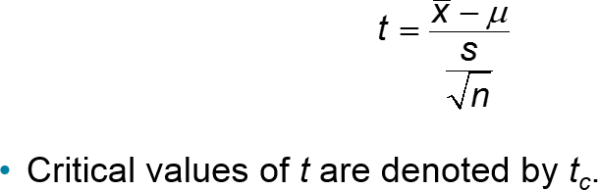
The t-Distribution
When the population standard deviation is unknown, the sample size is less than 30, and the random variable x is approximately normally distributed, it follows a t-distribution.

Slide 6
Properties of the t-Distribution (1 of 3)
The mean, median, and mode of the t-distribution are equal to zero.
The t-distribution is bell shaped and symmetric about the mean.
The total area under a t-curve is 1 or 100%.
The tails in the t-distribution are “thicker” than those in the standard normal distribution.
The standard deviation of the t-distribution varies with the sample size, but it is greater than 1.

Slide 7
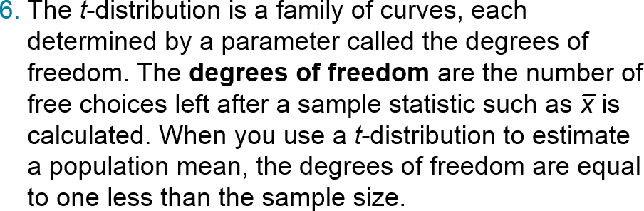
Properties of the t-Distribution (2 of 3)
    d.f. = n – 1 Degrees of freedom

Slide 8
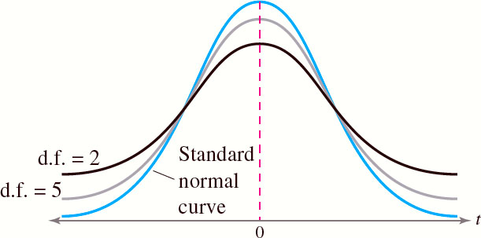
Properties of the t-Distribution (3 of 3)
As the degrees of freedom increase, the t-distribution approaches the normal distribution. After 30 d.f., the t-distribution is very close to the standard normal z-distribution.

Slide 9
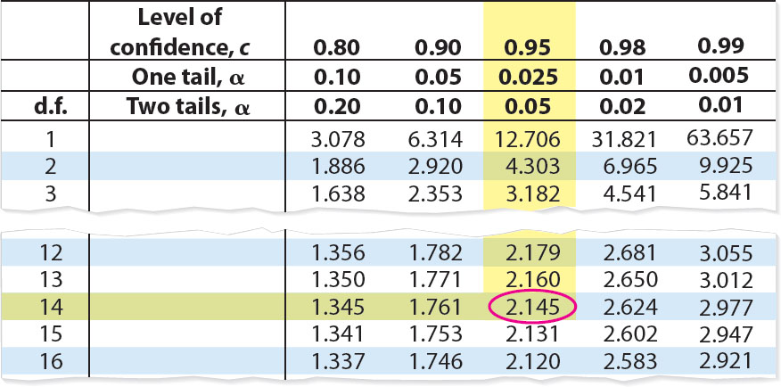
Example: Finding Critical Values of t (1 of 2)
Find the critical value t_{c} for a 95% confidence when the sample size is 15.
Solution: d.f. = n − 1 = 15 − 1 = 14

Slide 10
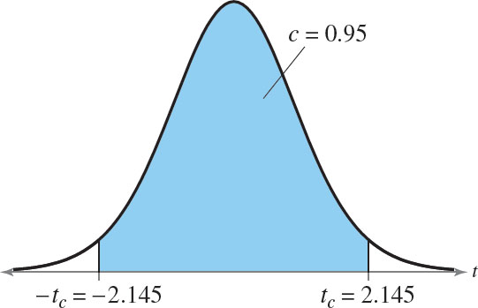
Example: Finding Critical Values of t (2 of 2)
95% of the area under the t-distribution curve with 14 degrees of freedom lies between t = ± 2.145.

Slide 11
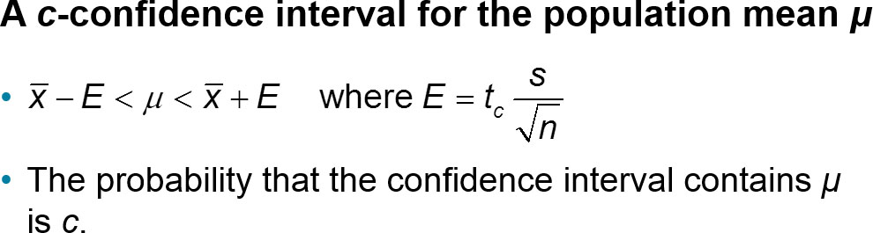
Confidence Intervals for the Population Mean

Slide 12
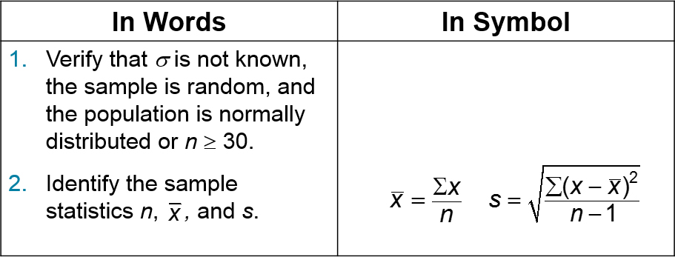
Confidence Intervals and t-Distributions (1 of 2)

Slide 13
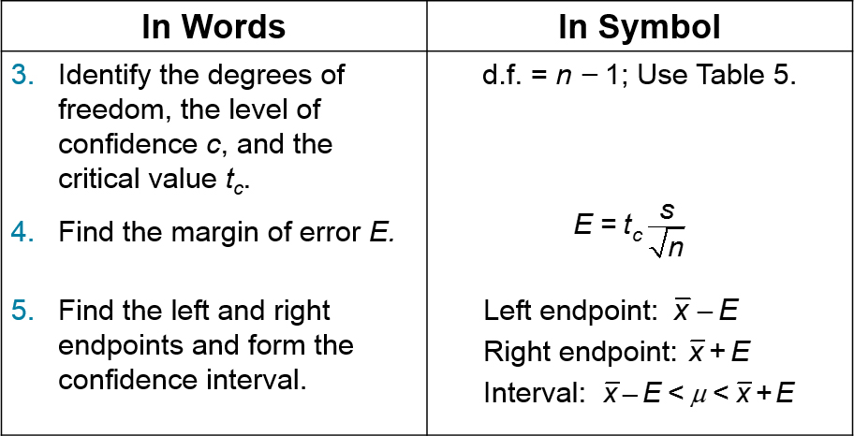
Confidence Intervals and t-Distributions (2 of 2)

Slide 14
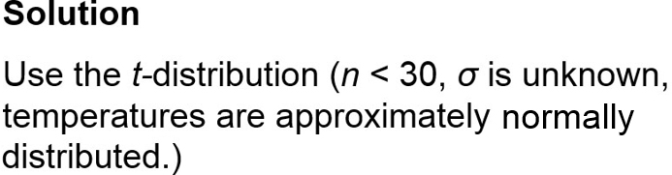
Example: Constructing a Confidence Interval (1 of 4)
You randomly select 16 coffee shops and measure the temperature of the coffee sold at each. The sample mean temperature is 162.0ºF with a sample standard deviation of 10.0ºF. Find the 95% confidence interval for the mean temperature. Assume the temperatures are approximately normally distributed.

Slide 15
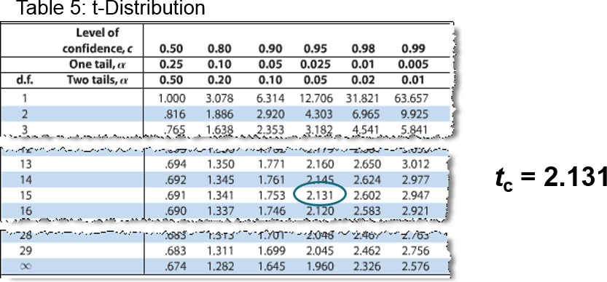
Example: Constructing a Confidence Interval (2 of 4)
df = n − 1 = 16 − 1 = 15
Critical Value

Slide 16
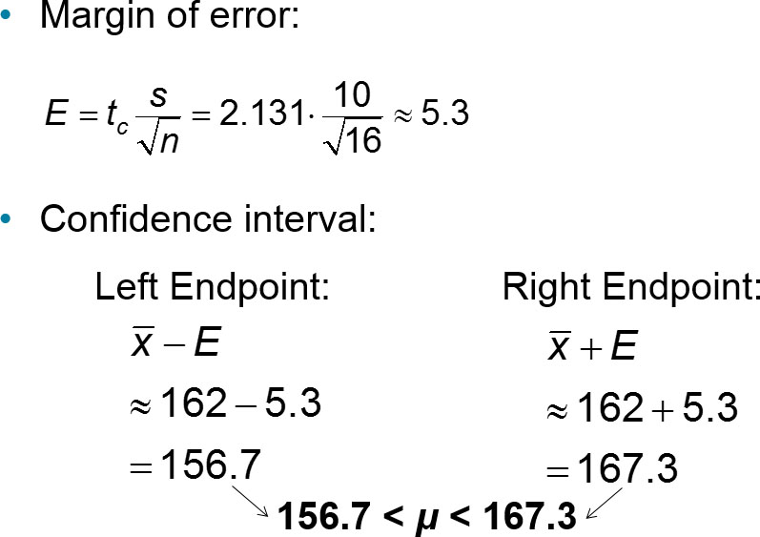
Example: Constructing a Confidence Interval (3 of 4)

Slide 17
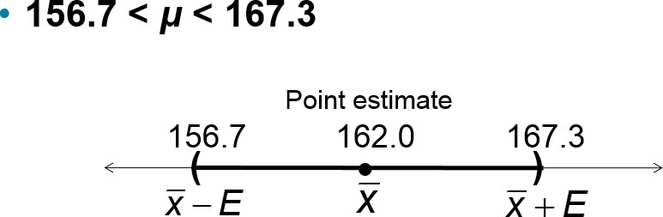
Example: Constructing a Confidence Interval (4 of 4)
With 95% confidence, you can say that the mean temperature of coffee sold is between 156.7ºF and 167.3ºF.

Slide 18
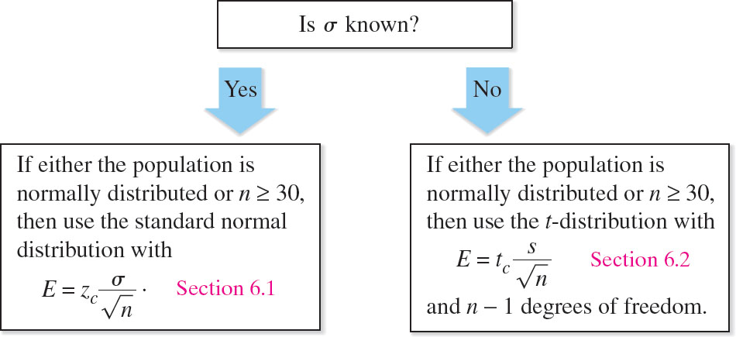
Normal or t-Distribution?

Slide 19

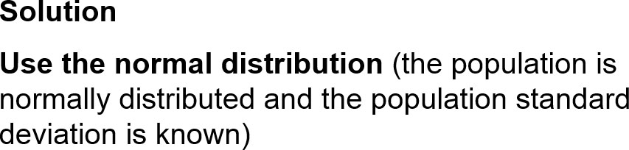
Example: Normal or t-Distribution?
You randomly select 25 newly constructed houses. The sample mean construction cost is $181,000 and the population standard deviation is $28,000. Assuming construction costs are normally distributed, should you use the normal distribution, the t-distribution, or neither to construct a 95% confidence interval for the population mean construction cost?

Slide 20
Section 6.2 Summary
Interpreted the t-distribution and used a t-distribution table
Constructed and interpreted confidence intervals for a population mean when σ is not known

