Slide 1
Elementary Statistics: Picturing The World
Sixth Edition
Chapter 6
Confidence Intervals
Copyright © 2015, 2012, 2009 Pearson Education, Inc. All Rights Reserved

Slide 2
Chapter Outline
6.1 Confidence Intervals for the Mean (σ Known)
6.2 Confidence Intervals for the Mean (σ Unknown)
6.3 Confidence Intervals for Population Proportions
6.4 Confidence Intervals for Variance and Standard Deviation

Slide 3
Section 6.1
Confidence Intervals for the Mean (σ Known)

Slide 4
Section 6.1 Objectives
How to find a point estimate and a margin of error
How to construct and interpret confidence intervals for the population mean
How to determine the minimum sample size required when estimating μ

Slide 5
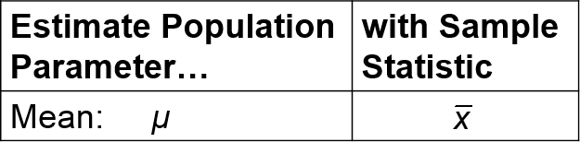
Point Estimate for Population μ
Point Estimate
A single value estimate for a population parameter
Most unbiased point estimate of the population mean

Slide 6
Example: Point Estimate for Population μ (1 of 2)
An economics researcher is collecting data about grocery store employees in a county. The data listed below represents a random sample of the number of hours worked by 40 employees from several grocery stores in the county. Find a point estimate of the population mean, μ.
30 | 26 | 33 | 26 | 26 | 33 | 31 | 31 | 21 | 37
27 | 20 | 34 | 35 | 30 | 24 | 38 | 34 | 39 | 31
22 | 30 | 23 | 23 | 31 | 44 | 31 | 33 | 33 | 26
27 | 28 | 25 | 35 | 23 | 32 | 29 | 31 | 25 | 27

Slide 7
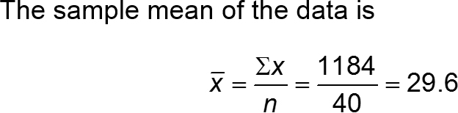
Example: Point Estimate for Population μ (2 of 2)
The point estimate for the mean number of hours worked by grocery store employees in this county is 29.6 hours.

Slide 8
Drawbacks of a point estimate
The chances or probability that the estimate is exactly the same as the population mean are zero

Slide 9
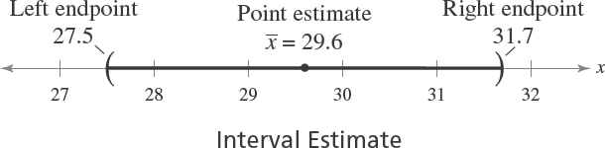
Interval Estimate
Interval estimate
An interval, or range of values, used to estimate a population parameter.

Slide 10
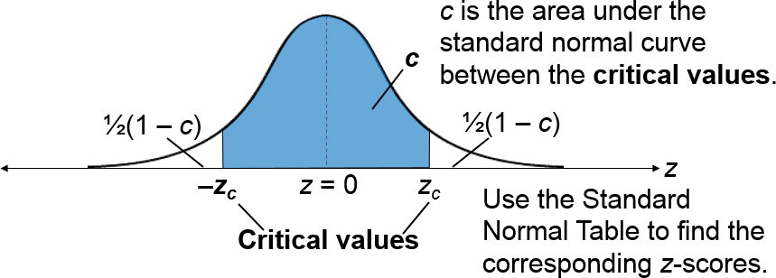
Level of Confidence (1 of 2)
Level of confidence c
The probability that the interval estimate contains the population parameter.

Slide 11
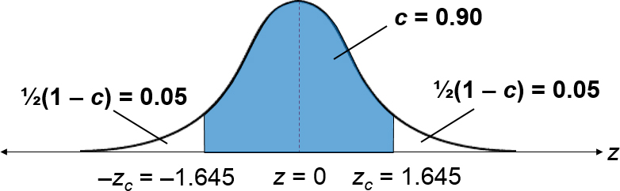
Level of Confidence (2 of 2)
If the level of confidence is 90%, this means that we are 90% confident that the interval contains the population mean μ.

Slide 12
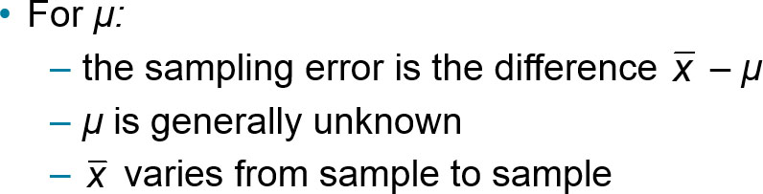
Sampling Error
Sampling error
The difference between the point estimate and the actual population parameter value.

Slide 13
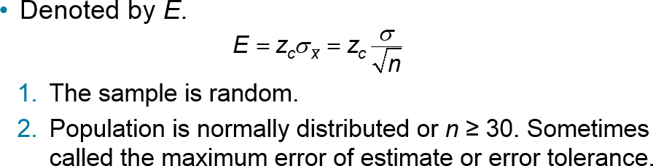
Margin of Error
Margin of error
The greatest possible distance between the point estimate and the value of the parameter it is estimating for a given level of confidence, c.

Slide 14
Example: Finding the Margin of Error (1 of 3)
Use the data about the grocery store employees and a 95% confidence level to find the margin of error for the mean number of hours worked by grocery store employees. Assume the population standard deviation is 7.9 hours.

Slide 15
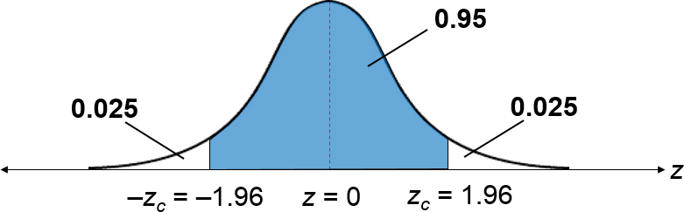
Example: Finding the Margin of Error (2 of 3)
95% of the area under the standard normal curve falls within 1.96 standard deviations of the mean. (You can approximate the distribution of the sample means with a normal curve by the Central Limit Theorem, because n = 40 ≥ 30.)

Slide 16
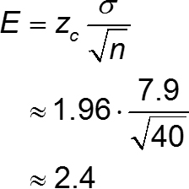
Example: Finding the Margin of Error (3 of 3)
You are 95% confident that the margin of error for the population mean is about 2.4 hours.

Slide 17
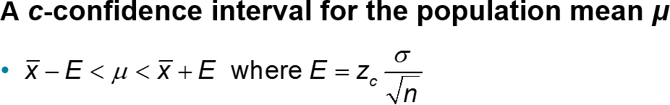
Confidence Intervals for the Population Mean
The probability that the confidence interval contains μ is c, assuming that the estimation process is repeated a large number of times.

Slide 18
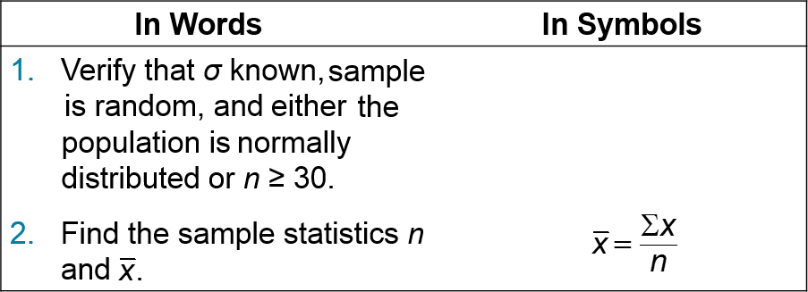
Constructing Confidence Intervals for μ (1 of 2)
Finding a Confidence Interval for a Population Mean (σ Known)

Slide 19
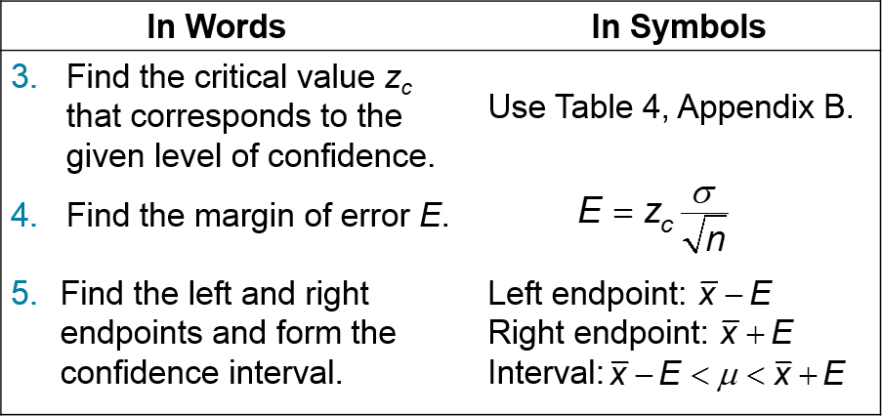
Constructing Confidence Intervals for μ (2 of 2)

Slide 20
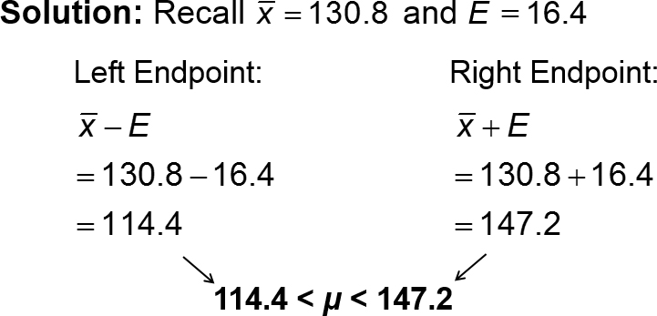
Example 1: Constructing a Confidence Interval (1 of 2)
Construct a 95% confidence interval for the mean number of friends for all users of the website.

Slide 21
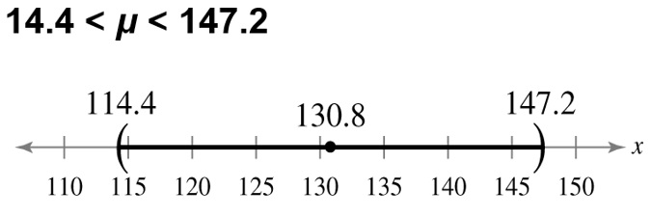
Example 1: Constructing a Confidence Interval (2 of 2)
With 95% confidence, you can say that the population mean number of friends is between 114.4 and 147.2.

Slide 22
Example 2: Constructing a Confidence Interval (1 of 4)
A college admissions director wishes to estimate the mean age of all students currently enrolled. In a random sample of 20 students, the mean age is found to be 22.9 years. From past studies, the standard deviation is known to be 1.5 years, and the population is normally distributed. Construct a 90% confidence interval of the population mean age.

Slide 23
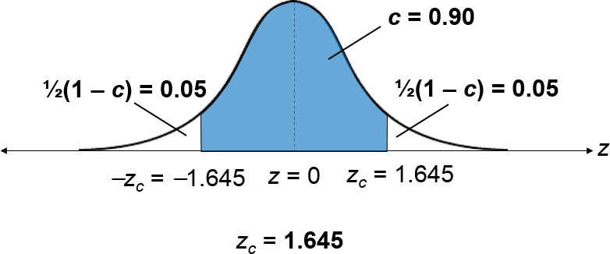
Example 2: Constructing a Confidence Interval (2 of 4)
Solution
First find the critical values

Slide 24
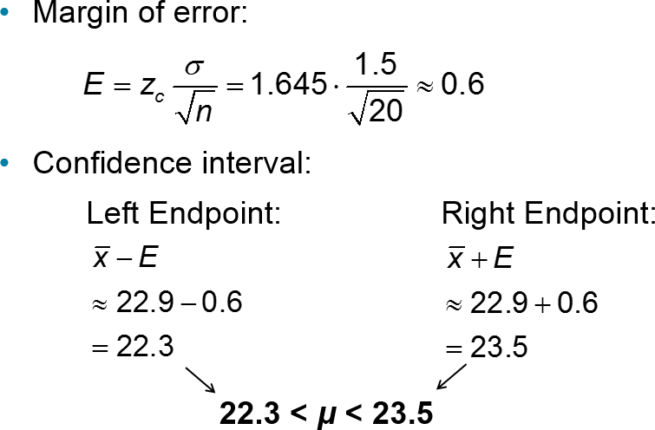
Example 2: Constructing a Confidence Interval (3 of 4)

Slide 25
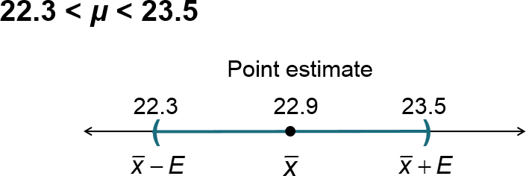
Example 2: Constructing a Confidence Interval (4 of 4)
With 90% confidence, you can say that the mean age of all the students is between 22.3 and 23.5 years.

Slide 26
Interpreting the Results (1 of 2)
μ is a fixed number. It is either in the confidence interval or not.
Incorrect: “There is a 90% probability that the actual mean is in the interval (22.3, 23.5).”
Correct: “If a large number of samples is collected and a confidence interval is created for each sample, approximately 90% of these intervals will contain μ.

Slide 27
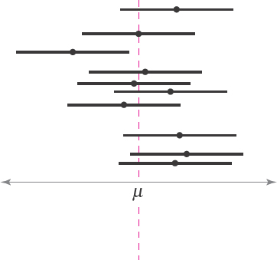
Interpreting the Results (2 of 2)
The horizontal segments represent 90% confidence intervals for different samples of the same size. In the long run, 9 of every 10 such intervals will contain μ.

Slide 28
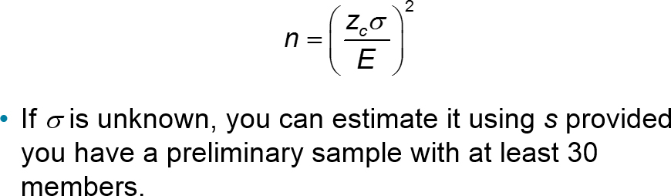
Sample Size
Given a c-confidence level and a margin of error E, the minimum sample size n needed to estimate the population mean μ is

Slide 29
Example: Determining a Minimum Sample Size (1 of 3)
You want to estimate the mean number of friends for all users of the website. How many users must be included in the sample if you want to be 95% confident that the sample mean is within seven friends of the population mean? Assume the sample standard deviation is about 53.0.

Slide 30
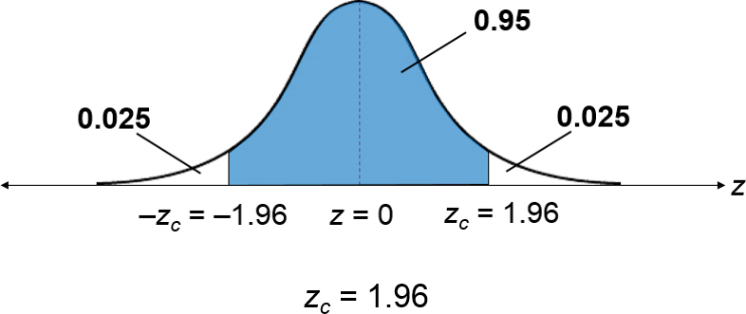
Example: Determining a Minimum Sample Size (2 of 3)
Solution
First find the critical values

Slide 31
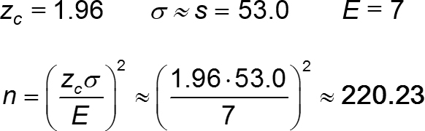
Example: Determining a Minimum Sample Size (3 of 3)
When necessary, round up to obtain a whole number.
You should include at least 221 users in your sample.

Slide 32
Section 6.1 Summary
Found a point estimate and a margin of error
Constructed and interpreted confidence intervals for the population mean
Determined the minimum sample size required when estimating μ

