Slide 1
Elementary Statistics: Picturing The World
Sixth Edition
Chapter 5
Normal Probability Distributions
Copyright © 2015, 2012, 2009 Pearson Education, Inc. All Rights Reserved

Slide 2
Chapter Outline
5.1 Introduction to Normal Distributions and the Standard Normal Distribution
5.2 Normal Distributions: Finding Probabilities
5.3 Normal Distributions: Finding Values
5.4 Sampling Distributions and the Central Limit Theorem
5.5 Normal Approximations to Binomial Distributions

Slide 3
Section 5.4
Sampling Distributions and the Central Limit Theorem

Slide 4
Section 5.4 Objectives
How to find sampling distributions and verify their properties
How to interpret the Central Limit Theorem
How to apply the Central Limit Theorem to find the probability of a sample mean

Slide 5
Sampling Distributions
Sampling distribution
The probability distribution of a sample statistic.
Formed when samples of size n are repeatedly taken from a population.
e.g. Sampling distribution of sample means

Slide 6
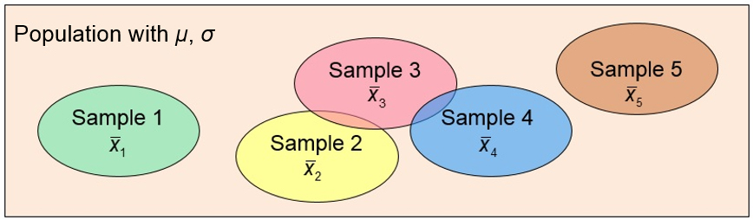
Sampling Distribution of Sample Means

Slide 7
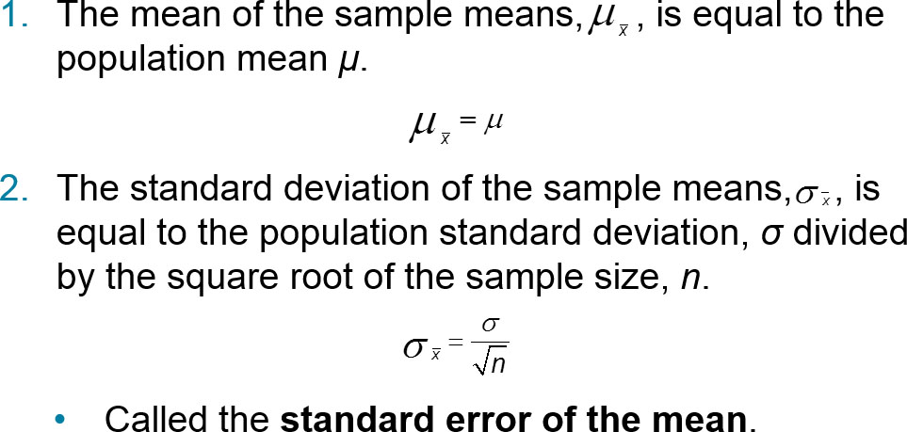
Properties of Sampling Distributions of Sample Means

Slide 8
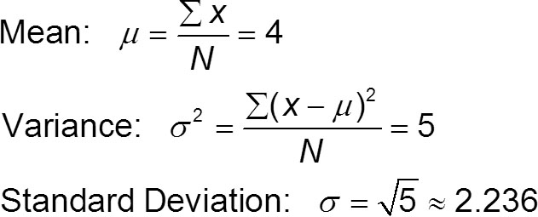
Example 1: Sampling Distribution of Sample Means
The population values {1, 3, 5, 7} are written on slips of paper and put in a box. Two slips of paper are randomly selected, with replacement.
  Find the mean, variance, and standard deviation of the population.
  Solution

Slide 9
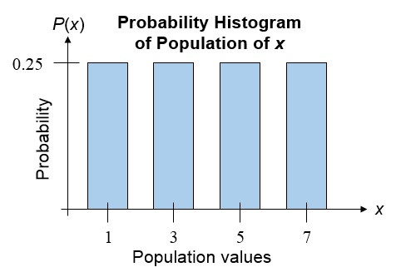
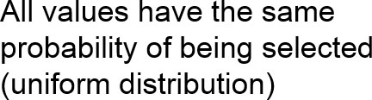
Example 2: Sampling Distribution of Sample Means
  Graph the probability histogram for the population values.
Solution

Slide 10
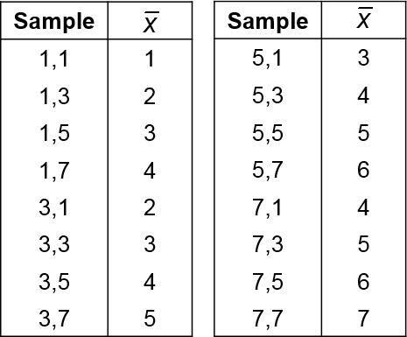
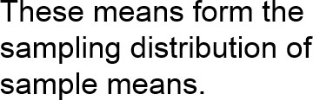
Example 3: Sampling Distribution of Sample Means
  List all the possible samples of size n = 2 and calculate the mean of each sample.
  Solution

Slide 11
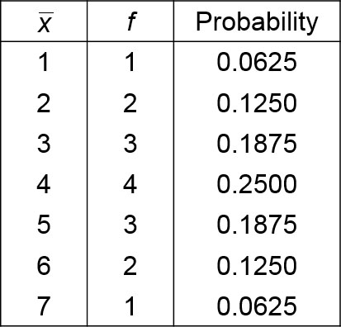
Example 4: Sampling Distribution of Sample Means
  Construct the probability distribution of the sample means.
  Solution

Slide 12
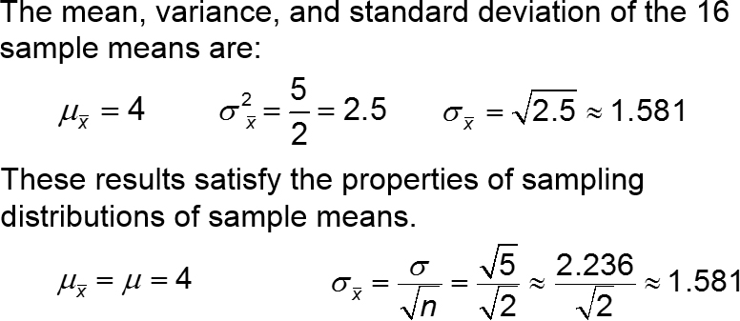
Example 5: Sampling Distribution of Sample Means
  Find the mean, variance, and standard deviation of the sampling distribution of the sample means.
Solution

Slide 13
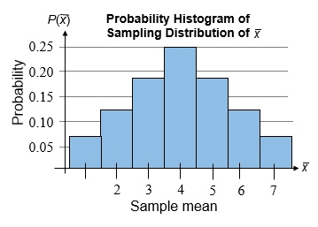
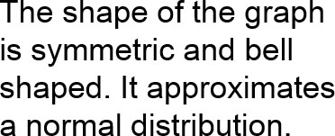
Example 6: Sampling Distribution of Sample Means
  Graph the probability histogram for the sampling distribution of the sample means.
Solution

Slide 14
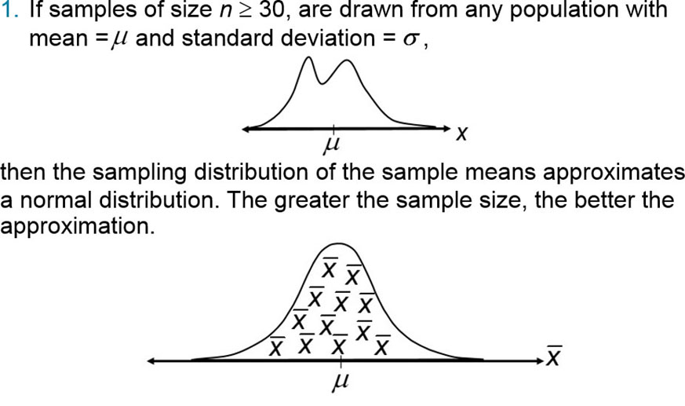
The Central Limit Theorem (1 of 4)

Slide 15
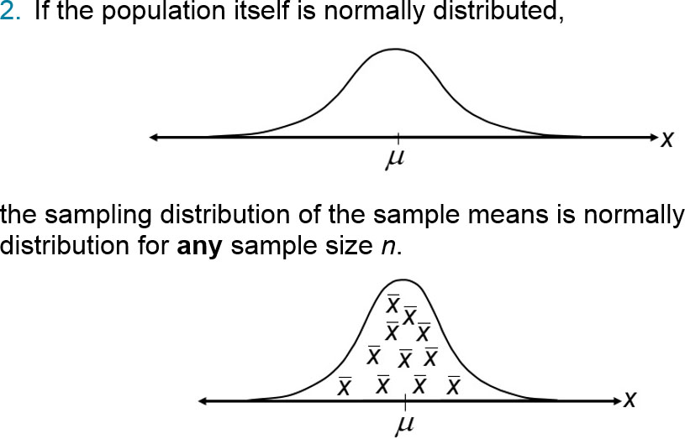
The Central Limit Theorem (2 of 4)

Slide 16
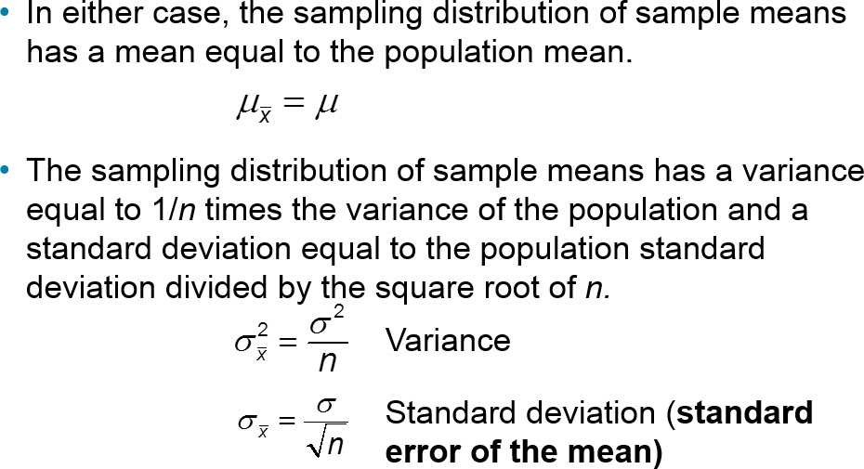
The Central Limit Theorem (3 of 4)

Slide 17
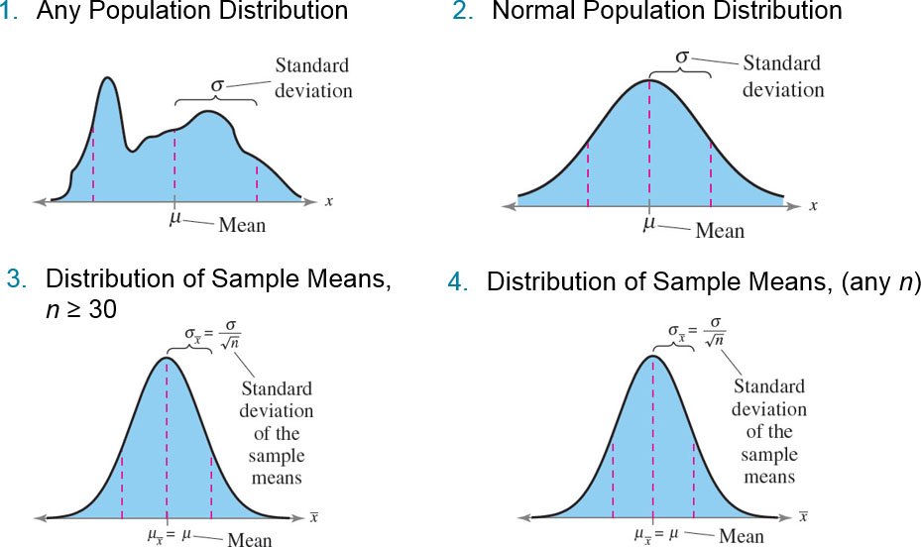
The Central Limit Theorem (4 of 4)

Slide 18
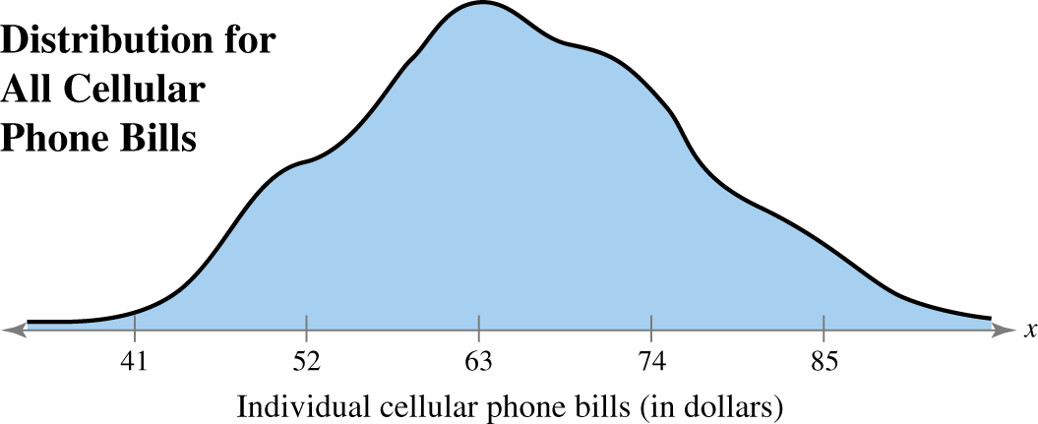
Example 1: Interpreting the Central Limit Theorem (1 of 3)
Cellular phone bills for residents of a city have a mean of $63 and a standard deviation of $11. Random samples of 100 cellular phone bills are drawn from this population and the mean of each sample is determined. Find the mean and standard error of the mean of the sampling distribution. Then sketch a graph of the sampling distribution of sample means.

Slide 19
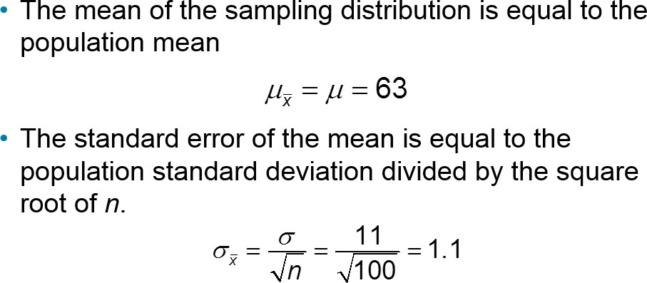
Example 1: Interpreting the Central Limit Theorem (2 of 3)

Slide 20
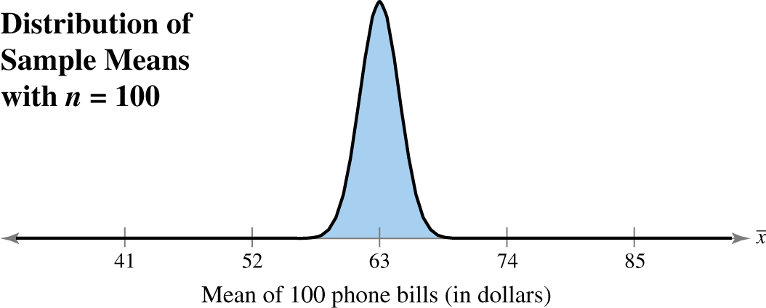
Example 1: Interpreting the Central Limit Theorem (3 of 3)
Since the sample size is greater than 30, the sampling distribution can be approximated by a normal distribution with

Slide 21
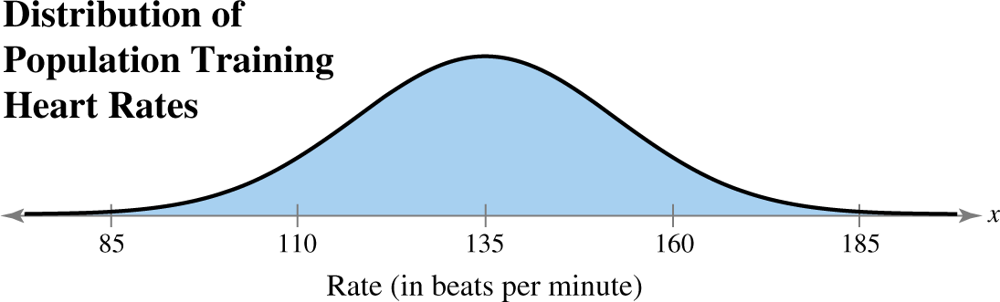
Example 2: Interpreting the Central Limit Theorem (1 of 3)
The training heart rates of all 20-years old athletes are normally distributed, with a mean of 135 beats per minute and standard deviation of 18 beats per minute. Random samples of size 4 are drawn from this population, and the mean of each sample is determined. Find the mean and standard error of the mean of the sampling distribution. Then sketch a graph of the sampling distribution of sample means.

Slide 22
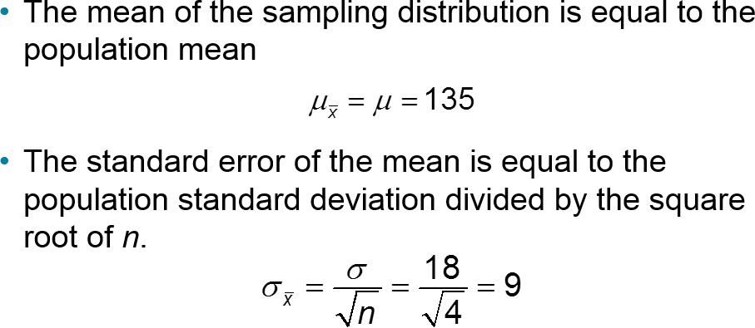
Example 2: Interpreting the Central Limit Theorem (2 of 3)

Slide 23

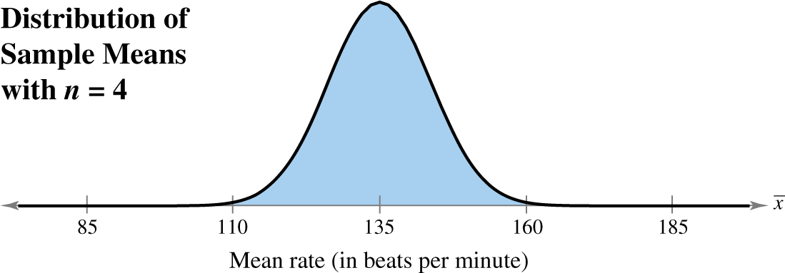
Example 2: Interpreting the Central Limit Theorem (3 of 3)
Since the population is normally distributed, the sampling distribution of the sample means is also normally distributed.

Slide 24
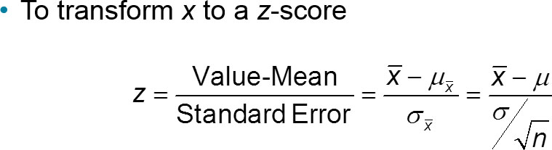
Probability and the Central Limit Theorem

Slide 25
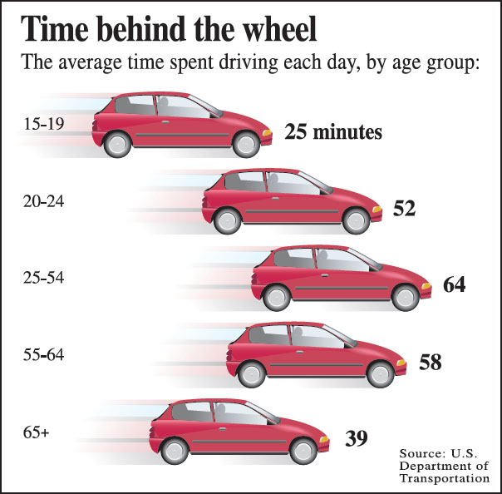
Example: Probabilities for Sampling Distributions (1 of 3)
The graph shows the length of time people spend driving each day. You randomly select 50 drivers age 15 to 19. What is the probability that the mean time they spend driving each day is between 24.7 and 25.5 minutes? Assume that σ = 1.5 minutes.

Slide 26
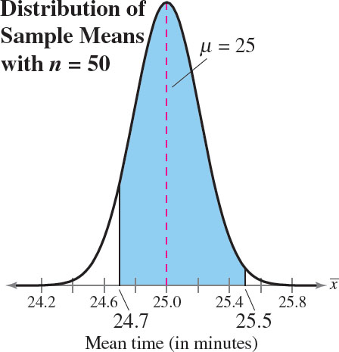
Example: Probabilities for Sampling Distributions (2 of 3)
Solution
From the Central Limit Theorem (sample size is greater than 30), the sampling distribution of sample means is approximately normal with

Slide 27
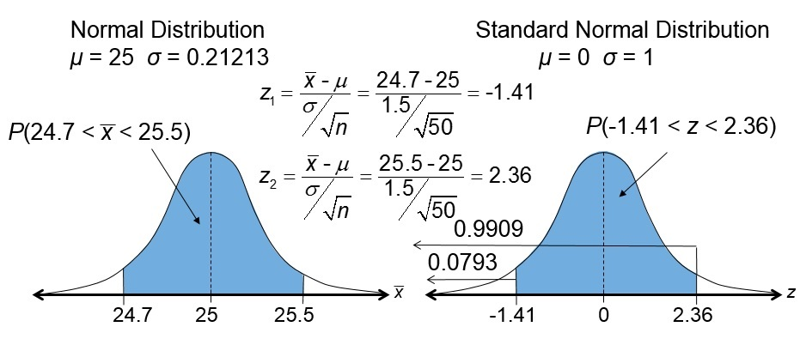

Example: Probabilities for Sampling Distributions (3 of 3)

Slide 28

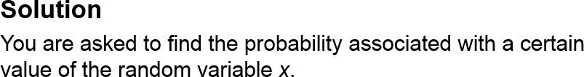
Example 1: Probabilities for x and
An education finance corporation claims that the average credit card debts carried by undergraduates are normally distributed, with a mean of $3173 and a standard deviation of $1120. (Adapted from Sallie Mae)
What is the probability that a randomly selected undergraduate, who is a credit card holder, has a credit card balance less than $2700?

Slide 29

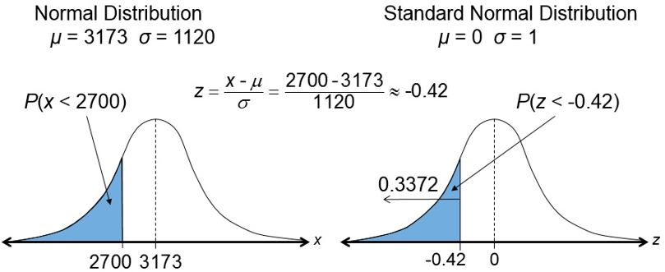
Example 1: Probabilities for x and

Slide 30

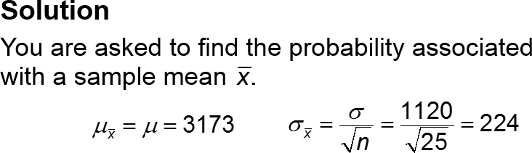
Example 2: Probabilities for x and
You randomly select 25 undergraduates who are credit card holders. What is the probability that their mean credit card balance is less than $2700?

Slide 31

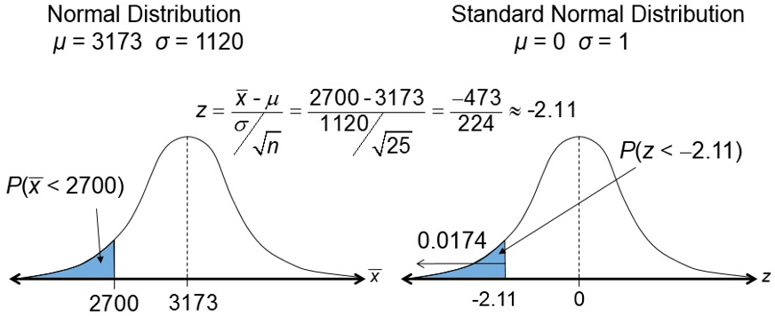

Example 2: Probabilities for x and

Slide 32

Example 2: Probabilities for x and
There is a 34% chance that an undergraduate will have a balance less than $2700.
There is only a 2% chance that the mean of a sample of 25 will have a balance less than $2700 (unusual event).
It is possible that the sample is unusual or it is possible that the corporation’s claim that the mean is $3173 is incorrect.

Slide 33
Section 5.4 Summary
Found sampling distributions and verified their properties
Interpreted the Central Limit Theorem
Applied the Central Limit Theorem to find the probability of a sample mean

