Slide 1
Elementary Statistics: Picturing The World
Sixth Edition
Chapter 5
Normal Probability Distributions
Copyright © 2015, 2012, 2009 Pearson Education, Inc. All Rights Reserved

Slide 2
Chapter Outline
5.1 introduction to Normal Distributions and the standard Normal Distributions
5.2 Normal Distributions: Finding probabilities
5.3 Normal Distributions: Finding Values
5.4 Sampling Distributions and the Central Limit Theorem
5.5 Normal approximations to binomial Distributions

Slide 3
Section 5.1
Introduction to Normal Distributions and the Standard Normal Distributions

Slide 4
Section 5.1 Objectives
How to interpret graphs of normal probability distributions
How to find areas under the standard normal curve

Slide 5
Properties of a Normal Distribution (1 of 4)
Continuous random variable
Has an infinite number of possible values that can be represented by an interval on the number line.

Slide 6
Properties of a Normal Distribution (2 of 4)
Normal distribution
A continuous probability distribution for a random variable, x.
The most important continuous probability distribution in statistics.
The graph of a normal distribution is called the normal curve.

Slide 7
Properties of a Normal Distribution (3 of 4)
The mean, median, and mode are equal.
The normal curve is bell-shaped and symmetric about the mean.
The total area under the curve is equal to one.
The normal curve approaches, but never touches the x-axis as it extends farther and farther away from the mean.

Slide 8
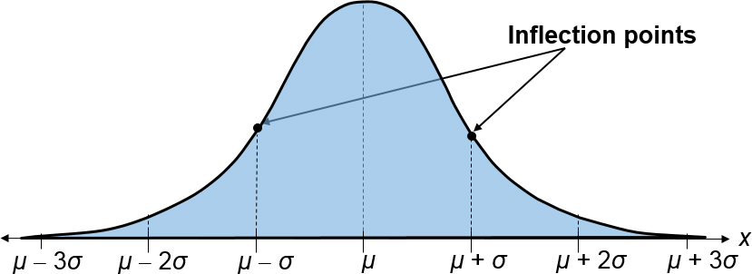
Properties of a Normal Distribution (4 of 4)
Between μ – σ and μ + σ (in the center of the curve), the graph curves downward. The graph curves upward to the left of μ – σ and to the right of μ + σ. The points at which the curve changes from curving upward to curving downward are called the inflection points.

Slide 9
Means and Standard Deviations
A normal distribution can have any mean and any positive standard deviation.
The mean gives the location of the line of symmetry.
The standard deviation describes the spread of the data.

Slide 10
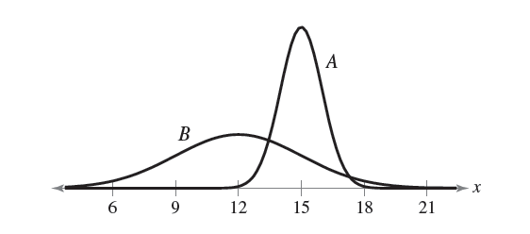
Example 1: Understanding Mean and Standard Deviation
Solution
Curve A has the greater mean (The line of symmetry of curve A occurs at x = 15. The line of symmetry of curve B occurs at x = 12.)

Slide 11
Example 2: Understanding Mean and Standard Deviation
Solution
Curve B has the greater standard deviation (Curve B is more spread out than curve A.)

Slide 12
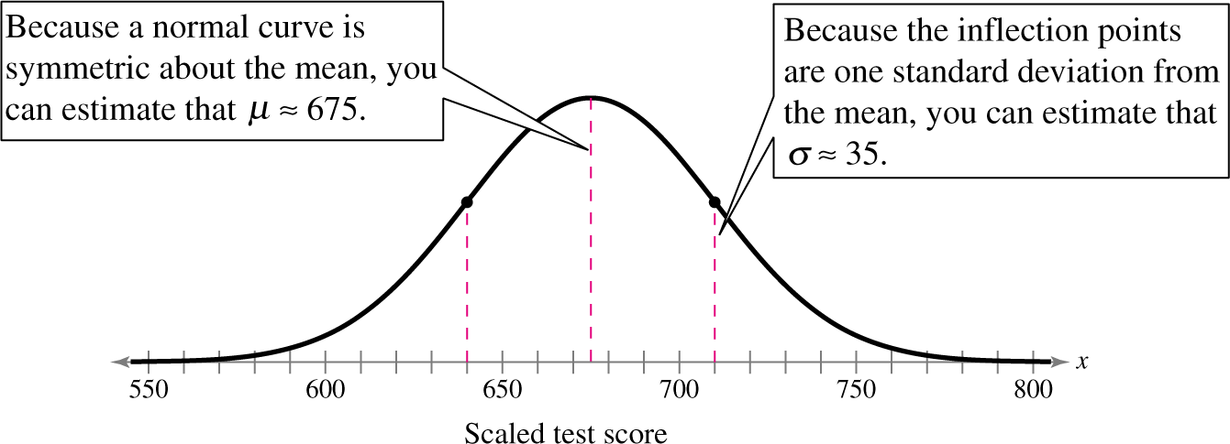
Example: Interpreting Graphs
The scaled test scores for New York State Grade 8 Mathematics Test are normally distributed. The normal curve shown below represents this distribution. Estimate the standard deviation.
Solution

Slide 13
The Standard Normal Distribution (1 of 2)
Standard normal distribution
A normal distribution with a mean of 0 and a standard deviation of 1.

Slide 14
The Standard Normal Distribution (2 of 2)
If each data value of a normally distributed random variable x is transformed into a z-score, the result will be the standard normal distribution.

Slide 15
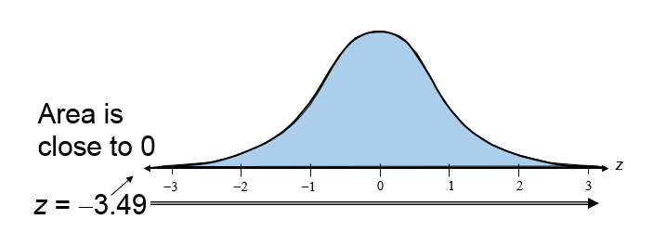
Properties of the Standard Normal Distribution (1 of 2)
The cumulative area is close to 0 for z-scores close to z = −3.49.
The cumulative area increases as the z-scores increase.

Slide 16
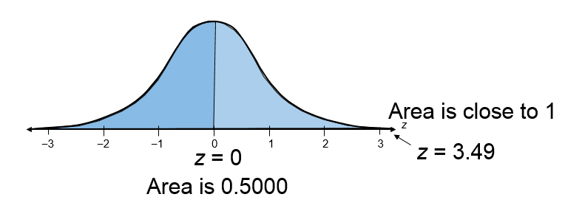
Properties of the Standard Normal Distribution (2 of 2)
The cumulative area for z = 0 is 0.5000.
The cumulative area is close to 1 for z-scores close to z = 3.49.

Slide 17
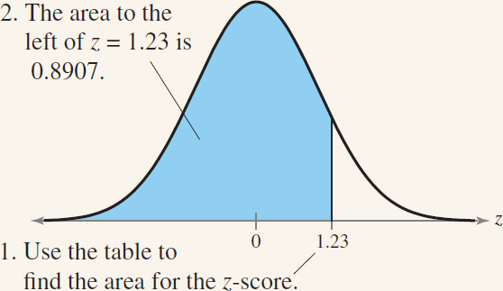
Finding Areas Under the Standard Normal Curve (1 of 7)
Sketch the standard normal curve and shade the appropriate area under the curve.
Find the area by following the directions for each case shown.
To find the area to the left of z, use the normalcdf function in the calculator. Normalcdf(-1E99,1.23,0,1)

Slide 18
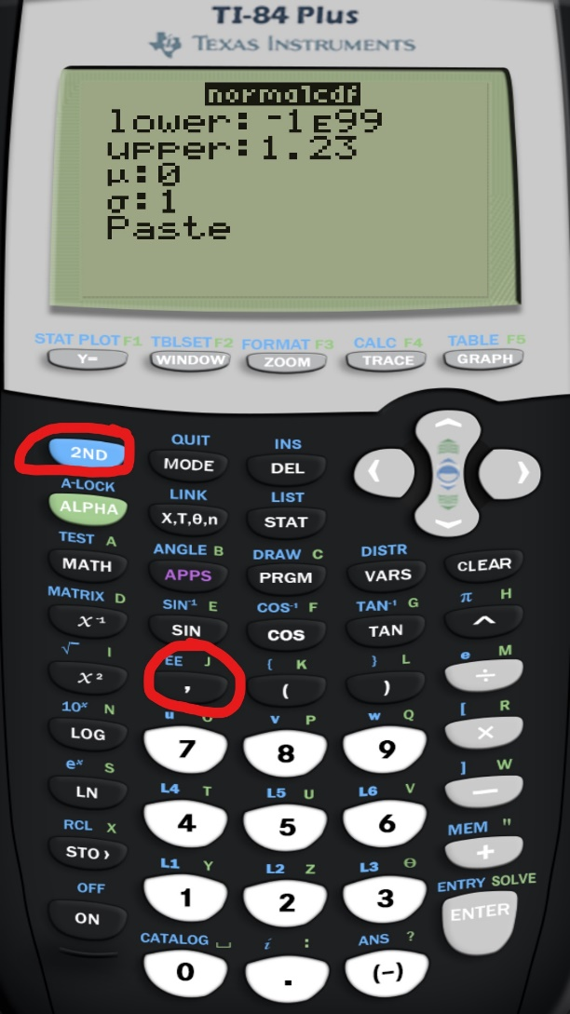
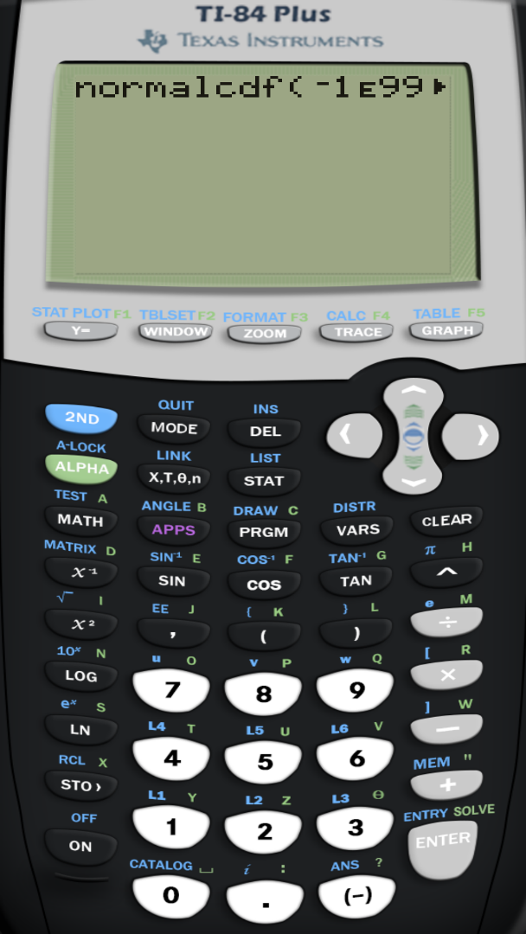
Finding Areas Under the Standard Normal Curve (2 of 7)

Slide 19
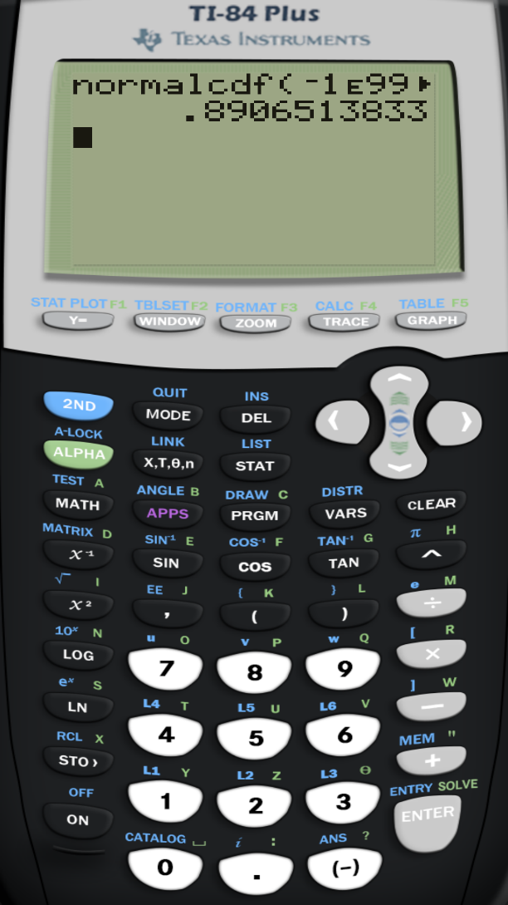
Finding Areas Under the Standard Normal Curve (3 of 7)

Slide 20
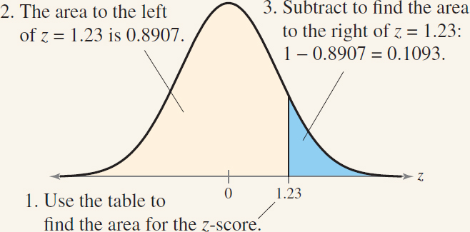
Finding Areas Under the Standard Normal Curve (4 of 7)
To find the area to the right of z, use the Standard Normal Table to find the area that corresponds to z. Then subtract the area from 1.

Slide 21
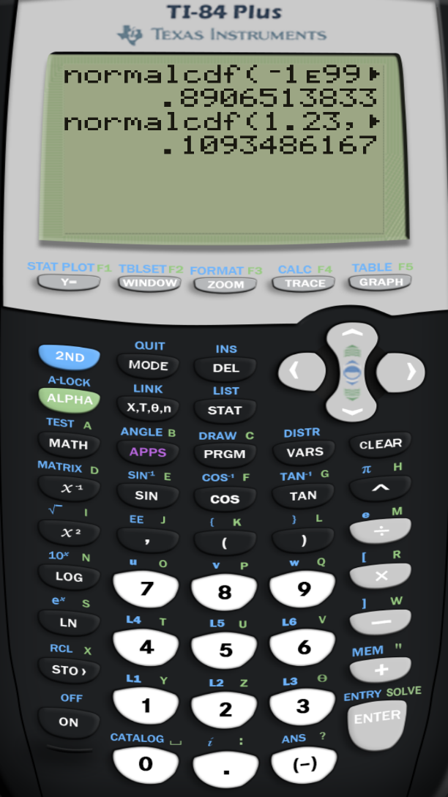
Finding Areas Under the Standard Normal Curve (5 of 7)

Slide 22
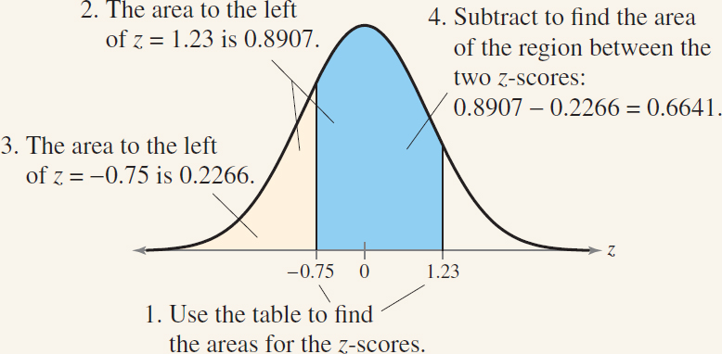
Finding Areas Under the Standard Normal Curve (6 of 7)
To find the area between two z-scores, find the area corresponding to each z-score in the Standard Normal Table. Then subtract the smaller area from the larger area.

Slide 23
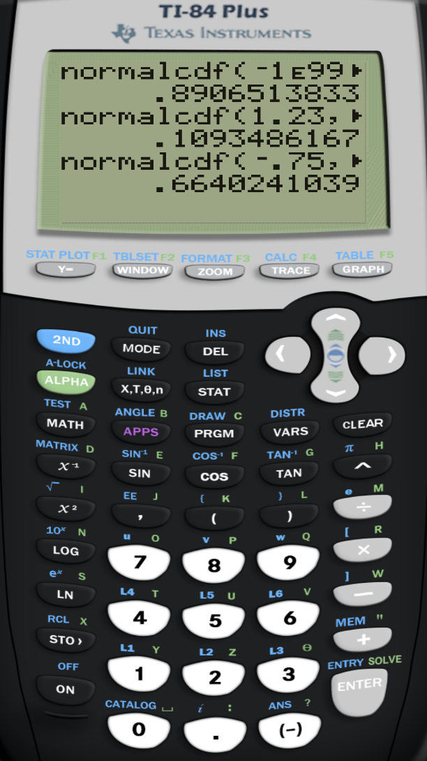
Finding Areas Under the Standard Normal Curve (7 of 7)

Slide 24
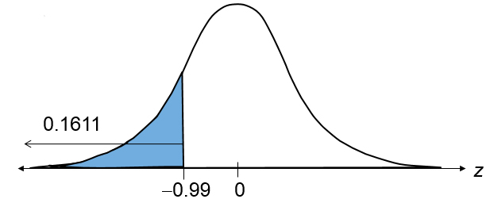
Example 1: Finding Area Under the Standard Normal Curve
Find the area under the standard normal curve to the left of z = –0.99.
Solution

Slide 25
Example 2: Finding Area Under the Standard Normal Curve
Find the area under the standard normal curve to the right of z = 1.06.
Solution

Slide 26
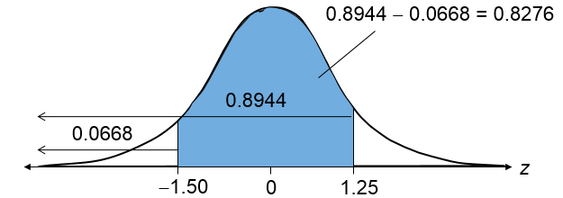
Example 3: Finding Area Under the Standard Normal Curve
Find the area under the standard normal curve between z = −1.5 and z = 1.25.
Solution

Slide 27
Section 5.1 Summary
Interpreted graphs of normal probability distributions
Found areas under the standard normal curve

