Slide 1
Elementary Statistics: Picturing The World
Sixth Edition
Chapter 4
Discrete Probability Distributions
Copyright © 2015, 2012, 2009 Pearson Education, Inc. All Rights Reserved

Slide 2
Chapter Outline
4.1 Probability Distributions
4.2 Binomial Distributions
4.3 More Discrete Probability Distributions

Slide 3
Section 4.2
Binomial Distributions

Slide 4
Section 4.2 Objectives
How to determine whether a probability experiment is a binomial experiment
How to find binomial probabilities using the binomial probability formula
How to find binomial probabilities using technology, formulas, and a binomial table
How to construct and graph a binomial distribution
How to find the mean, variance, and standard deviation of a binomial probability distribution

Slide 5
Binomial Experiments
The experiment is repeated for a fixed number of trials, where each trial is independent of other trials.
There are only two possible outcomes of interest for each trial. The outcomes can be classified as a success (S) or as a failure (F).
The probability of a success, P(S), is the same for each trial.
The random variable x counts the number of successful trials.

Slide 6
Notation for Binomial Experiments
Symbol | Description
n | The number of times a trial is repeated
p = P(S) | The probability of success in a single trial
q = P(F) | The probability of failure in a single trial (q = 1 − p)
x | The random variable represents a count of the number of successes in n trials: x = 0, 1, 2, 3, … , n.

Slide 7
Example 1: Binomial Experiments (1 of 3)
Decide whether the experiment is a binomial experiment. If it is, specify the values of n, p, and q, and list the possible values of the random variable x.
A certain surgical procedure has an 85% chance of success. A doctor performs the procedure on eight patients. The random variable represents the number of successful surgeries.

Slide 8
Example 1: Binomial Experiments (2 of 3)
Solution
Binomial Experiment
Each surgery represents a trial. There are eight surgeries, and each one is independent of the others.
There are only two possible outcomes of interest for each surgery: a success (S) or a failure (F).
The probability of a success, P(S), is 0.85 for each surgery.
The random variable x counts the number of successful surgeries.

Slide 9
Example 1: Binomial Experiments (3 of 3)
Binomial Experiment
n = 8 (number of trials)
p = 0.85 (probability of success)
q = 1 − p = 1 − 0.85 = 0.15 (probability of failure)
x = 0, 1, 2, 3, 4, 5, 6, 7, 8 (number of successful surgeries)

Slide 10
Example 2: Binomial Experiments (1 of 2)
Decide whether the experiment is a binomial experiment. If it is, specify the values of n, p, and q, and list the possible values of the random variable x.
A jar contains five red marbles, nine blue marbles, and six green marbles. You randomly select three marbles from the jar, without replacement. The random variable represents the number of red marbles.

Slide 11
Example 2: Binomial Experiments (2 of 2)
Solution
Not a Binomial Experiment
The probability of selecting a red marble on the first trial is 5/20.
Because the marble is not replaced, the probability of success (red) for subsequent trials is no longer 5/20.
The trials are not independent and the probability of a success is not the same for each trial.

Slide 12
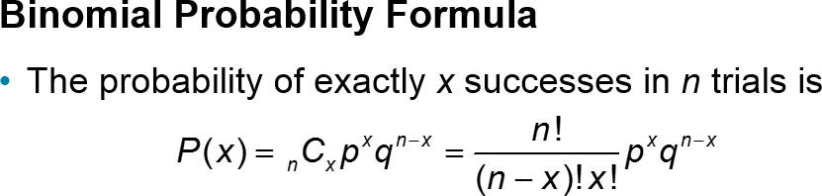
Binomial Probability Formula
n = number of trials
p = probability of success
q = 1 − p probability of failure
x = number of successes in n trials
Note: number of failures is n − x

Slide 13
Example: Finding Binomial Probabilities (1 of 5)
Microfracture knee surgery has a 75% chance of success on patients with degenerative knees. The surgery is performed on three patients. Find the probability of the surgery being successful on exactly two patients.

Slide 14
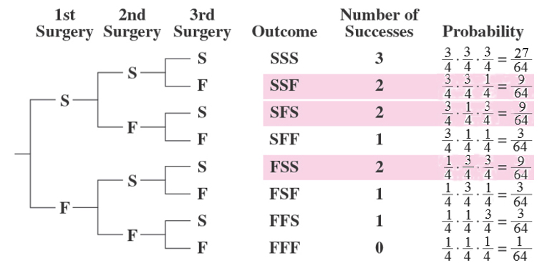

Example: Finding Binomial Probabilities (2 of 5)
Solution
Method 1: Draw a tree diagram and use the Multiplication Rule

Slide 15
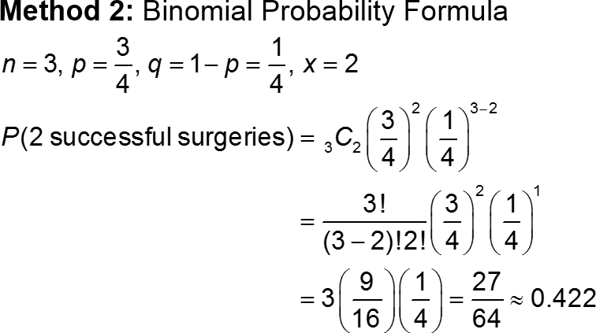
Example: Finding Binomial Probabilities (3 of 5)

Slide 16
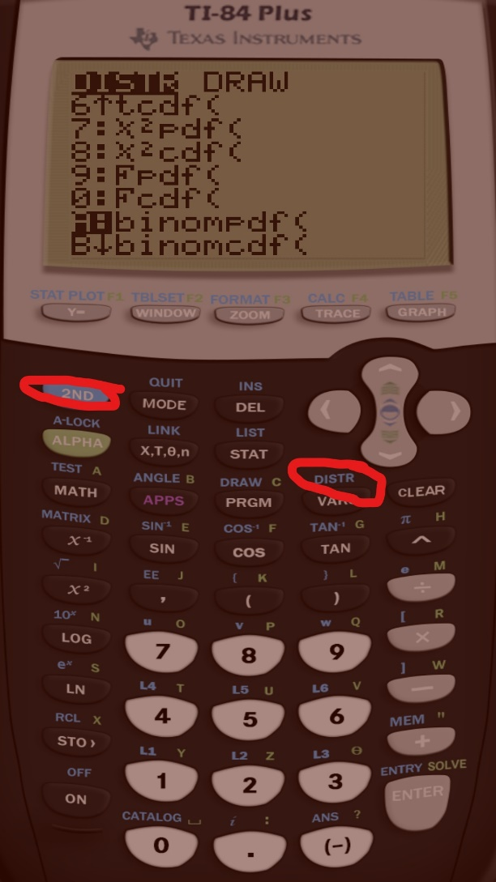
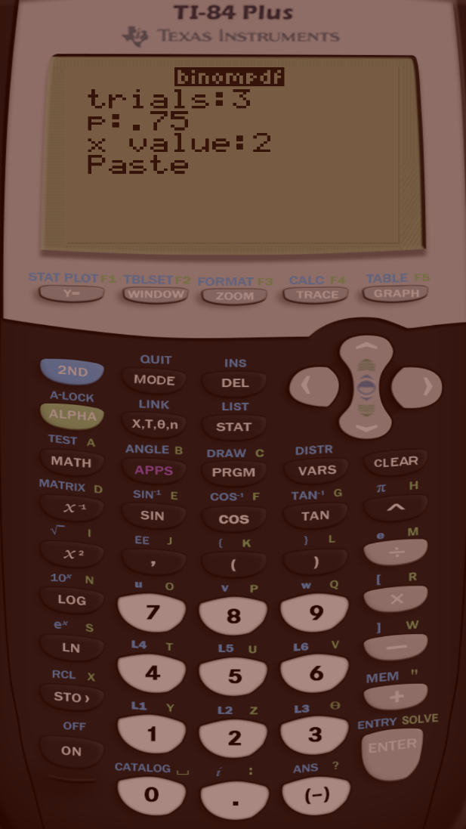
Example: Finding Binomial Probabilities using the calculator (4 of 5)

Slide 17
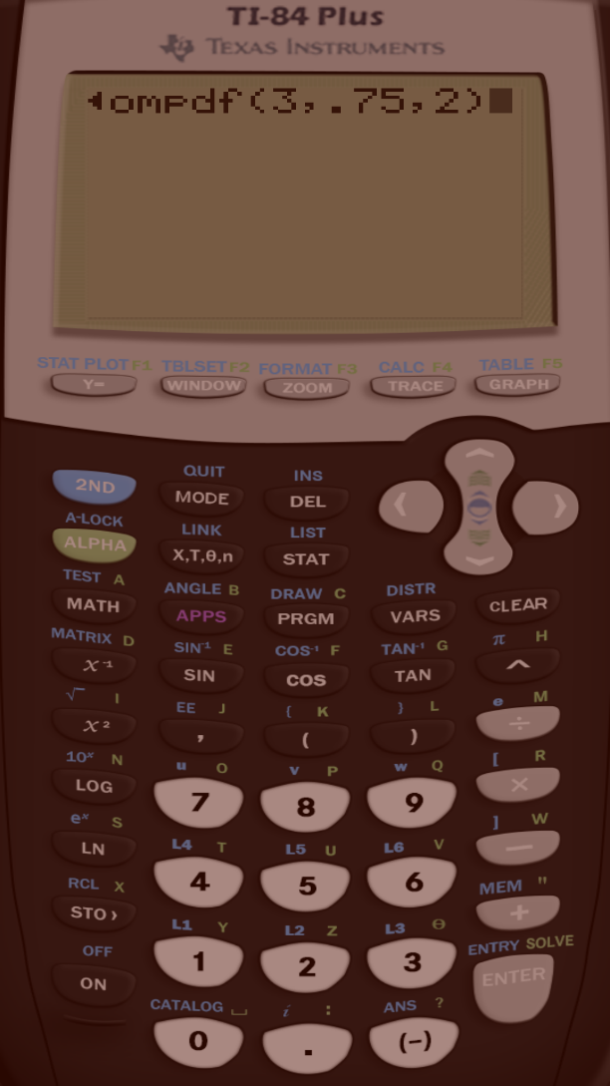
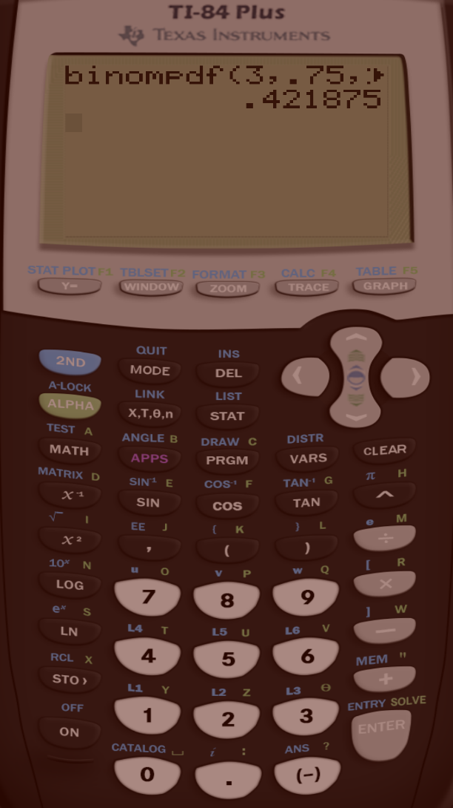
Example: Finding Binomial Probabilities using the calculator (4 of 5)

Slide 18
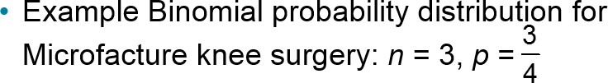

Binomial Probability Distribution
Binomial Probability Distribution
List the possible values of x with the corresponding probability of each.
x | 0 | 1 | 2 | 3
P(x) | 0.016 | 0.141 | 0.422 | 0.422

Slide 19
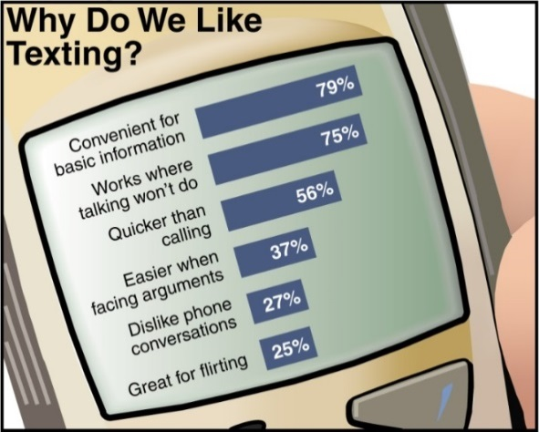
Example: Constructing a Binomial Distribution (1 of 3)
In a survey, U.S. adults were asked to give reasons why they liked texting on their cellular phones. Seven adults who participated in the survey are randomly selected and asked whether they like texting because it is quicker than Calling. Create a binomial probability distribution for the number of adults who respond yes.

Slide 20
Example: Constructing a Binomial Distribution (2 of 3)
Solution
56% of adults like texting because it is quicker than calling.
n = 7, p = 0.56, q = 0.44, x = 0, 1, 2, 3, 4, 5, 6, 7
P(x = 0) = ₇C₀(0.56)⁰(0.44)⁷ = 1(0.56)⁰(0.44)⁷ ≈ 0.0032
P(x = 1) = ₇C₁(0.56)¹(0.44)⁶ = 7(0.56)¹(0.44)⁶ ≈ 0.0284
P(x = 2) = ₇C₂(0.56)²(0.44)⁵ = 21(0.56)²(0.44)⁵ ≈ 0.1086
P(x = 3) = ₇C₃(0.56)³(0.44)⁴ = 35(0.56)³(0.44)⁴ ≈ 0.2304
P(x = 4) = ₇C₄(0.56)⁴(0.44)³ = 35(0.56)⁴(0.44)³ ≈ 0.2932
P(x = 5) = ₇C₅(0.56)⁵(0.44)² = 21(0.56)⁵(0.44)² ≈ 0.2239
P(x = 6) = ₇C₆(0.56)⁶(0.44)¹ = 7(0.56)⁶(0.44)¹ ≈ 0.0950
P(x = 7) = ₇C₇(0.56)⁷(0.44)⁰ = 1(0.56)⁷(0.44)⁰ ≈ 0.0173

Slide 21
Example: Constructing a Binomial Distribution (3 of 3)
x | P(x)
0 | 0.0032
1 | 0.0284
2 | 0.1086
3 | 0.2304
4 | 0.2932
5 | 0.2239
6 | 0.0950
7 | 0.0173
All of the probabilities are between 0 and 1 and the sum of the probabilities is 1.00001 ≈ 1.

Slide 22
Example 1: Finding Binomial Probabilities Using Technology (1 of 2)
The results of a recent survey indicate that 67% of U.S. adults consider air conditioning a necessity. If you randomly select 100 adults, what is the probability that exactly 75 adults consider air conditioning a necessity? Use a technology tool to find the probability. (Source: Opinion Research Corporation)
Solution
Binomial with n = 100, p = 0.67, x = 75

Slide 23
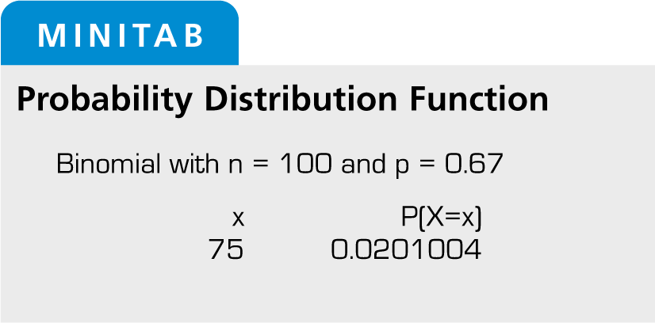
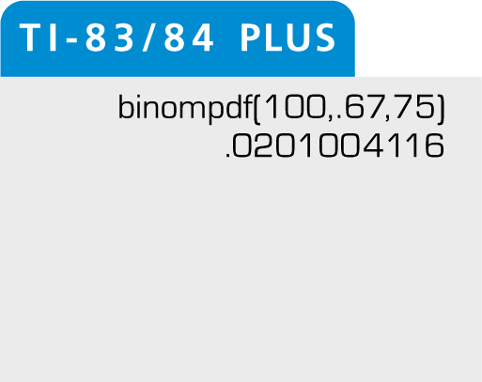
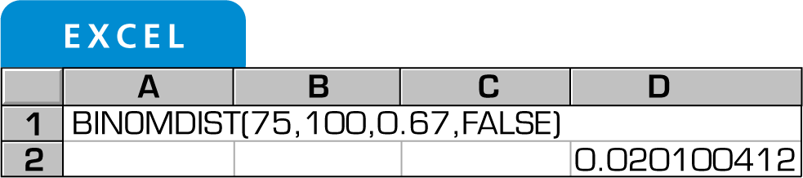
Example 1: Finding Binomial Probabilities Using Technology (2 of 2)
From the displays, you can see that the probability that exactly 75 adults consider air conditioning a necessity is about 0.02.

Slide 24
Example 1: Finding Binomial Probabilities Using Formulas (1 of 4)
A survey indicates that 41% of women in the U.S. consider reading their favorite leisure-time activity. You randomly select four U.S. women and ask them if reading is their favorite leisure-time activity. Find the probability that at least two of them respond yes.
Solution
n = 4, p = 0.41, q = 0.59
At least two means two or more.
Find the sum of P(2), P(3), and P(4).

Slide 25
Example 1: Finding Binomial Probabilities Using Formulas (2 of 4)
P(x = 2) = ₄C₂ (0.41)² (0.59)² = 6(0.41)² (0.59)² ≈ 0.351094
P(x = 3) = ₄C₃ (0.41)³ (0.59)¹ = 4(0.41)³ (0.59)¹ ≈ 0.162654
P(x = 4) = ₄C₄ (0.41)⁴ (0.59)⁰ = 1(0.41)⁴ (0.59)⁰ ≈ 0.028258
P(x ≥ 2) = P(2) + P(3) + P(4)
≈ 0.351094 + 0.162654 + 0.028258
≈ 0.542
Or
P(x ≥ 2) = 1-P(x<2) =1-P(x≤1)=1-(P(0)+P(1))

Slide 26
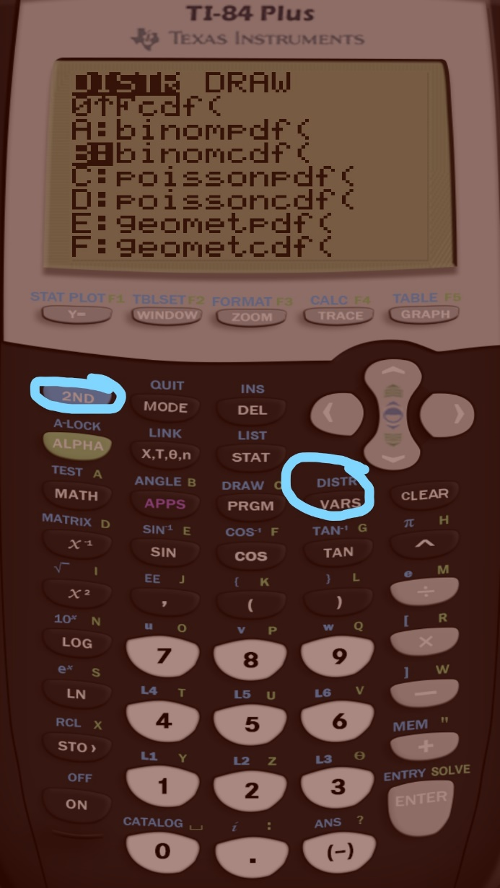
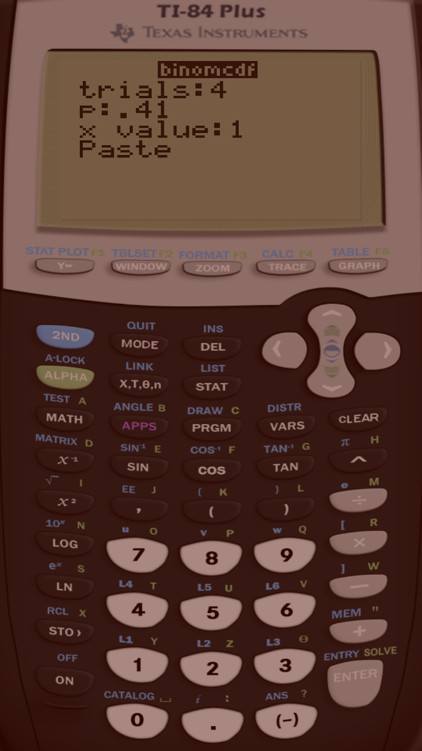
Example 1: Finding Binomial Probabilities Using the calculator (3 of 4)

Slide 27


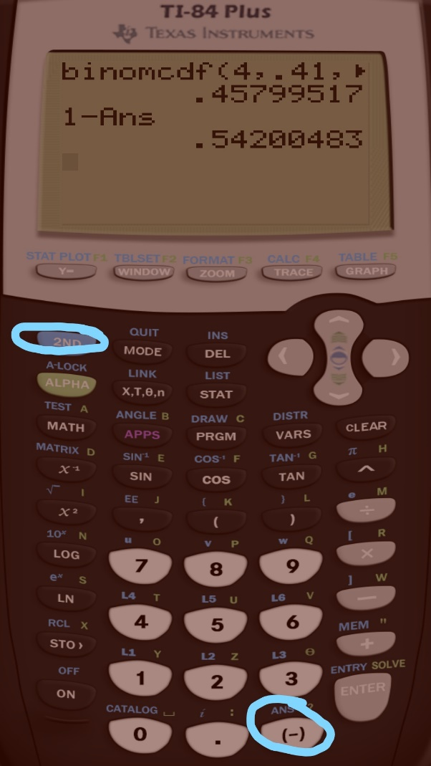
Example 1: Finding Binomial Probabilities Using the calculator (4 of 4)

Slide 28
Example 2: Finding Binomial Probabilities Using Technology (1 of 2)
The results of a recent survey indicate that 67% of U.S. adults consider air conditioning a necessity. If you randomly select 100 adults, what is the probability that exactly 75 adults consider air conditioning a necessity? Use a technology tool to find the probability. (Source: Opinion Research Corporation)
Solution
Binomial with n = 100, p = 0.67, x = 75

Slide 29
Example 2: Finding Binomial Probabilities Using Technology (2 of 2)
From the displays, you can see that the probability that exactly 75 adults consider air conditioning a necessity is about 0.02.

Slide 30
Example: Graphing a Binomial Distribution (1 of 2)
Sixty percent of households in the U.S. own a video game console. You randomly select six households and ask each if they own a video game console. Construct a probability distribution for the random variable x. Then graph the distribution. (Source: Deloitte, LLP)
Solution
n = 6, p = 0.6, q = 0.4
Find the probability for each value of x

Slide 31
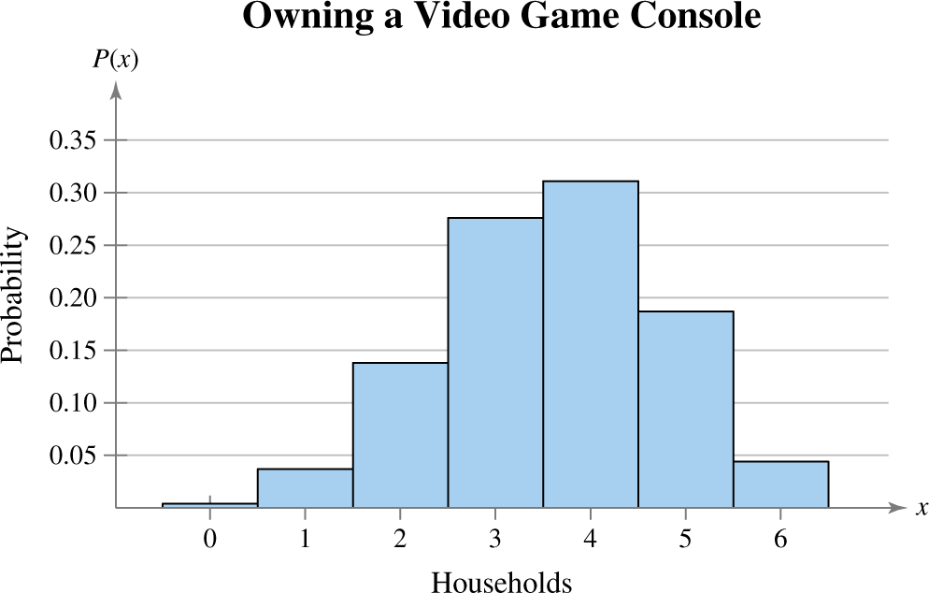
Example: Graphing a Binomial Distribution (2 of 2)
x | 0 | 1 | 2 | 3 | 4 | 5 | 6
P(x) | 0.004 | 0.037 | 0.138 | 0.276 | 0.311 | 0.187 | 0.047
Histogram:

Slide 32
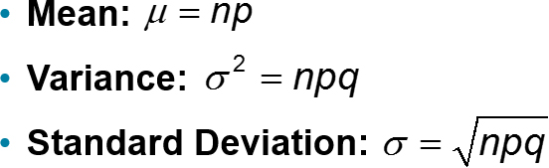
Mean, Variance, and Standard Deviation

Slide 33
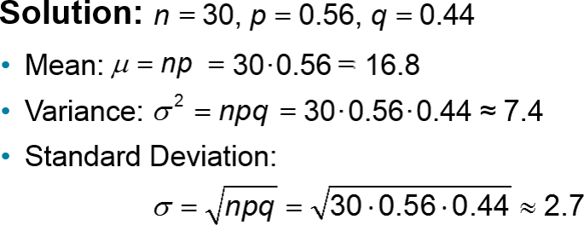
Example: Finding the Mean, Variance, and Standard Deviation (1 of 2)
In Pittsburgh, Pennsylvania, about 56% of the days in a year are cloudy. Find the mean, variance, and standard deviation for the number of cloudy days during the month of June. Interpret the results and determine any unusual values. (Source: National Climatic Data Center)

Slide 34
Example: Finding the Mean, Variance, and Standard Deviation (2 of 2)
µ = 16.8 σ² ≈ 7.4 σ ≈ 2.7
On average, there are 16.8 cloudy days during the month of June.
The standard deviation is about 2.7 days.
Values that are more than two standard deviations from the mean are considered unusual.
  16.8 – 2(2.7) =11.4; A June with 11 cloudy days or less would be unusual.
  16.8 + 2(2.7) = 22.2; A June with 23 cloudy days or more would also be unusual.

Slide 35
Section 4.2 Summary
Determined if a probability experiment is a binomial experiment
Found binomial probabilities using the binomial probability formula
Found binomial probabilities using technology, formulas, and a binomial table
Constructed and graphed a binomial distribution
Found the mean, variance, and standard deviation of a binomial probability distribution

