Slide 1
Elementary Statistics: Picturing The World
Sixth Edition
Chapter 4
Discrete Probability Distributions
Copyright © 2015, 2012, 2009 Pearson Education, Inc. All Rights Reserved

Slide 2
Chapter Outline
4.1 Probability Distributions
4.2 Binomial Distributions
4.3 More Discrete Probability Distributions

Slide 3
Section 4.1
Probability Distributions

Slide 4
Section 4.1 Objectives
How to distinguish between discrete random variables and continuous random variables
How to construct a discrete probability distribution and its graph and how to determine if a distribution is a probability distribution
How to find the mean, variance, and standard deviation of a discrete probability distribution
How to find the expected value of a discrete probability distribution

Slide 5
Random Variables (1 of 3)
Random Variable
Represents a numerical value associated with each outcome of a probability distribution.
Denoted by x
Examples
  x = Number of sales calls a salesperson makes in one day.
  x = Hours spent on sales calls in one day.

Slide 6

Random Variables (2 of 3)
Discrete Random Variable
Has a finite or countable number of possible outcomes that can be listed.
Example
  x = Number of sales calls a salesperson makes in one day.

Slide 7

Random Variables (3 of 3)
Continuous Random Variable
Has an uncountable number of possible outcomes, represented by an interval on the number line.
Example
  x = Hours spent on sales calls in one day.

Slide 8

Example 1: Random Variables
Decide whether the random variable x is discrete or continuous.
​x = The number of Fortune 500 companies that lost money in the previous year.
Solution
Discrete random variable (The number of companies that lost money in the previous year can be counted.)

Slide 9

Example 2: Random Variables
Decide whether the random variable x is discrete or continuous.
​x = The volume of gasoline in a 21-gallon tank.
Solution
Continuous random variable (The amount of gasoline in the tank can be any volume between 0 gallons and 21 gallons.)

Slide 10
Discrete Probability Distributions
Discrete probability distribution
Lists each possible value the random variable can assume, together with its probability.
Must satisfy the following conditions:
In Words | In Symbols
The probability of each value of the discrete random variable is between 0 and 1, inclusive. | 0 ≤ P(x) ≤ 1
The sum of all the probabilities is 1. | ΣP(x) = 1

Slide 11
Constructing a Discrete Probability Distribution
Let x be a discrete random variable with possible outcomes x₁, x₂, … , x_{n}.
Make a frequency distribution for the possible outcomes.
Find the sum of the frequencies.
Find the probability of each possible outcome by dividing its frequency by the sum of the frequencies.
Check that each probability is between 0 and 1 and that the sum is 1.

Slide 12
Example: Constructing a Discrete Probability Distribution (1 of 4)
An industrial psychologist administered a personality inventory test for passive-aggressive traits to 150 employees. Individuals were given a score from 1 to 5, where 1 was extremely passive and 5 extremely aggressive. A score of 3 indicated neither trait. Construct a probability distribution for the random variable x. Then graph the distribution using a histogram.
Score, x | Frequency, f
1 | 24
2 | 33
3 | 42
4 | 30
5 | 21

Slide 13
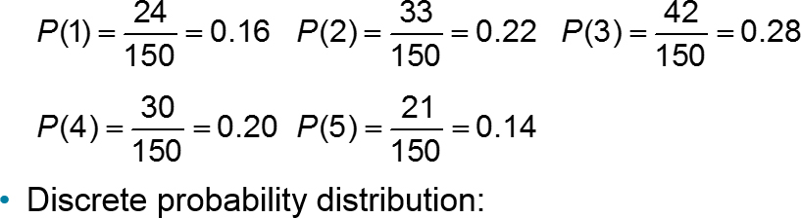
Example: Constructing a Discrete Probability Distribution (2 of 4)
Solution
Divide the frequency of each score by the total number of individuals in the study to find the probability for each value of the random variable.
x | 1 | 2 | 3 | 4 | 5
P(x) | 0.16 | 0.22 | 0.28 | 0.20 | 0.14

Slide 14
Example: Constructing a Discrete Probability Distribution (3 of 4)
x | 1 | 2 | 3 | 4 | 5
P(x) | 0.16 | 0.22 | 0.28 | 0.20 | 0.14
This is a valid discrete probability distribution since
Each probability is between 0 and 1, inclusive, 0 ≤ P(x) ≤ 1.
The sum of the probabilities equals 1, ΣP(x) = 0.16 + 0.22 + 0.28 + 0.20 + 0.14 = 1.

Slide 15
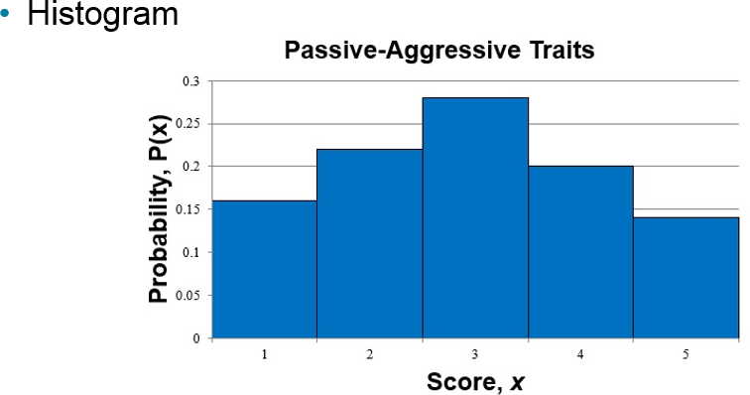
Example: Constructing a Discrete Probability Distribution (4 of 4)
Because the width of each bar is one, the area of each bar is equal to the probability of a particular outcome.

Slide 16
Mean
Mean of a discrete probability distribution
µ = ΣxP(x)
Each value of x is multiplied by its corresponding probability and the products are added.

Slide 17
Example: Finding the Mean
The probability distribution for the personality inventory test for passive-aggressive traits is given. Find the mean.
Solution
x | P(x)
1 | 0.16
2 | 0.22
3 | 0.28
4 | 0.20
5 | 0.14

Slide 18
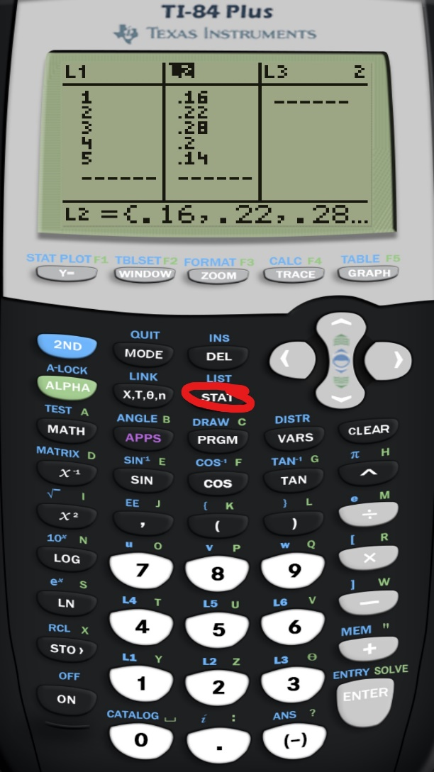
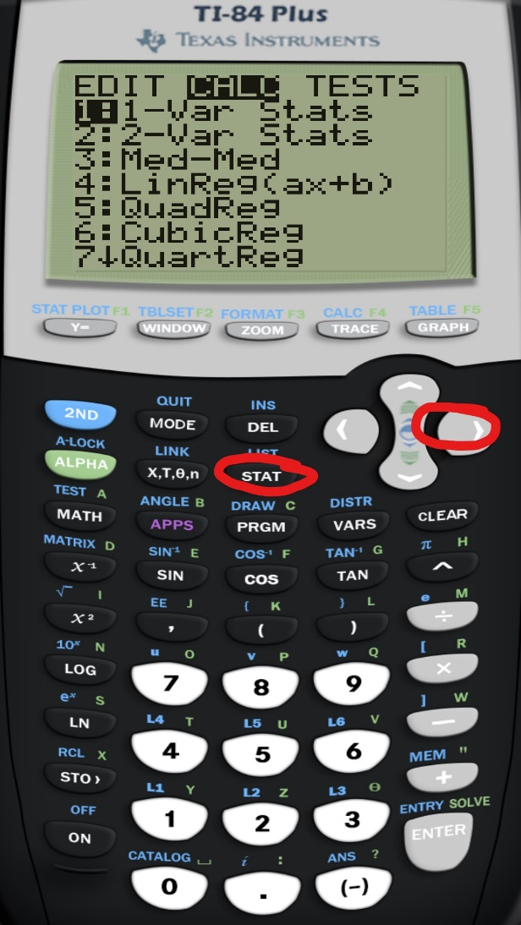
Finding the mean with a calculator

Slide 19
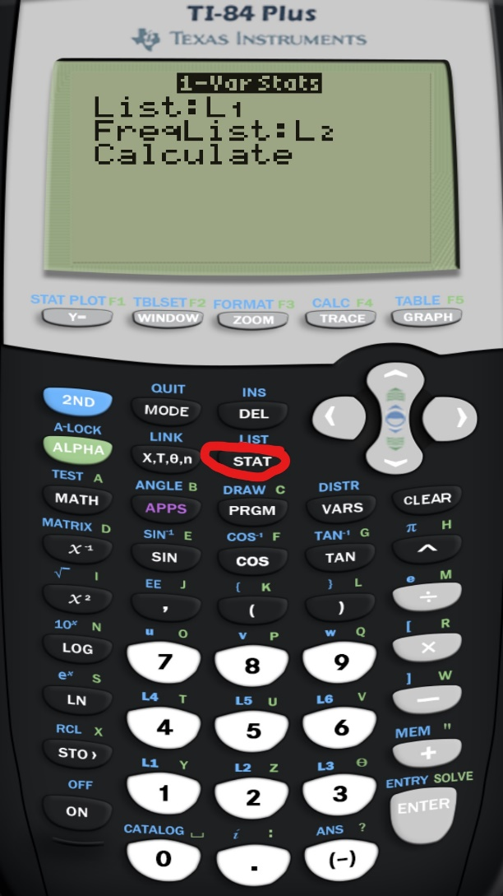
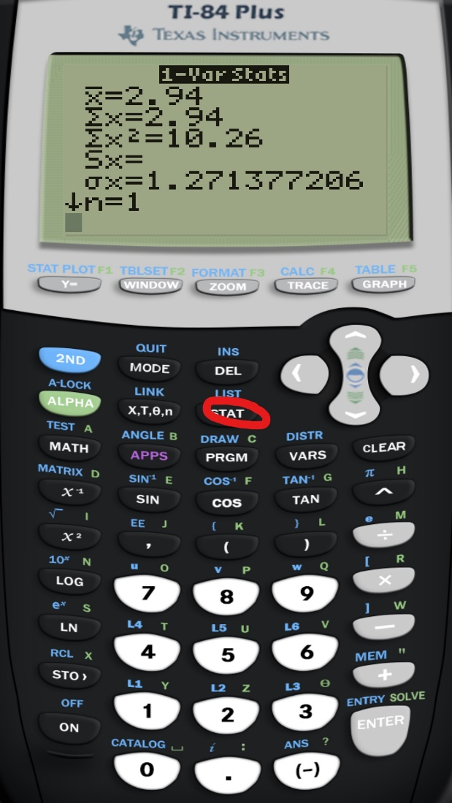
Finding the mean with a calculator

Slide 20
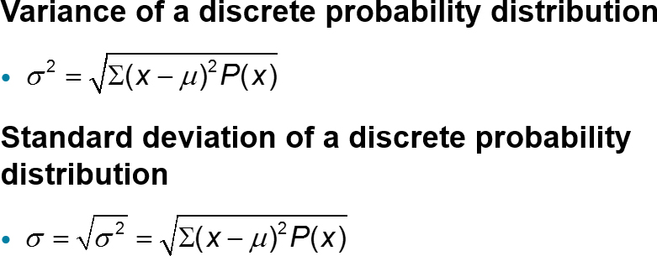
Variance and Standard Deviation

Slide 21
Example: Finding the Variance and Standard Deviation (1 of 2)
The probability distribution for the personality inventory test for passive-aggressive traits is given. Find the variance and standard deviation. (µ = 2.94)
x | P(x)
1 | 0.16
2 | 0.22
3 | 0.28
4 | 0.20
5 | 0.14

Slide 22

Example: Finding the Variance and Standard Deviation (2 of 2)
Solution
Recall (µ = 2.94)
x | P(x) | x – µ
1 | 0.16 | 1 – 2.94 = –1.94
2 | 0.22 | 2 – 2.94 = –0.94
3 | 0.28 | 3 – 2.94 = 0.06
4 | 0.20 | 4 – 2.94 = 1.06
5 | 0.14 | 5 – 2.94 = 2.06

Slide 23
Expected Value
Expected value of a discrete random variable
Equal to the mean of the random variable.
E(x) = µ = ΣxP(x)

Slide 24
Example: Finding an Expected Value (1 of 3)
At a raffle, 1500 tickets are sold at $2 each for four prizes of $500, $250, $150, and $75. You buy one ticket. What is the expected value of your gain?

Slide 25
Example: Finding an Expected Value (2 of 3)
Solution
To find the gain for each prize, subtract the price of the ticket from the prize:
  Your gain for the $500 prize is $500 – $2 = $498
  Your gain for the $250 prize is $250 – $2 = $248
  Your gain for the $150 prize is $150 – $2 = $148
  Your gain for the $75 prize is $75 – $2 = $73
  If you do not win a prize, your gain is $0 – $2 = –$2

Slide 26
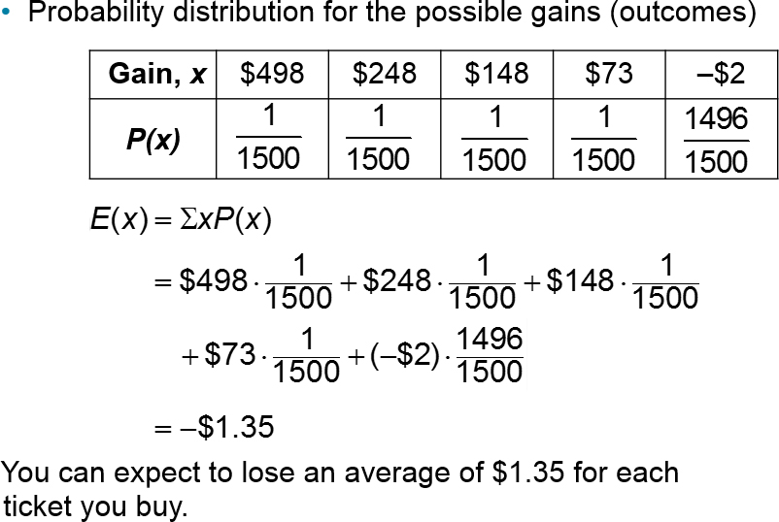
Example: Finding an Expected Value (3 of 3)

Slide 27
Section 4.1 Summary
Distinguished between discrete random variables and continuous random variables
Constructed a discrete probability distribution and its graph and determined if a distribution is a probability distribution
Found the mean, variance, and standard deviation of a discrete probability distribution
Found the expected value of a discrete probability distribution

