Slide 1
Elementary Statistics: Picturing The World
Sixth Edition
Chapter 3
Probability
Copyright © 2015, 2012, 2009 Pearson Education, Inc. All Rights Reserved

Slide 2
Chapter Outline
3.1 Basic Concepts of Probability
3.2 Conditional Probability and the Multiplication Rule
3.3 The Addition Rule
3.4 Additional Topics in Probability and Counting

Slide 3
Section 3.4
Additional Topics in Probability and Counting

Slide 4
Section 3.4 Objectives
How to find the number of ways a group of objects can be arranged in order
How to find the number of ways to choose several objects from a group without regard to order
How to use the counting principles to find probabilities

Slide 5
Permutations (1 of 2)
Permutation
An ordered arrangement of objects
The number of different permutations of n distinct objects is n! (n factorial)
  n! = n∙(n – 1)∙(n – 2)∙(n – 3)∙ ∙ ∙3∙2 ∙1
  0! = 1
  Examples:
    6! = 6∙5∙4∙3∙2∙1 = 720
    4! = 4∙3∙2∙1 = 24

Slide 6
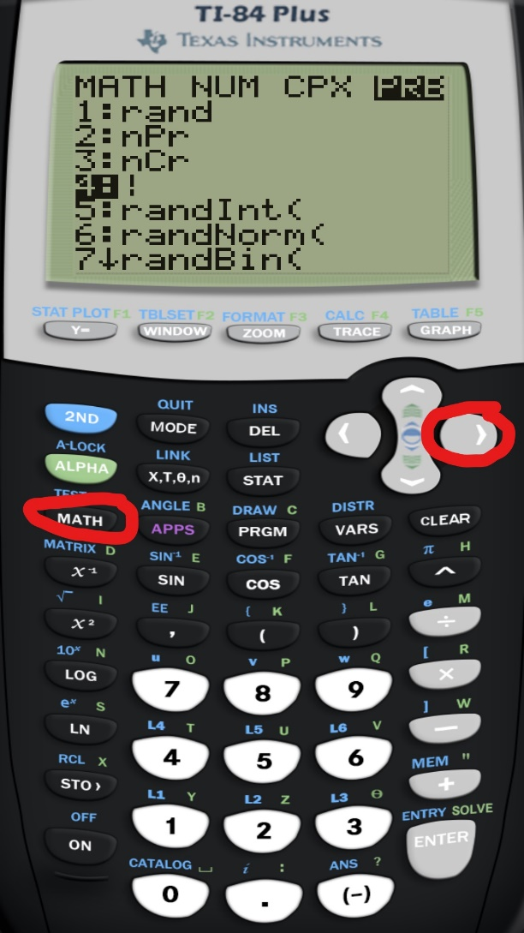
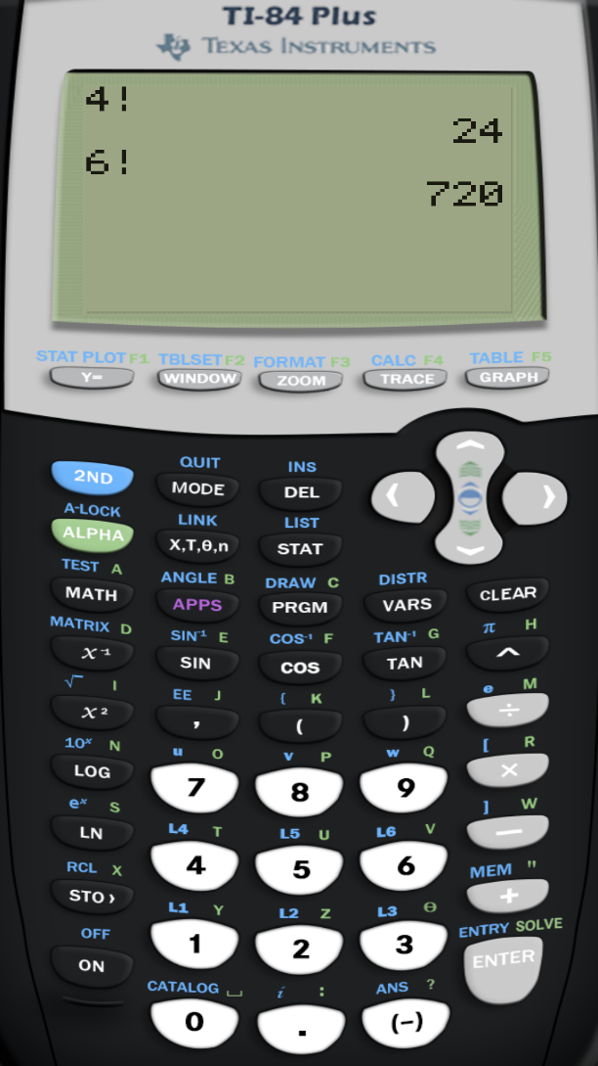
Factorial feature in the calculator

Slide 7
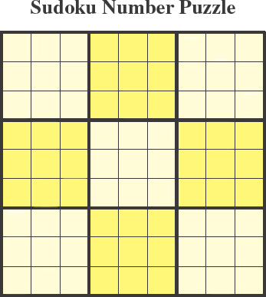
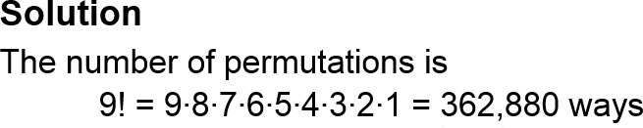
Example: Permutation of n Objects
The objective of a 9 x 9 Sudoku number puzzle is to fill the grid so that each row, each column, and each 3 x 3 grid contain the digits 1 to 9. How many different ways can the first row of a blank 9 x 9 Sudoku grid be filled?

Slide 8

Permutations (2 of 2)
Permutation of n objects taken r at a time
The number of different permutations of n distinct objects taken r at a time

Slide 9
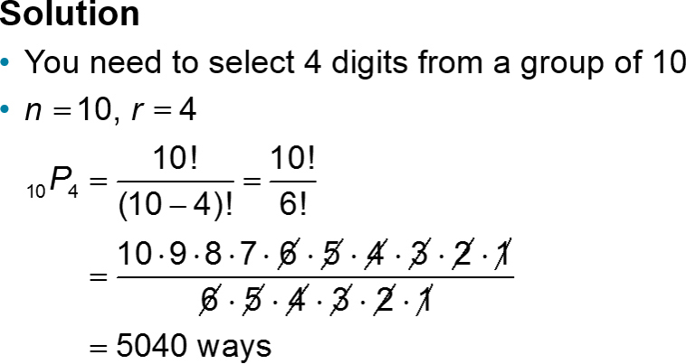
Example 1: Finding _{n}P_{r}
Find the number of ways of forming four-digit codes in which no digit is repeated.

Slide 10
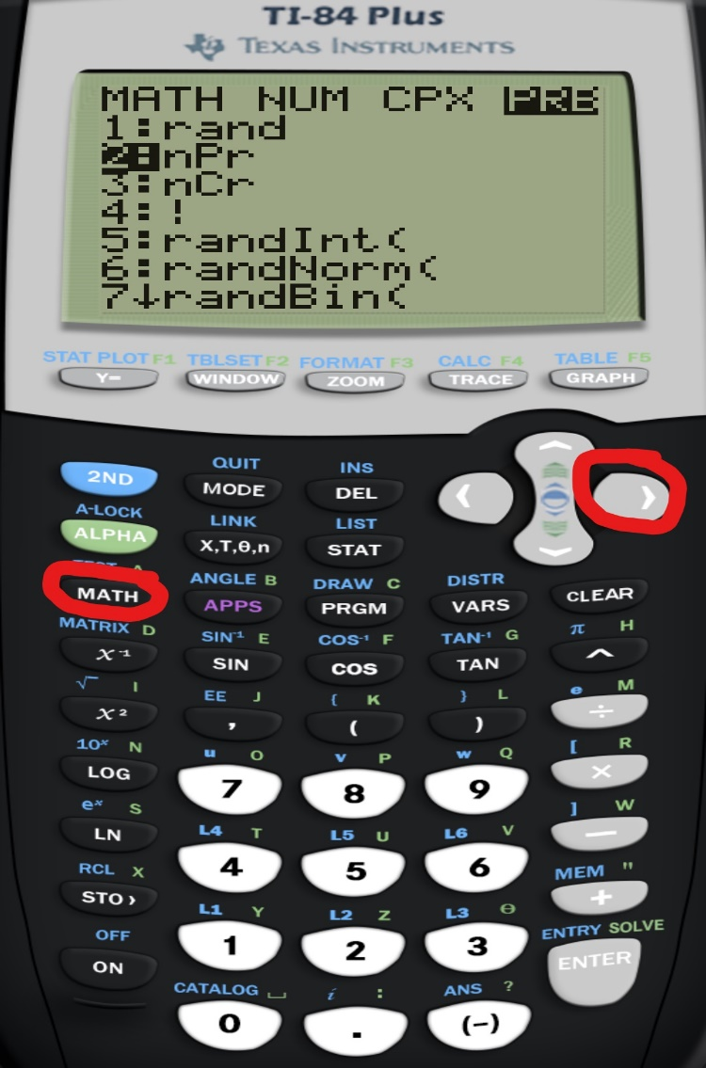
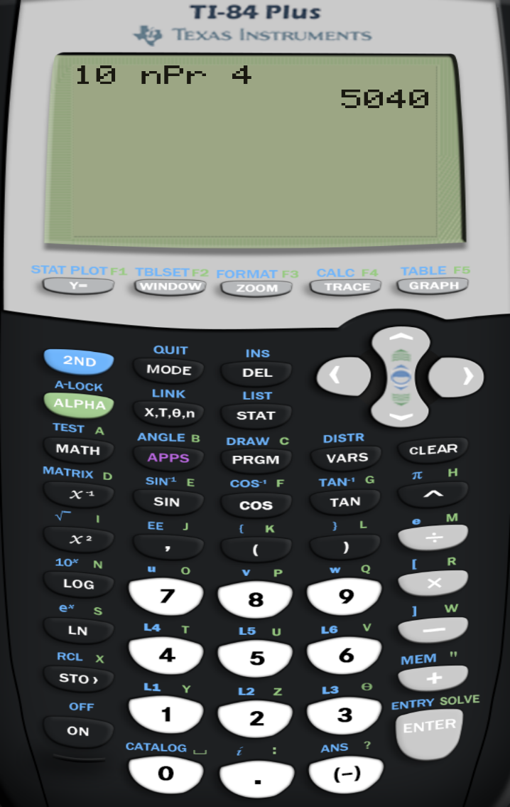
Permutation feature in the calculator

Slide 11
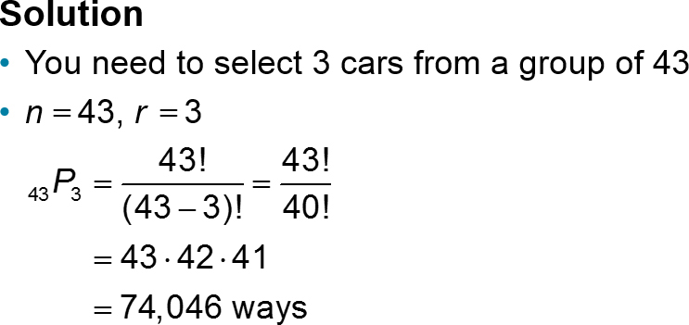
Example 2: Finding _{n}P_{r}
Forty-three race cars started the 2007 Daytona 500. How many ways can the cars finish first, second, and third?

Slide 12

Distinguishable Permutations
Distinguishable Permutations
The number of distinguishable permutations of n objects where n₁ are of one type, n₂ are of another type, and so on

Slide 13
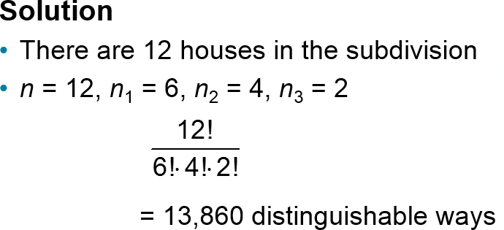
Example: Distinguishable Permutations
A building contractor is planning to develop a subdivision that consists of 6 one-story houses, 4 two-story houses, and 2 split-level houses. In how many distinguishable ways can the houses be arranged?

Slide 14
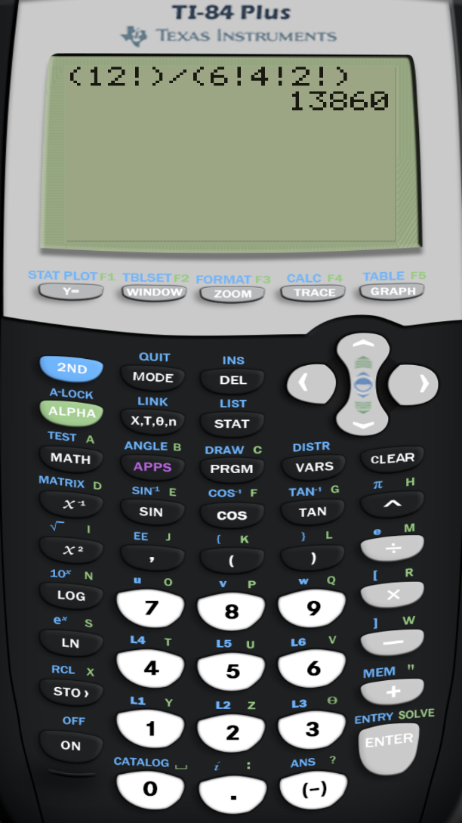
Distinguishable Permutations in the calculator

Slide 15

Combinations
Combination of n objects taken r at a time
A selection of r objects from a group of n objects without regard to order

Slide 16
Example: Combinations (1 of 2)
A state’s department of transportation plans to develop a new section of interstate highway and receives 16 bids for the project. The state plans to hire four of the bidding companies. How many different combinations of four companies can be selected from the 16 bidding companies?
Solution
You need to select 4 companies from a group of 16
n = 16, r = 4
Order is not important

Slide 17
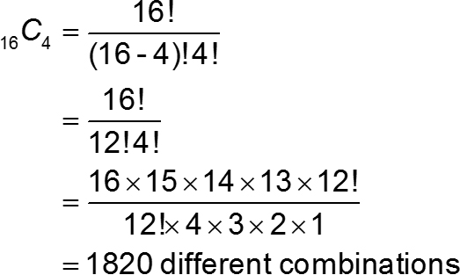

Example: Combinations (2 of 2)

Slide 18
Example 1: Finding Probabilities (1 of 2)
A student advisory board consists of 17 members. Three members serve as the board’s chair, secretary, and webmaster. Each member is equally likely to serve any of the positions. What is the probability of selecting at random the three members that hold each position?

Slide 19
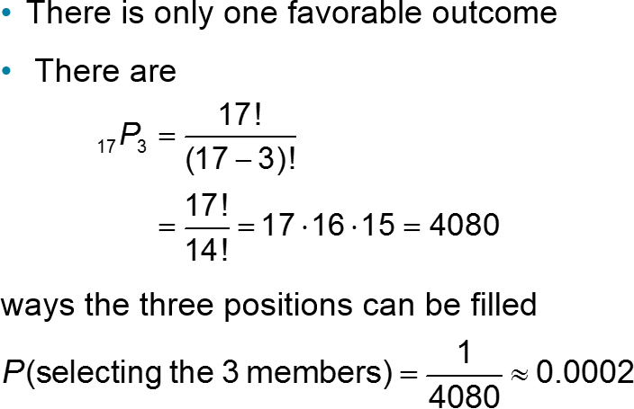
Example 1: Finding Probabilities (2 of 2)

Slide 20
Example 2: Finding Probabilities (1 of 2)
You have 11 letters consisting of one M, four Is, four Ss, and two Ps. If the letters are randomly arranged in order, what is the probability that the arrangement spells the word Mississippi?

Slide 21
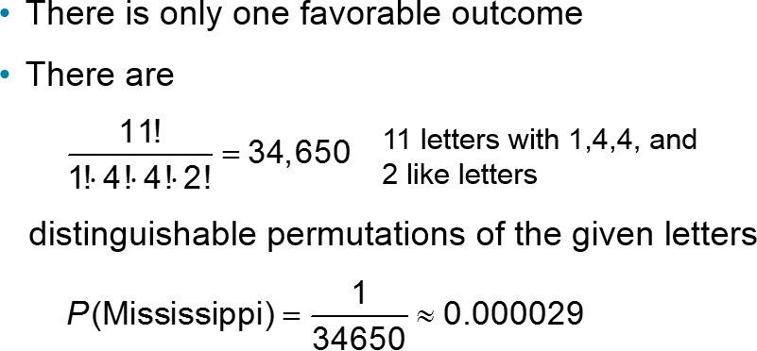
Example 2: Finding Probabilities (2 of 2)

Slide 22
Example 3: Finding Probabilities (1 of 3)
A food manufacturer is analyzing a sample of 400 corn kernels for the presence of a toxin. In this sample, three kernels have dangerously high levels of the toxin. If four kernels are randomly selected from the sample, what is the probability that exactly one kernel contains a dangerously high level of the toxin?

Slide 23
Example 3: Finding Probabilities (2 of 3)
Solution
The possible number of ways of choosing one toxic kernel out of three toxic kernels is
₃C₁ = 3
The possible number of ways of choosing three nontoxic kernels from 397 nontoxic kernels is
₃₉₇C₃ = 10,349,790
Using the Multiplication Rule, the number of ways of choosing one toxic kernel and three nontoxic kernels is
₃C₁ ∙ ₃₉₇C₃ = 3 ∙ 10,349,790 = 31,049,370

Slide 24
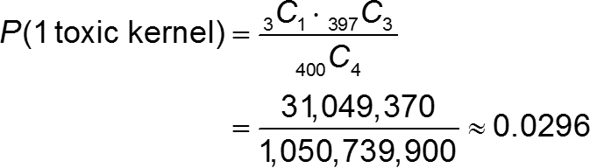
Example 3: Finding Probabilities (3 of 3)
The number of possible ways of choosing 4 kernels from 400 kernels is
₄₀₀C₄ = 1,050,739,900
The probability of selecting exactly 1 toxic kernel is

Slide 25
Section 3.4 Summary
Found the number of ways a group of objects can be arranged in order
Found the number of ways to choose several objects from a group without regard to order
Used the counting principles to find probabilities

