Slide 1
Elementary Statistics: Picturing The World
Sixth Edition
Chapter 3
Probability
Copyright © 2015, 2012, 2009 Pearson Education, Inc. All Rights Reserved

Slide 2
Chapter Outline
3.1 Basic Concepts of Probability
3.2 Conditional Probability and the Multiplication Rule
3.3 The Addition Rule
3.4 Additional Topics in Probability and Counting

Slide 3
Section 3.3
The Addition Rule

Slide 4
Section 3.3 Objectives
How to determine whether two events are mutually exclusive
How to use the Addition Rule to find the probability of two events

Slide 5
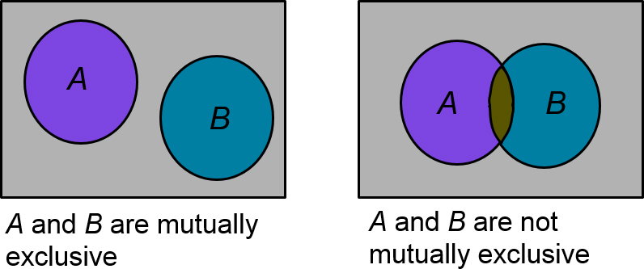
Mutually Exclusive Events
Mutually exclusive
Two events A and B cannot occur at the same time

Slide 6

Example 1: Mutually Exclusive Events
Solution
Mutually exclusive (The first event has one outcome, a 3. The second event also has one outcome, a 4. These outcomes cannot occur at the same time.)

Slide 7

Example 2: Mutually Exclusive Events
Decide if the events are mutually exclusive.
Event A: Randomly select a male student.
Event B: Randomly select a nursing major.

Slide 8
The Addition Rule
Addition rule for the probability of A or B
The probability that events A or B will occur is
  P(A or B) = P(A) + P(B) – P(A and B)
For mutually exclusive events A and B, the rule can be simplified to
  P(A or B) = P(A) + P(B)
  Can be extended to any number of mutually exclusive events

Slide 9

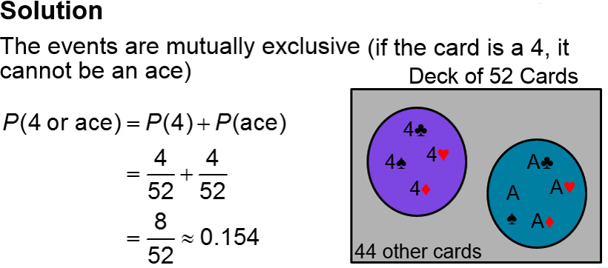
Example 1: Using the Addition Rule
You select a card from a standard deck. Find the probability that the card is a 4 or an ace.

Slide 10
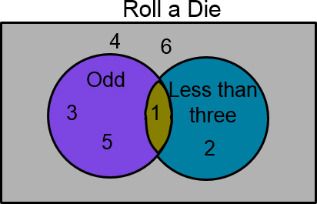
Example 2: Using the Addition Rule (1 of 2)
You roll a die. Find the probability of rolling a number less than 3 or rolling an odd number.
Solution
The events are not mutually exclusive (1 is an outcome of both events)

Slide 11
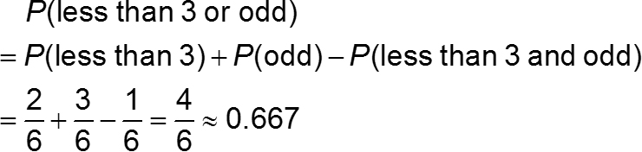
Example 2: Using the Addition Rule (2 of 2)

Slide 12
Example 3: Using the Addition Rule (1 of 2)
The frequency distribution shows the volume of sales (in dollars) and the number of months a sales representative reached each sales level during the past three years. If this sales pattern continues, what is the probability that the sales representative will sell between $75,000 and $124,999 next month?
Sales volume ($) | Months
0–24,999 | 3
25,000–49,999 | 5
50,000–74,999 | 6
75,000–99,999 | 7
100,000–124,999 | 9
125,000–149,999 | 2
150,000–174,999 | 3
175,000–199,999 | 1

Slide 13
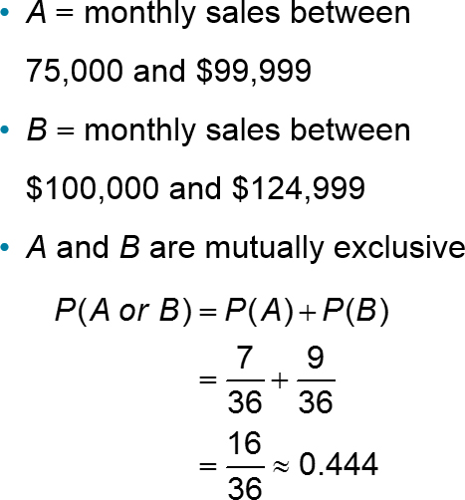
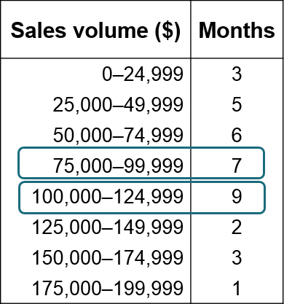
Example 3: Using the Addition Rule (2 of 2)

Slide 14
Example 4: Using the Addition Rule (1 of 2)
A blood bank catalogs the types of blood given by donors during the last five days. A donor is selected at random. Find the probability the donor has type O or type A blood.
blank | Type O | Type A | Type B | Type AB | Total
Rh-Positive | 156 | 139 | 37 | 12 | 344
Rh-Negative | 28 | 25 | 8 | 4 | 65
Total | 184 | 164 | 45 | 16 | 409

Slide 15
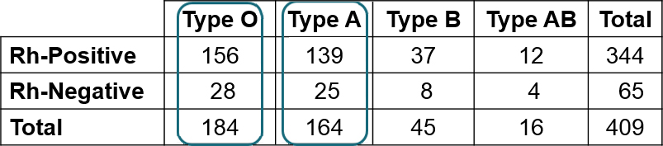
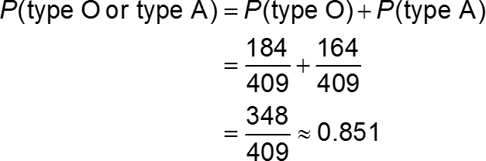
Example 4: Using the Addition Rule (2 of 2)
Solution
The events are mutually exclusive (a donor cannot have type O blood and type A blood)

Slide 16
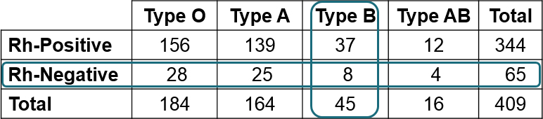
Example 5: Using the Addition Rule (1 of 2)
Solution
The events are not mutually exclusive (a donor can have type B blood and be Rh-negative)

Slide 17
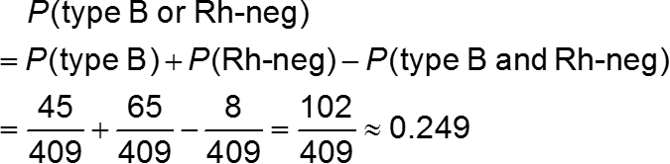
Example 5: Using the Addition Rule (2 of 2)

Slide 18
Section 3.3 Summary
Determined if two events are mutually exclusive
Used the Addition Rule to find the probability of two events

