Slide 1
Elementary Statistics: Picturing The World
Sixth Edition
Chapter 3
Probability
Copyright © 2015, 2012, 2009 Pearson Education, Inc. All Rights Reserved

Slide 2
Chapter Outline
3.1 Basic Concepts of Probability
3.2 Conditional Probability and the Multiplication Rule
3.3 The Addition Rule
3.4 Additional Topics in Probability and Counting

Slide 3
Section 3.1
Basic Concepts of Probability

Slide 4
Section 3.1 Objectives
How to identify the sample space of a probability experiment and how to identify simple events
How to use the Fundamental Counting Principle to find the number of ways two or more events can occur
How to distinguish among classical probability, empirical probability, and subjective probability
How to find the probability of the complement of an event
How to use a tree diagram and the Fundamental Counting Principle to find probabilities

Slide 5
Probability Experiments (1 of 2)
Probability experiment
An action, or trial, through which specific results (counts, measurements, or responses) are obtained.
Outcome
The result of a single trial in a probability experiment.
Sample Space
The set of all possible outcomes of a probability experiment
Event
Consists of one or more outcomes and is a subset of the sample space.

Slide 6
Probability Experiments (2 of 2)
Probability experiment: Roll a die
Outcome: {3}
Sample space: {1, 2, 3, 4, 5, 6}
Event: {Die is even} = {2, 4, 6}

Slide 7


Example: Identifying the Sample Space (1 of 2)
Solution
There are two possible outcomes when tossing a coin: a head (H) or a tail (T). For each of these, there are six possible outcomes when rolling a die: 1, 2, 3, 4, 5, or 6. One way to list outcomes for actions occurring in a sequence is to use a tree diagram.

Slide 8
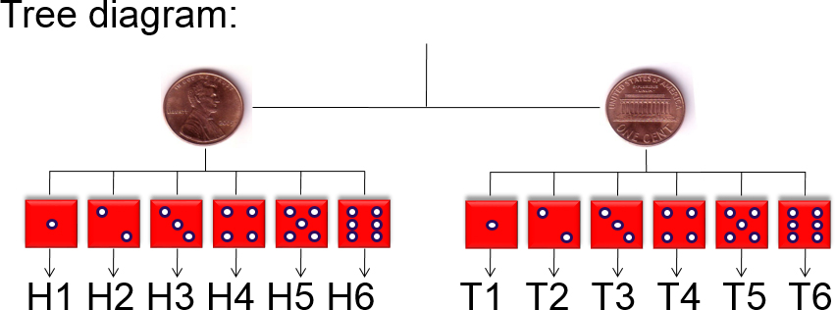
Example: Identifying the Sample Space (2 of 2)
The sample space has 12 outcomes:
{H1, H2, H3, H4, H5, H6, T1, T2, T3, T4, T5, T6}

Slide 9
Simple Events
Simple event
An event that consists of a single outcome.
  e.g. “Tossing heads and rolling a 3” {H3}
An event that consists of more than one outcome is not a simple event.
  e.g. “Tossing heads and rolling an even number” {H2, H4, H6}

Slide 10

Example: Identifying Simple Events
Determine whether the event is simple or not.
You roll a six-sided die. Event B is rolling at least a 4.
Solution
Not simple (event B has three outcomes: rolling a 4, a 5, or a 6)

Slide 11
Fundamental Counting Principle
Fundamental Counting Principle
If one event can occur in m ways and a second event can occur in n ways, the number of ways the two events can occur in sequence is m ∙ n.
Can be extended for any number of events occurring in sequence.

Slide 12
Example: Fundamental Counting Principle (1 of 2)
You are purchasing a new car. The possible manufacturers, car sizes, and colors are listed.
  Manufacturer: Ford, GM, Honda
  Car size: compact, midsize
  Color: white (W), red (R), black (B), green (G)
How many different ways can you select one manufacturer, one car size, and one color? Use a tree diagram to check your result.

Slide 13
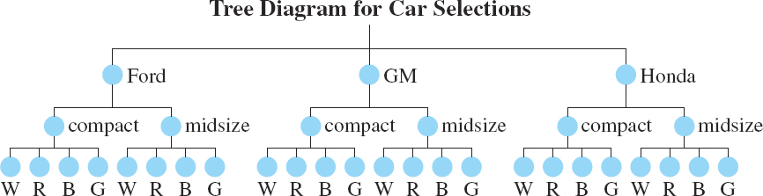
Example: Fundamental Counting Principle (2 of 2)
Solution
There are three choices of manufacturers, two car sizes, and four colors.
Using the Fundamental Counting Principle:
3 ∙ 2 ∙ 4 = 24 ways

Slide 14

Types of Probability (1 of 3)
Classical (theoretical) Probability
Each outcome in a sample space is equally likely.

Slide 15


Example: Finding Classical Probabilities (1 of 2)
You roll a six-sided die. Find the probability of each event.
Event A: rolling a 3
Event B: rolling a 7
Event C: rolling a number less than 5

Slide 16
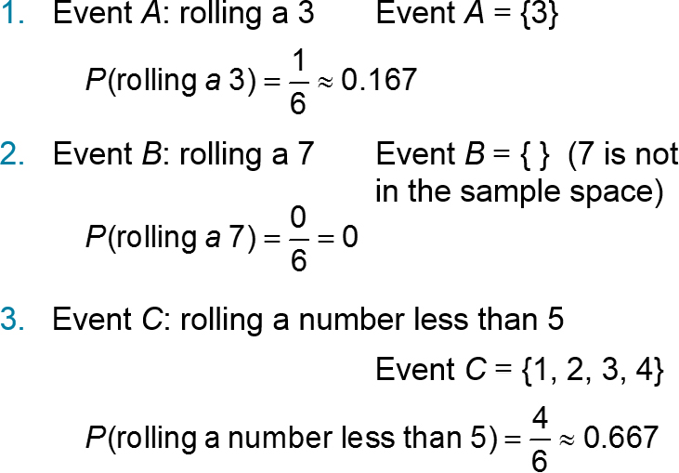
Example: Finding Classical Probabilities (2 of 2)

Slide 17

Types of Probability (2 of 3)
Empirical (statistical) Probability
Based on observations obtained from probability experiments.
Relative frequency of an event.

Slide 18
Example: Finding Empirical Probabilities (1 of 2)
A company is conducting a telephone survey of randomly selected individuals to get their overall impressions of the past decade (2000s). So far, 1504 people have been surveyed. What is the probability that the next person surveyed has a positive overall impression of the 2000s? (Source: Princeton Survey Research Associates International)
Response | Number of times, f
Positive | 406
Negative | 752
Neither | 316
Don’t know | 30
blank | Σf = 1504

Slide 19
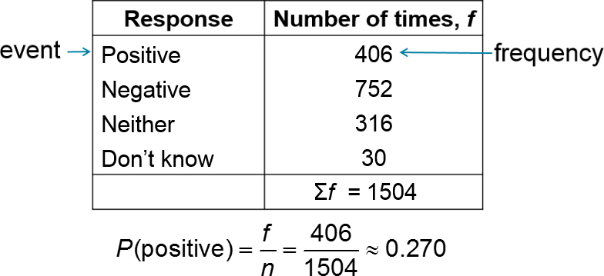
Example: Finding Empirical Probabilities (2 of 2)

Slide 20
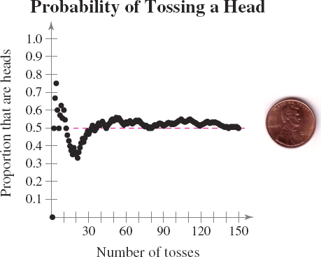
Law of Large Numbers
Law of Large Numbers
As an experiment is repeated over and over, the empirical probability of an event approaches the theoretical (actual) probability of the event.

Slide 21
Types of Probability (3 of 3)
Subjective Probability
Intuition, educated guesses, and estimates.
e.g. A doctor may feel a patient has a 90% chance of a full recovery.

Slide 22
Example: Classifying Types of Probability (1 of 3)
Classify the statement as an example of classical, empirical, or subjective probability.
The probability that you will get the flu this year is 0.1.
Solution
Subjective probability (most likely an educated guess)

Slide 23

Example: Classifying Types of Probability (2 of 3)
Classify the statement as an example of classical, empirical, or subjective probability.
The probability that a voter chosen at random will be younger than 35 years old is 0.3.

Slide 24
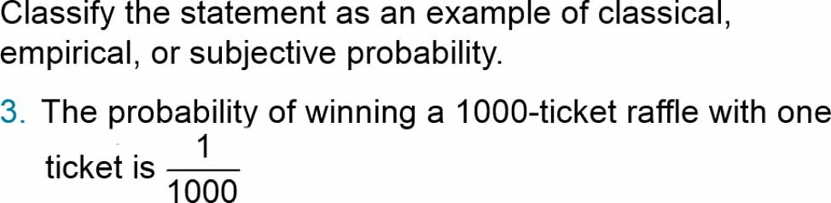
Example: Classifying Types of Probability (3 of 3)
Solution
Classical probability (equally likely outcomes)

Slide 25
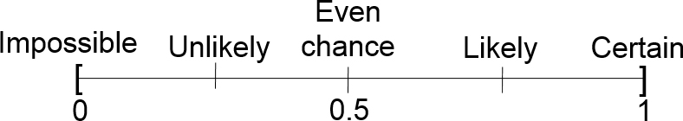
Range of Probabilities Rule
Range of probabilities rule
The probability of an event E is between 0 and 1, inclusive.
0 ≤ P(E) ≤ 1

Slide 26
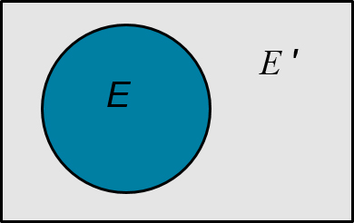
Complementary Events
Complement of event E
The set of all outcomes in a sample space that are not included in event E.
Denoted E ′ (E prime)
P(E ′) + P(E) = 1
P(E) = 1 – P(E ′)
P(E ′) = 1 – P(E)

Slide 27
Example: Probability of the Complement of an Event (1 of 2)
You survey a sample of 1000 employees at a company and record the age of each. Find the probability of randomly choosing an employee who is not between 25 and 34 years old.
Employee ages | Frequency, f
15 to 24 | 54
25 to 34 | 366
35 to 44 | 233
45 to 54 | 180
55 to 64 | 125
65 and over | 42
Blank | Σf = 1000

Slide 28
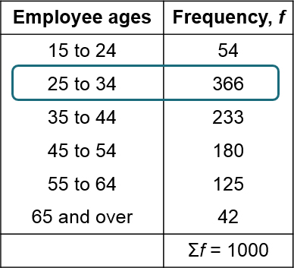
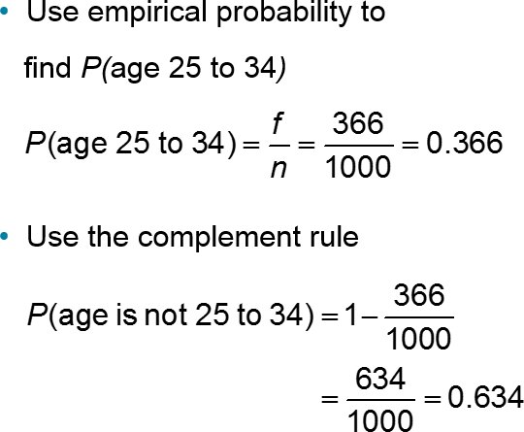
Example: Probability of the Complement of an Event (2 of 2)

Slide 29

Example: Probability Using a Tree Diagram (1 of 2)
A probability experiment consists of tossing a coin and spinning the spinner shown. The spinner is equally likely to land on each number. Use a tree diagram to find the probability of tossing a tail and spinning an odd number.

Slide 30
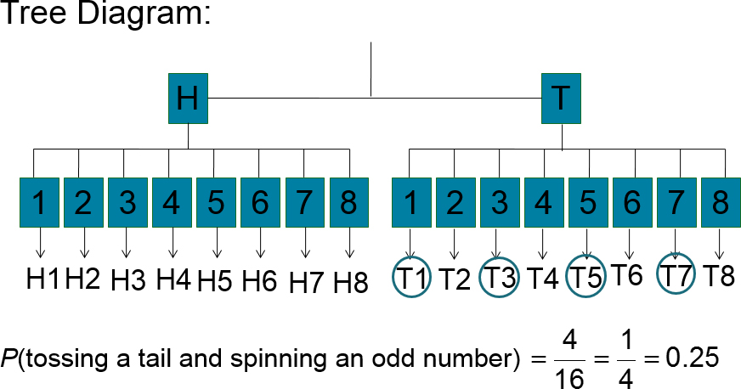
Example: Probability Using a Tree Diagram (2 of 2)

Slide 31
Example: Probability Using the Fundamental Counting Principle (1 of 2)
Your college identification number consists of 8 digits. Each digit can be 0 through 9 and each digit can be repeated. What is the probability of getting your college identification number when randomly generating eight digits?

Slide 32

Example: Probability Using the Fundamental Counting Principle (2 of 2)
Solution
Each digit can be repeated
There are 10 choices for each of the 8 digits
Using the Fundamental Counting Principle, there are
  10 ∙ 10 ∙ 10 ∙ 10 ∙ 10 ∙ 10 ∙ 10 ∙ 10
  = 10⁸ = 100,000,000 possible identification numbers
Only one of those numbers corresponds to your ID number

Slide 33
Section 3.1 Summary
Identified the sample space of a probability experiment and identified simple events
Used the Fundamental Counting Principle to find the number of ways two or more events can occur
Distinguished among classical probability, empirical probability, and subjective probability
Determined the probability of the complement of an event
Used a tree diagram and the Fundamental Counting Principle to find probabilities

