Slide 1
Elementary Statistics: Picturing The World
Sixth Edition
Chapter 1
Introduction to Statistics
Copyright © 2015, 2012, 2009 Pearson Education, Inc. All Rights Reserved

Slide 2
Chapter Outline
1.1 An Overview of Statistics
1.2 Data Classification
1.3 Experimental Design

Slide 3
Section 1.2
Data Classification

Slide 4
Section 1.2 Objectives
How to distinguish between qualitative data and quantitative data
How to classify data with respect to the four levels of measurement

Slide 5
Types of Data (1 of 2)
Qualitative Data
Consists of attributes, labels, or nonnumerical entries.

Slide 6
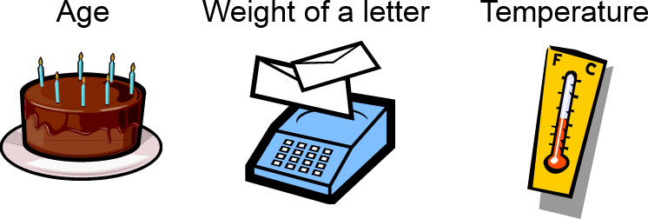
Types of Data (2 of 2)
Quantitative data
Numerical measurements or counts.

Slide 7
Example: Classifying Data by Type (1 of 2)
The base prices of several vehicles are shown in the table. Which data are qualitative data and which are quantitative data? (Source Ford Motor Company)
Model | Suggested retail price
Focus Sedan | $15,995
Fusion | $19,270
Mustang | $20,995
Edge | $26,920
Flex | $28,495
Escape Hybrid | $32,260
Expedition | $35,085
F-450 | $44,145

Slide 8
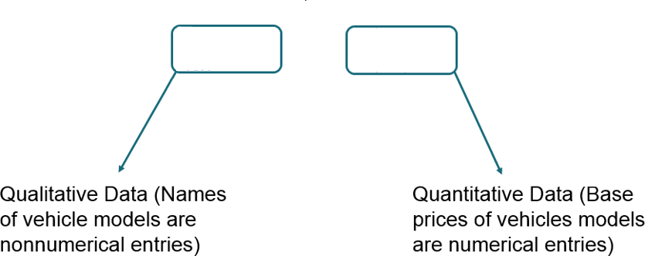
Example: Classifying Data by Type (2 of 2)
Model | Suggested retail price
Focus Sedan | $15,995
Fusion | $19,270
Mustang | $20,995
Edge | $26,920
Flex | $28,495
Escape Hybrid | $32,260
Expedition | $35,085
F-450 | $44,145

Slide 9
Levels of Measurement
Nominal level of measurement
Qualitative data only
Categorized using names, labels, or qualities
No mathematical computations can be made
Ordinal level of measurement
Qualitative or quantitative data
Data can be arranged in order, or ranked
Differences between data entries is not meaningful

Slide 10
Example: Classifying Data by Level (1 of 4)
Two data sets are shown. Which data set consists of data at the nominal level? Which data set consists of data at the ordinal level? (Source: Nielsen Media Research)
Top Five TV Programs (from 5/4/09 to 5/10/09)
1. | American Idol-Wednesday
2. | American Idol-Tuesday
3. | Dancing with the Stars
4. | NCIS
5. | The Mentalist
Network Affiliates in Pittsburgh, PA
WTAE | (ABC)
WPXI | (NBC)
KDKA | (CBS)
WPGH | (FOX)

Slide 11
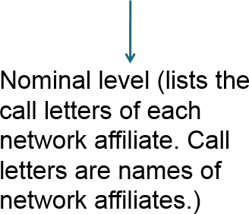
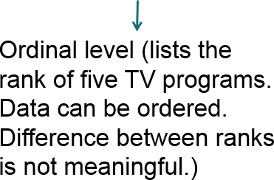
Example: Classifying Data by Level (2 of 4)
Top Five TV Programs (from 5/4/09 to 5/10/09)
1. | American Idol-Wednesday
2. | American Idol-Tuesday
3. | Dancing with the Stars
4. | NCIS
5. | The Mentalist
Network Affiliates in Pittsburgh, PA
WTAE | (ABC)
WPXI | (NBC)
KDKA | (CBS)
WPGH | (FOX)

Slide 12
Levels of Measurement (1 of 2)
Interval level of measurement
Quantitative data
Data can be ordered
Differences between data entries is meaningful
Zero represents a position on a scale (not an inherent zero – zero does not imply “none”)

Slide 13
Levels of Measurement (2 of 2)
Ratio level of measurement
Similar to interval level
Zero entry is an inherent zero (implies “none”)
A ratio of two data values can be formed
One data value can be expressed as a multiple of another

Slide 14
Example: Classifying Data by Level (3 of 4)
Two data sets are shown. Which data set consists of data at the interval level? Which data set consists of data at the ratio level? (Source: Major League Baseball)
2009 American League Home Run Totals (by Team)
Baltimore | 160
Boston | 212
Chicago | 184
Cleveland | 161
Detroit | 183
Kansas City | 144
Los Angeles | 173
Minnesota | 172
New York | 244
Oakland | 135
Seattle | 160
Tampa Bay | 199
Texas | 224
Toronto | 209
New York Yankees’ World Series Victories (Years)
1923, | 1927, | 1928, | 1932, | 1936,
1937, | 1938, | 1939, | 1941, | 1943,
1947, | 1949, | 1950, | 1951, | 1952,
1953, | 1956, | 1958, | 1961, | 1962,
1977, | 1978, | 1996, | 1998, | 1999,
2000, | 2009 | blank | blank | blank

Slide 15
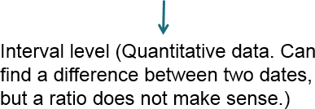
Example: Classifying Data by Level (4 of 4)
New York Yankees’ World Series Victories (Years)
1923, | 1927, | 1928, | 1932, | 1936,
1937, | 1938, | 1939, | 1941, | 1943,
1947, | 1949, | 1950, | 1951, | 1952,
1953, | 1956, | 1958, | 1961, | 1962,
1977, | 1978, | 1996, | 1998, | 1999,
2000, | 2009 | blank | blank | blank
2009 American League Home Run Totals (by Team)
Baltimore | 160
Boston | 212
Chicago | 184
Cleveland | 161
Detroit | 183
Kansas City | 144
Los Angeles | 173
Minnesota | 172
New York | 244
Oakland | 135
Seattle | 160
Tampa Bay | 199
Texas | 224
Toronto | 209

Slide 16
Summary of Four Levels of Measurement
Level of Measurement | Put data in categories | Arrange data in order | Subtract data values | Determine if one data value is a multiple of another
Nominal | Yes | No | No | No
Ordinal | Yes | Yes | No | No
Interval | Yes | Yes | Yes | No
Ratio | Yes | Yes | Yes | Yes

Slide 17
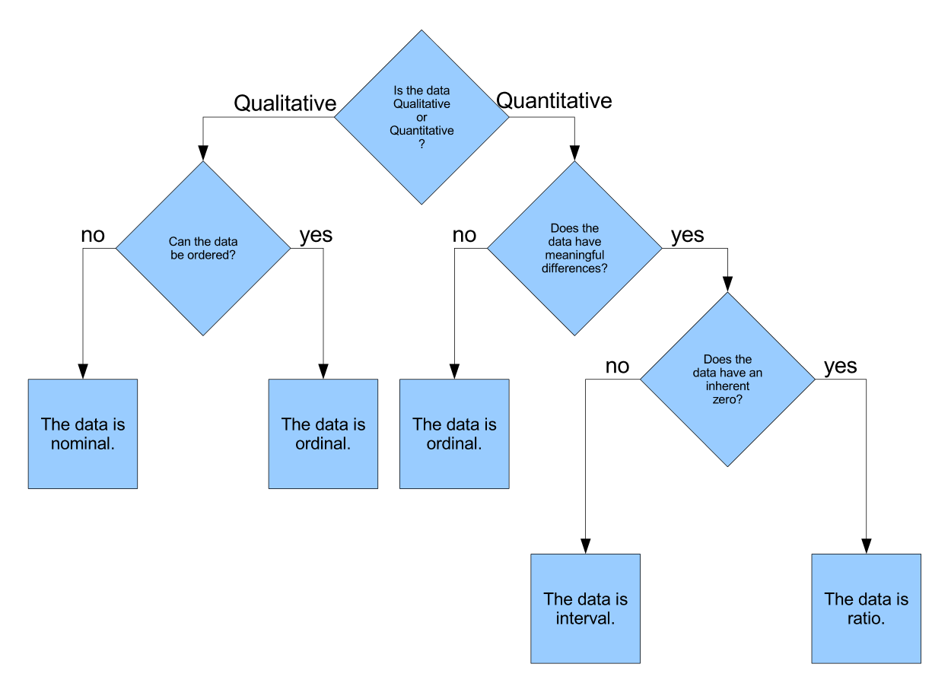
Level of Measurement Flowchart

Slide 18
Section 1.2 Summary
Distinguished between qualitative data and quantitative data
Classified data with respect to the four levels of measurement

